Slide 1
Bell Ringer Monday November 13th
In the bell ringer section of your notebook- please make a list of things you ALREADY KNOW about World War II (Can be things from movies, other classes, pop culture, etc)

Slide 2
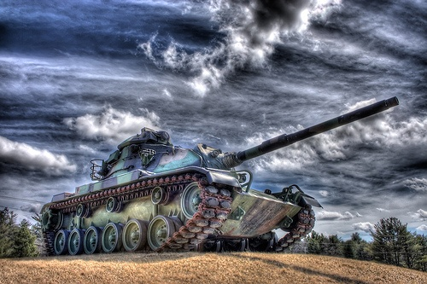
Dictators Threaten
World Peace
Focus Question: Why does WWII Begin?

Slide 3
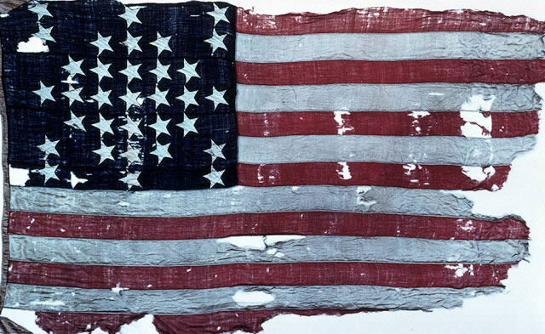
Long Term Causes
of World War II
1. World War I
2. Economic instability in Europe
3. Rise of totalitarianism
4. Failure of appeasement

Slide 4
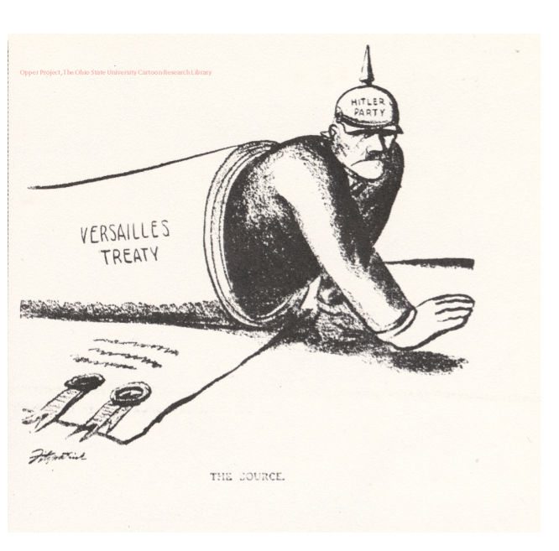
World War I
Treaty of Versailles
Germany loses surrounding lands
Germany forced to pay $33 billion in reparations
Forced to sign War Guilt Clause
Germans are Angry and Embarrassed

Slide 5
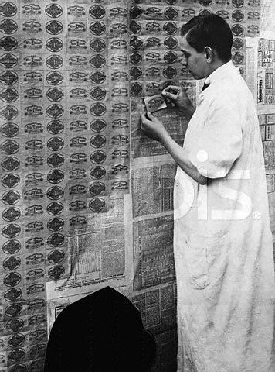
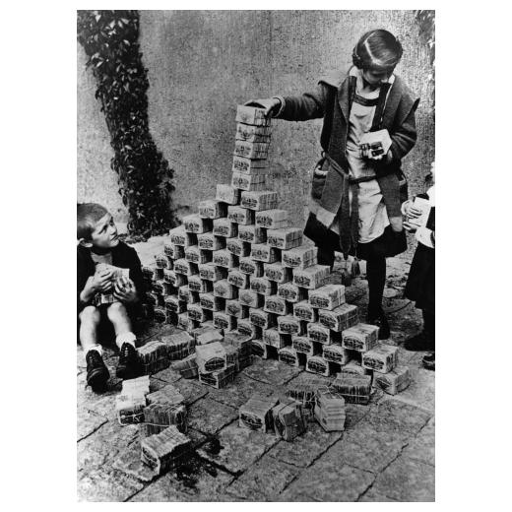
Economic Instability in Europe
World Wide Depression
Depression extends outside of the U.S… Especially in Germany
European Desperation leads allows outspoken dictators to rise to power
Germany
Russia
Spain
Italy
These leaders find a scapegoat to blame for their struggles.

Slide 6
Rise of Totalitarianism
In a Totalitarian country, individual rights are not viewed as important as the needs of the nation
Mussolini
Hitler
Stalin
Communist (USSR)
Fascism
(Germany, Italy, Spain)
Totalitarianism
Franco
Military Rule (Japan)
Tojo

Slide 7
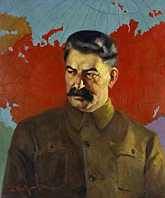
Soviet Union – Joseph Stalin
Death of V.I. Lenin (1924)
Communist
Against all private enterprise – state owns everything
Leads U.S.S.R. to become Industrial Power (2nd only to the U.S.)
Kills anyone who stands in the way
(13-20 million)
Stalin’s last name means “Man of Steel”

Slide 8
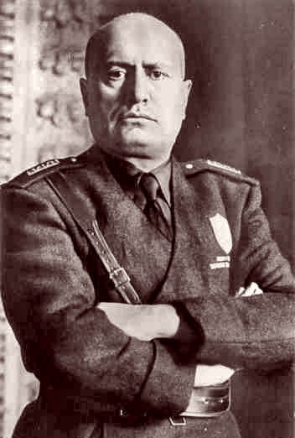
Italy – Benito Mussolini
1921 – forms the Fascist Party
Played on fears of economic collapse and communism
With thousands of his followers, marches on Rome where the king appoints him as head of the government.
Known as Il Duce – “the leader”

Slide 9
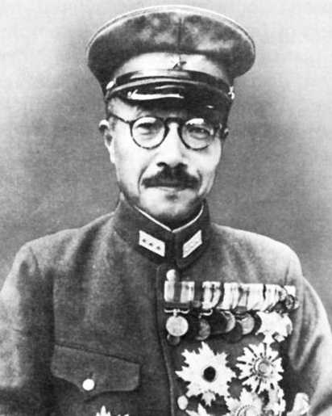
Japan- Hideki Tojo
Japanese military leaders wish to expand empire
Military Leader Hideki Tojo rises to power
Emperor Hirohito left virtually powerless.

Slide 10
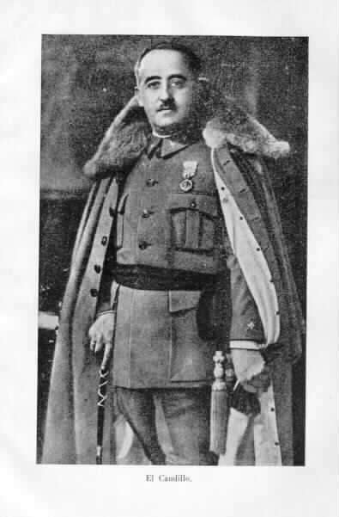
Spain- Francisco Franco
General Francisco Franco leads rebels into civil war
Backed by Mussolini
500,000 dead
Franco declared victory in 1939 → established another totalitarian government

Slide 11
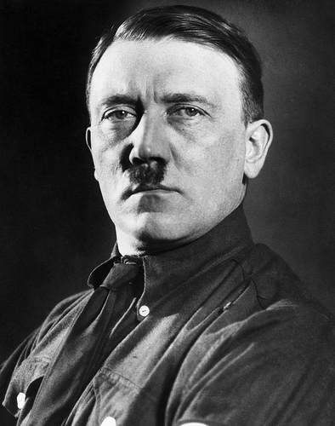
Germany – Adolf Hitler
Unemployed drifter after WWI
Joined National Socialist German Worker’s Party (NAZI)
Known as powerful speaker and became Der Fuher – “the Leader” of Party
Nazism: extreme nationalism – based on racial purification
Hitler’s goal was to re unite all German Speaking People
1933: Millions unemployed – elected Hitler chancellor of Germany. Replaces democracy with the Third Reich

Slide 12
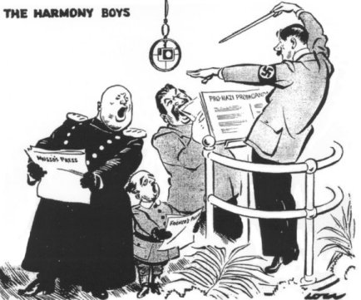

Slide 13
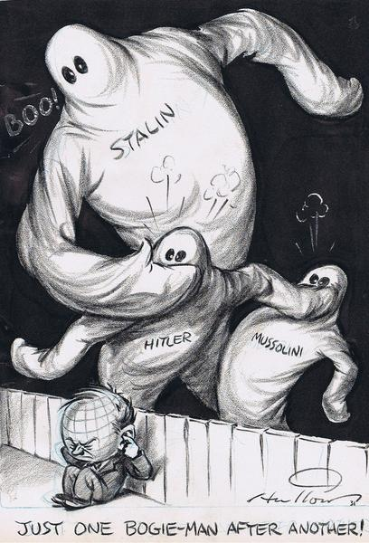

Slide 14
Video Clip
How Hitler Came to Power

Slide 15
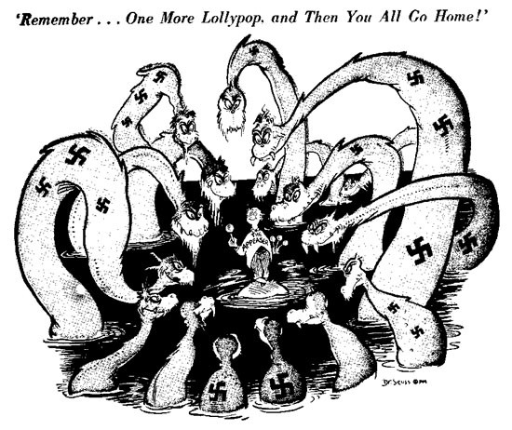
Failure of Appeasement
Appeasement: giving dictators what they want and hope that they won’t want anything else
“giving a bully what he wants”

Slide 17
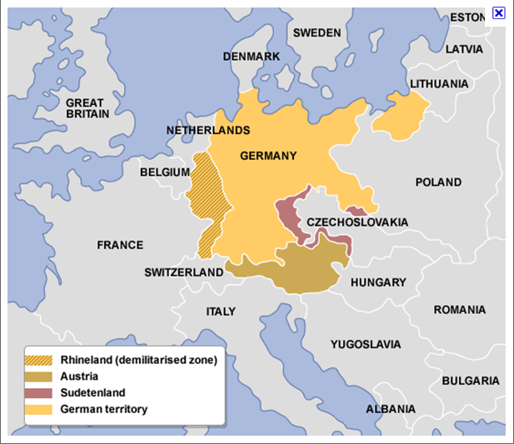
Germany
Hitler violates Treaty of Versailles
Send Military into Rhineland
Takes Sudetenland from Czechoslovakia
Annexes Austria
L.O.N. Nations does nothing
Britain actually sign agreement allowing Germany to rebuilt a portion of their navy

Slide 18
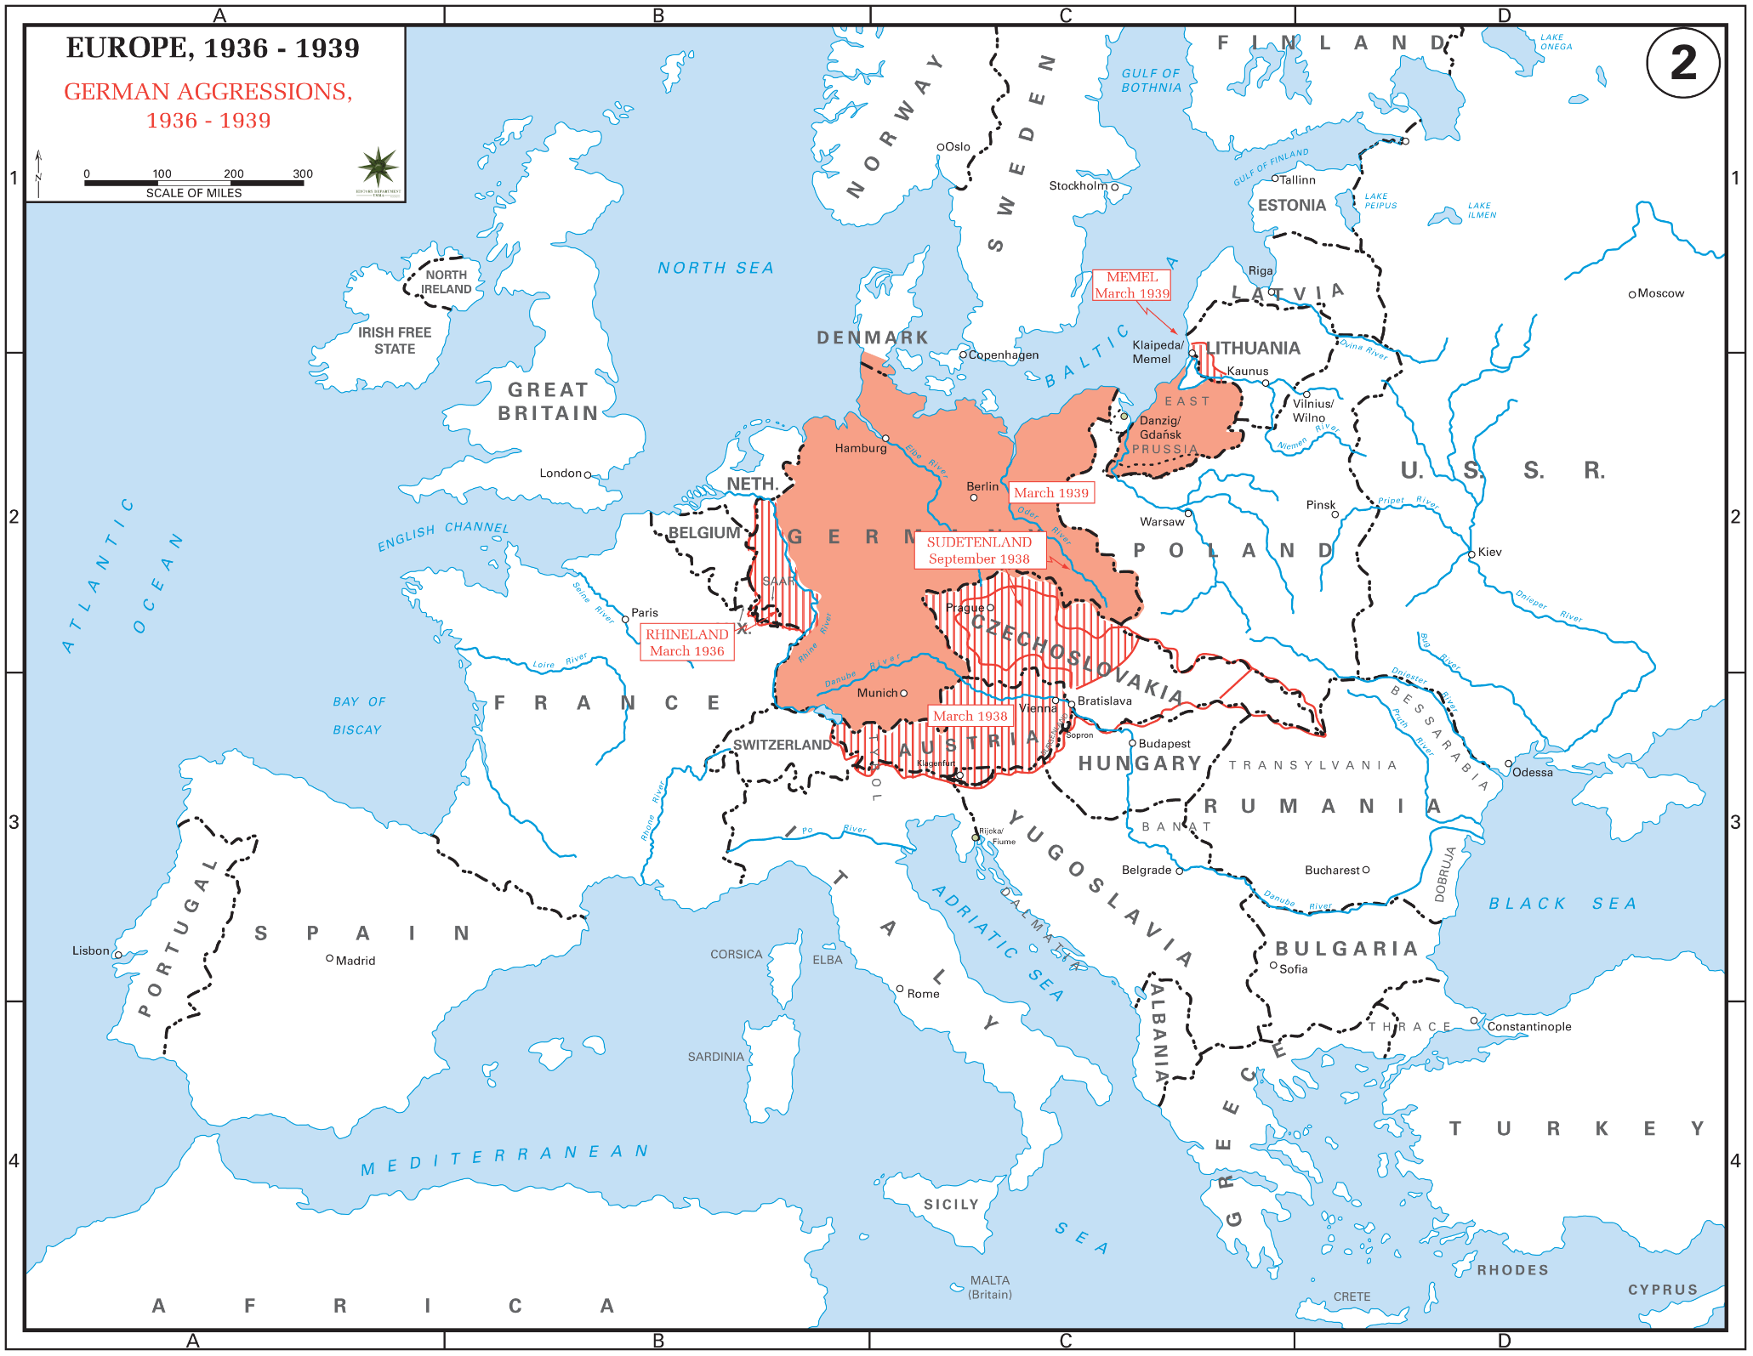

Slide 19
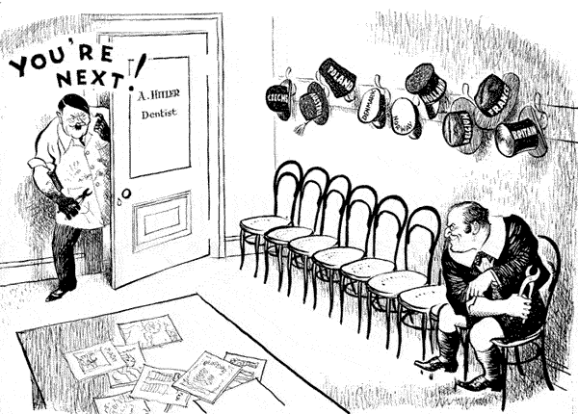

Slide 20
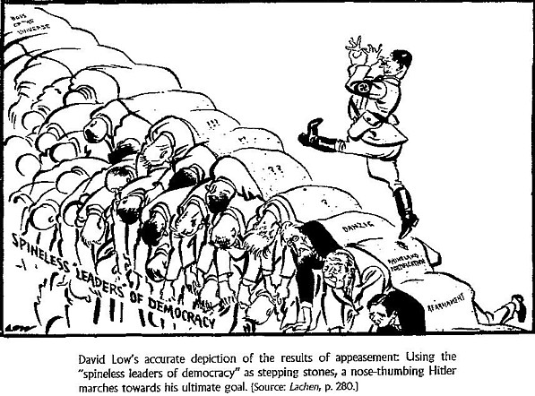

Slide 21
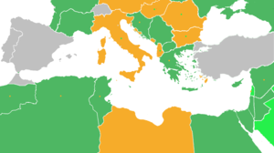
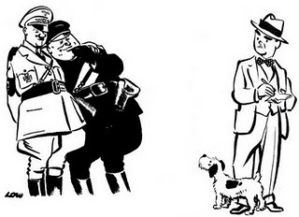
Italy
Invades Northern Africa
First takes Ethiopia (1835)
Wants access to Mediterranean
Wished to expand Empire
Rome-Berlin Axis Pact
Peace agreement between Hitler and Mussolini
Despite plea from Ethiopia, L.O.N. does nothing
“It is us today, it will be you tomorrow” –
Haile Selassie (ousted emperor of Ethiopia)

Slide 22
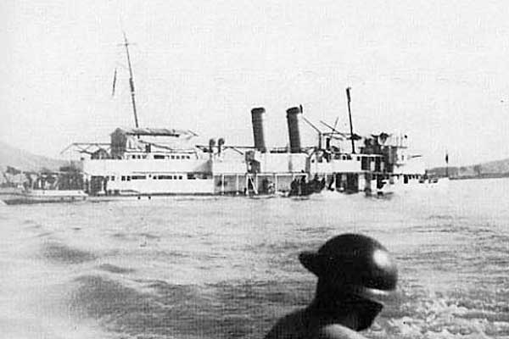
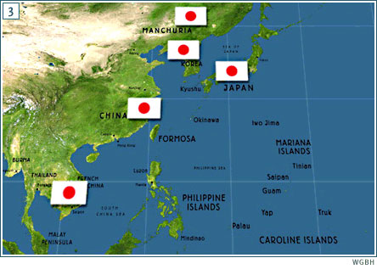
Japan
Moves into SE Asia and China
First move into Manchuria
Expands into modern day
Vietnam, Korea, and China
Sinks U.S. Ship in international waterway in China
Panay Incident (1937)
U.S. does nothing

Slide 23
Japan invades Manchuria

Slide 24
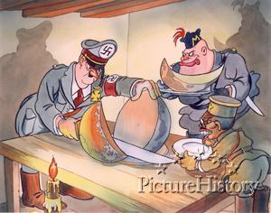

Slide 25
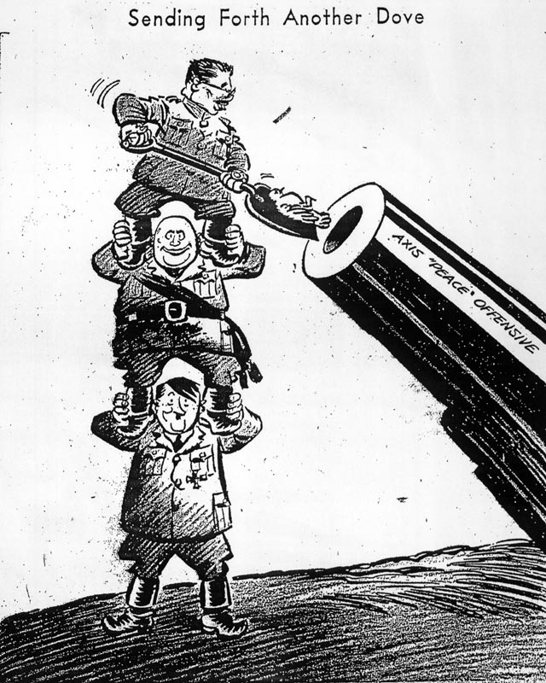

Slide 26
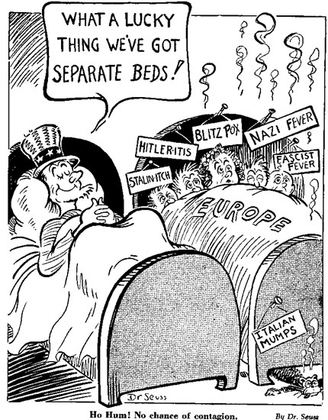
The U.S. Responds Cautiously
Neutrality Acts (1935)
Passed to please Isolationists
Placed “Moral Embargo” on all countries involved in confrontations

Slide 27
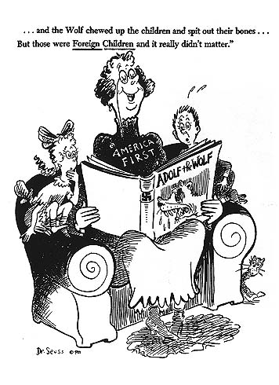

Slide 28
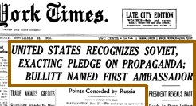
Neutrality Breaks Down
FDR Recognizes the Soviet Union (1933)
FDR felt that recognizing Moscow might bolster the US against Japan.
Maybe trade with the USSR would help the US economy during the Depression.
Shift from Isolationism to Neutrality
- Is there a difference?

Slide 29
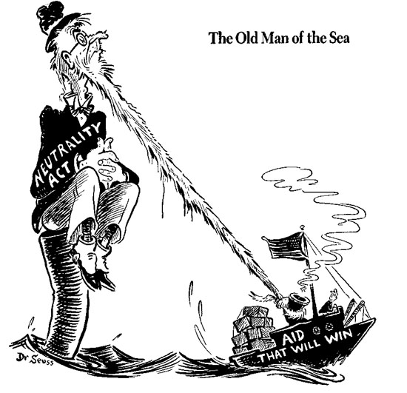
Neutrality Breaks Down
Neutrality Act of 1937
FDR’s Idea
Renews “Cash and Carry” basis
Passed after Sino-Japanese War begins (China vs. Japan)
Places “Moral Embargo” on Japan
Shift from Isolation to Neutrality

Slide 30
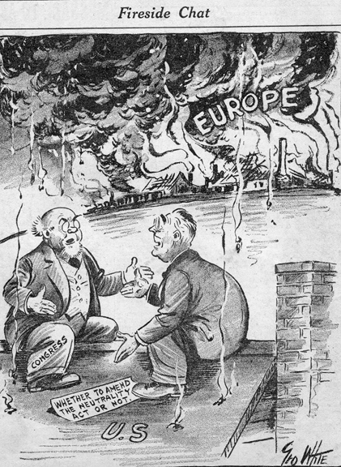

Slide 31
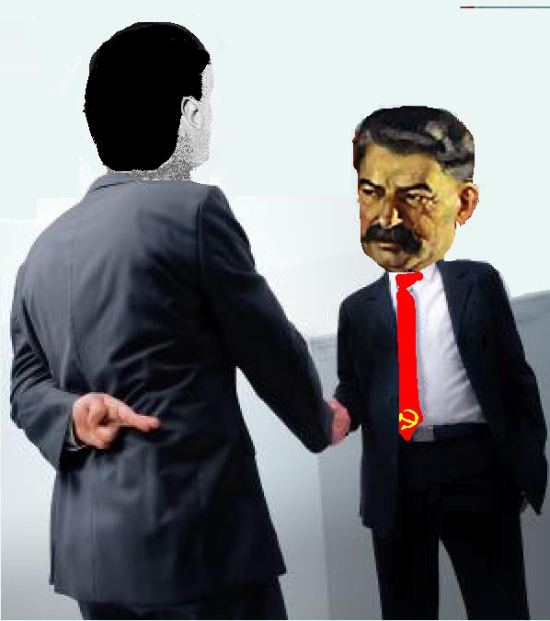
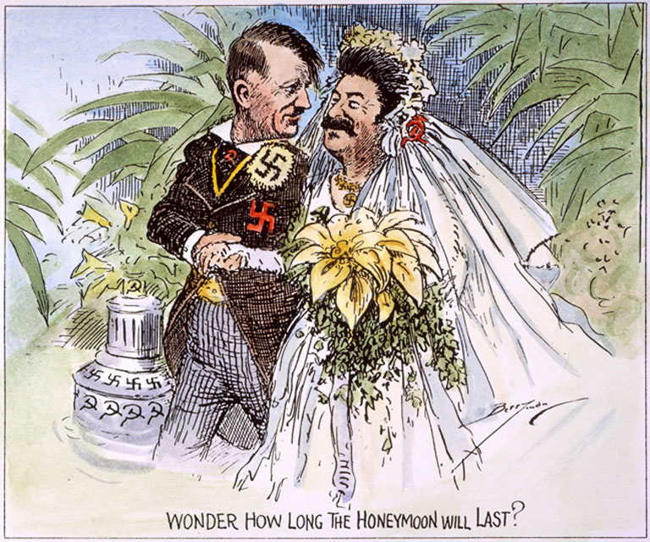
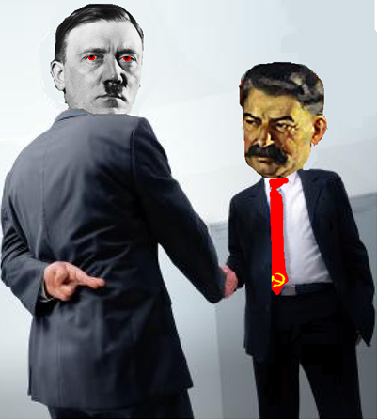
German invasion of Poland 1939
Return of German Speaking Lands
Nonaggression Pact Russia stays out of the war in return for 1/2 of Poland
Prevents a war on two fronts
Great Britain & France declare war on Germany
League of Nations fails to prevent another world war.
Lil Hitler Video

Slide 32
German Aggression Map
Use your textbook (both hard copy and online are fine)- see assignment sheet for page #s to complete the German Aggression Map.
You need six different colors
Don’t forget a key!
Don’t forget to also answer the questions on the front of the map once you are finished.

Slide 33
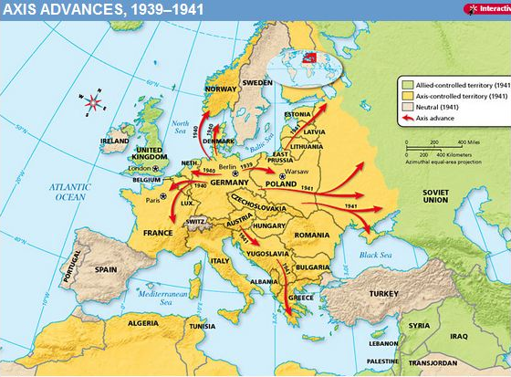

Slide 35
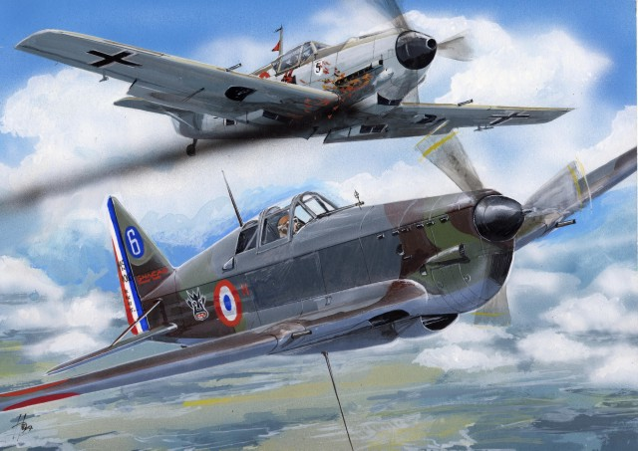
France and Great Britain go to war against Germany

Slide 36
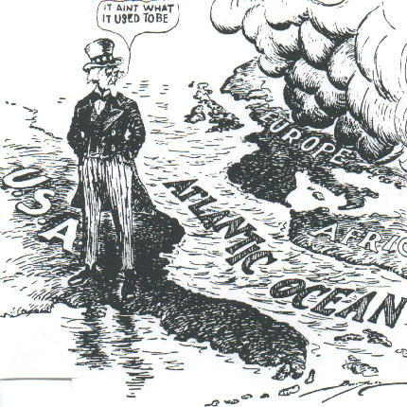
US Neutrality

Slide 37
Alliances of World War II
Allied Powers | Axis Powers
Great Britain Neville Chamberlain | Germany Adolf Hitler
2. France Charles de Gualle | 2. Italy Benito Mussolini
3. United States (1941) FDR | 3. Japan (1940) Emperor Hirohito
4. Soviet Union (1941) Joseph Stalin

Slide 38
Do now: America on the Sidelines Activity
You will need a laptop. Go to my website and look under AHII, Unit 6 for the link.
Complete the chart as you go through the interactive timeline. Be sure to also pay attention to the map.
As you work through the timeline, record your choice of action as well as U.S. Response.
Please also complete the 1st Quarter student survey on my website. Go to my site and click “classroom resources”- from there you will see the link ☺

Slide 39
Holocaust DBQ
DBQ due at beginning of class tomorrow. These documents are a class set- so write your answers on a separate sheet of paper.
Don’t forget to do final thought question in form of essay. Needs to be at least one page in length.
Documents are linked to my website (AHII, Unit 6) if you need to access them tonight.

Slide 40
DBQ Essay
Using the information from all 11 documents, write a min. 1 page essay in which you:
Describe three examples of human rights violations during the Holocaust (3 things Nazis were doing to Jews) AND three reasons for this (ie:if one of your examples of a rights violation is the fact that Jews had to wear an ID badge– why would Nazis do this)
In your conclusion- include the reaction of the international community… what were they doing? If anything?

Slide 41
DBQ Essay
Using the information from all 11 documents, writ ea minimum 1 page essay in which you:
How the Nazi’s changed life for Jews living in Europe- politically, economically and socially
How the Jews were treated in Nazi Germany
How the Nazi’s implemented their “final solution”
*Make sure to reference at least three specific documents in your essay.

Slide 42
Discussion Question # 1
Was Germany being aggressive prior to WWII? Were the justified in behaving this way? Explain.

Slide 43
Discussion Question 2
Do you think the British strategy of appeasement was appropriate? Why or Why not? If you were the leader of Great Britain what would you have done?

Slide 44
Discussion #3
As Germany was becoming increasingly more aggressive, America remained neutral. If you were an American citizen in 1939, would you have supported an isolationist strategy or a more interventionist approach? Why?

Slide 45
Discussion #4
Was WWII inevitable? Explain your reasoning.

