Slide 1
Bell ringer Thursday 11/16 *Turn in your timeline- make sure name(s) is on it- put it on front table not in your period’s tray!
1) What type of government became popular in several European (and Asian) countries in the 1930s? What types of actions were these governments taking?
2) What act finally forced France & Great Britain to declare war on Germany?
3) How did the United States manage to stay out of the war but still be prepared? Be specific!
4) What event caused the United States to enter the war?

Slide 2
Activity Directions
Your group has been assigned a WWII battle
Research your battle using the textbook (look here first) and the chrome book.
You will then create a poster displaying the BASIC information about your battle (you can discuss more detail out loud that doesn’t have to appear on the poster!) Poster must have:
Name of Battle, Date & Location
Winner (Allies or Axis)?
Brief Summary 2-3 bullet points
Significance- Anything that makes your battle stand out as important?
PICTURE that relates to your battle!
You will share your poster and battle with the class – the audience will take notes into an organizer provided by Mrs. Wilson

Slide 3
The European Theater

Slide 4
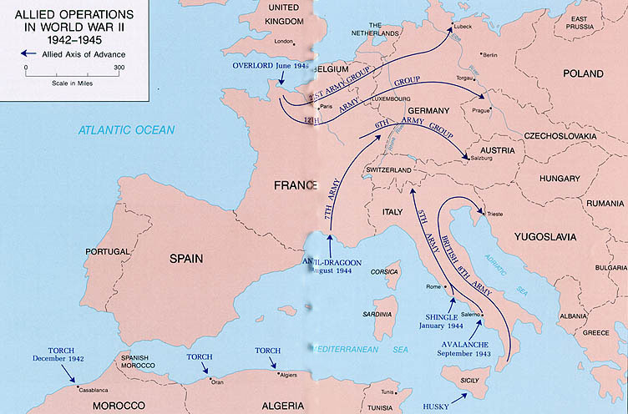
Operation Torch: North African Front

Slide 5
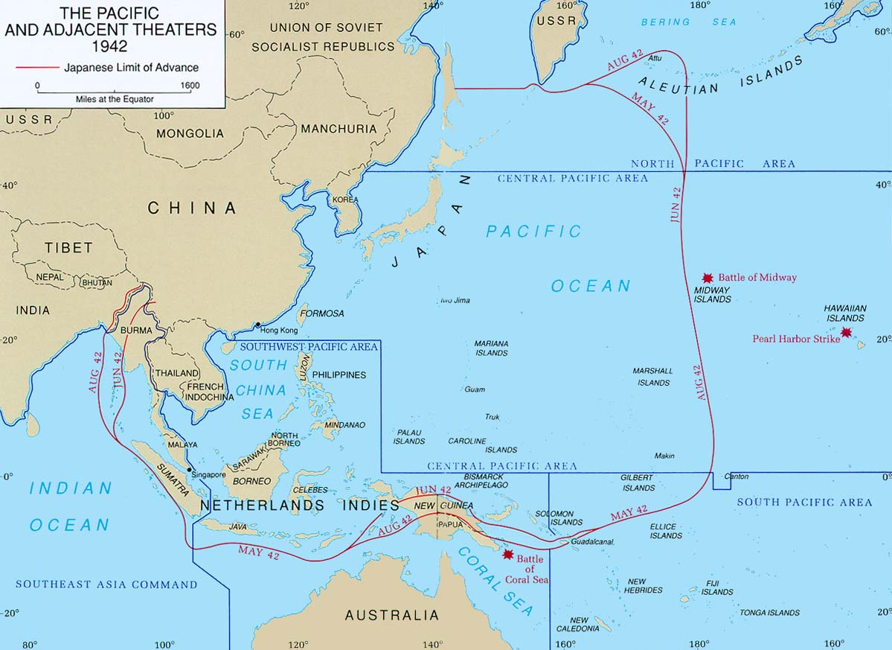
The Pacific Theater

Slide 6
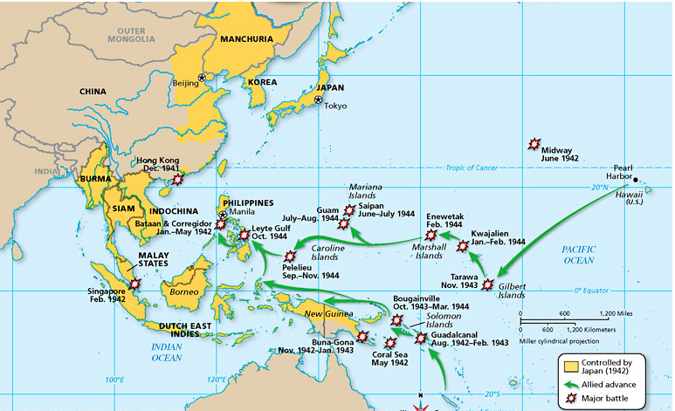

Slide 7
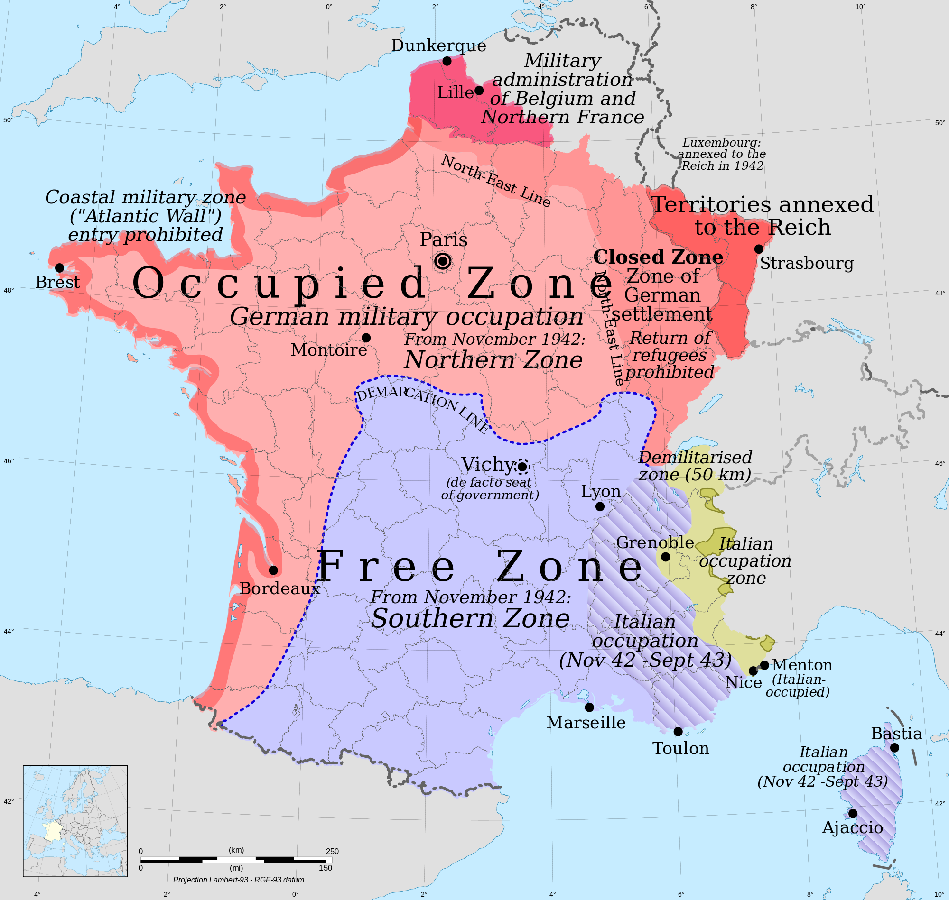

Slide 8
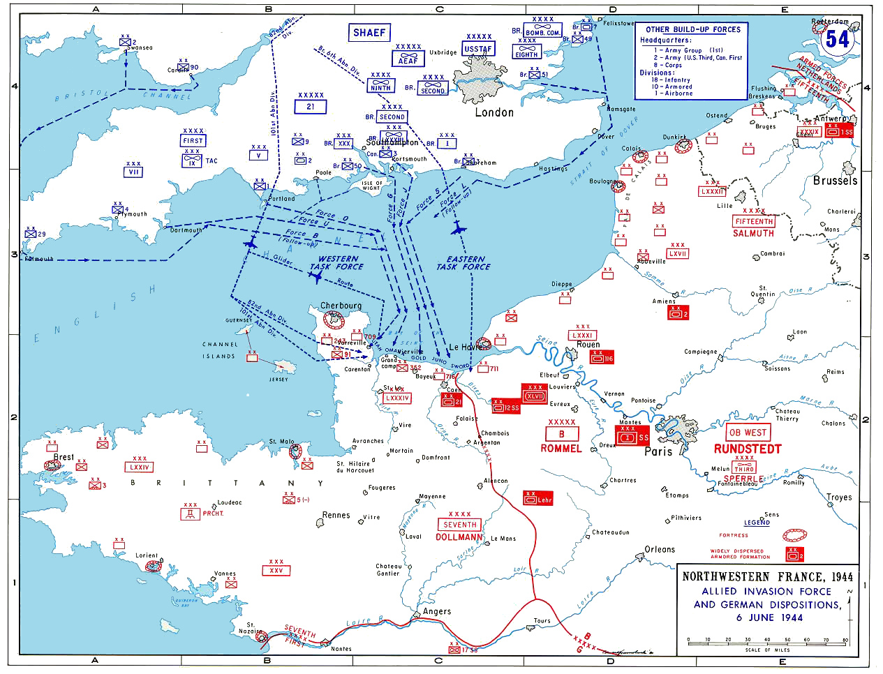

Slide 9
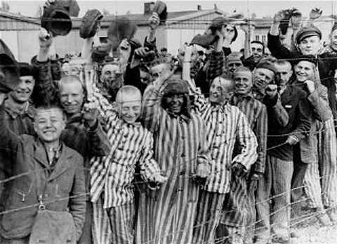

Slide 10
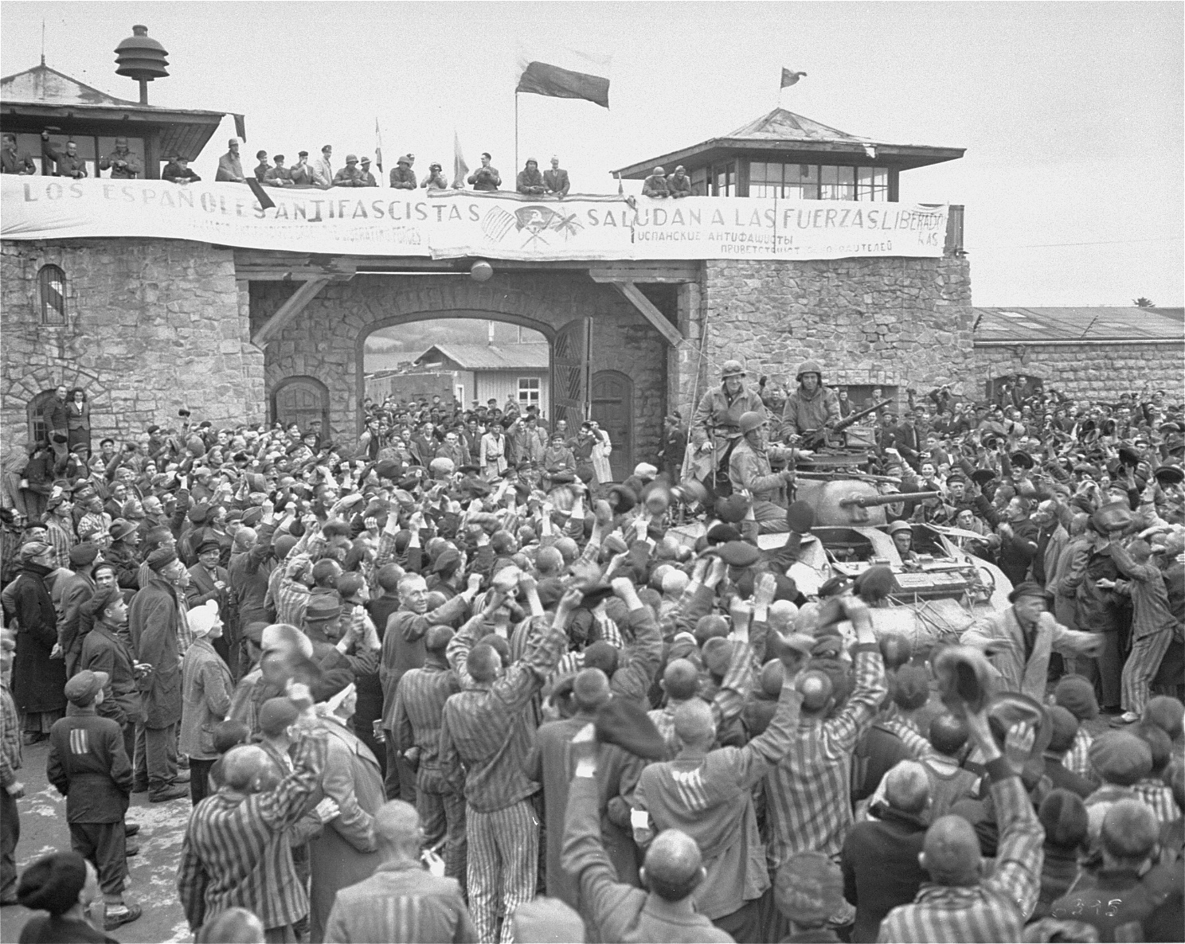

Slide 11
WWII Battles Map Pages in your book that will help: 540 & 552
On the map you have been given, label all countries. Then, for all 9 battles that we studied today- write the name of the battle at the location it happened.
Then, for each battle: color code them as an Allied or an Axis victory (don’t forget a key!)
Lastly, give a brief 1 sentence summary of the significance of each battle. How can you differentiate this battle from the rest on the test?

