Slide 1
Bellringer
Imagine you are collecting contributions ($) door to door to raise money for AIDS research, but you realize you will get more money and larger donations if you lie and say you are collecting for UNICEF (children). Please answer the following question: Is it wrong to lie, even if your motivation is good? Or do the ends justify the means?

Slide 2
Please draw this spectrum in your notebook:
How often do the ends justify the means?
Always----Usually----Sometimes----Rarely---Never

Slide 3
Honors American History II Monday November 10th 2014
Essential Questions: How does World War II end? Why does President Truman ultimately decide to use the atomic bomb?
Objectives:
Analyze a series of primary source documents and evaluate Truman’s decision to drop the atomic bomb on Japan.
Identify and explain how the war ends and the consequences of World War II.
Agenda
-Bellringer: Recap Questions (Homefront)
-PP Notes: The End of World War II & Video Clips
-Indv: Primary Source Reading & Discussion- To Drop the Bomb
or Not?
-Pairs: WWII Matching Review Game
-Wrap Up: Study Guide Questions to prepare for test
Reminders: -Unit 6 (WWII) Study Guide and Extra Credit are due Wednesday 11/12
-Remember our test is Wednesday 11/12!

Slide 4
American History II Monday November 10th 2014
Essential Questions: How does World War II end? Why does President Truman ultimately decide to use the atomic bomb?
Objectives:
Analyze a series of primary source documents and evaluate Truman’s decision to drop the atomic bomb on Japan.
Identify and explain how the war ends and the consequences of World War II.
Agenda
-Bellringer: Recap Questions (Homefront)
-PP Notes: The End of World War II & Video Clips
-Indv: Primary Source Reading & Discussion- To Drop the Bomb
or Not?
-Pairs: WWII Matching Review Game
-Wrap Up: Study Guide Questions to prepare for test
Reminders: -Unit 6 (WWII) Study Guide and Extra Credit are due Wednesday 11/12
-Remember our test is Wednesday 11/12!

Slide 5
Bell ringer Monday November 20th
1. Why is the court case Korematsu v. United States significant?
2. Why did the U.S. government create Rosie the Riveter?
3. How would you describe the African American “Double V” campaign?
4. What was the purpose of the Bracero program?
5. Was WWII America’s “good” war? Include at least one example of a negative impact of WWII on the homefront and one example of a positive impact of WWII on the homefront.

Slide 6
Reminders/Announcements
Unit 6 (WWII) Test is Tomorrow! Study Guide & Extra Credit Vocab Due @ start of class.

Slide 7
The End of World War II
Focus Questions: How does World War II end? What steps does the United States take to increase its power after the War?

Slide 8
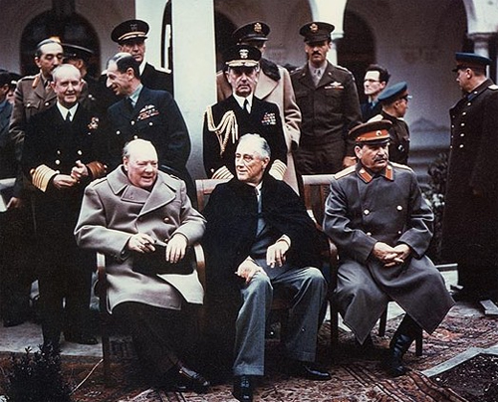
Ending the War in EUrope
Yalta Conference
WHEN: Feb. 1945, the war in the Pacific was still going on
WHO: The Big Three (Roosevelt, Stalin, & Churchill) met to discuss fate of Germany and Europe
WHAT: Decided to split Germany into 4 Zones
*Each occupied by one of the Allies

Slide 9
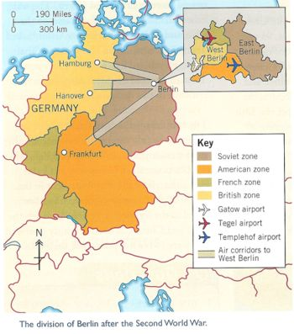

Slide 10
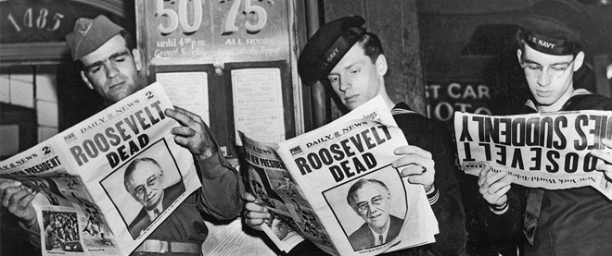
FDR dies in April 1945 of a massive cerebral hemorrhage. Who will be the next President?

Slide 11
Victory in Europe (V-E) Day
May 8th 1945
Cities in the U.S. and Europe put out flags, banners,etc. to rejoice defeating the Nazis
German troops officially surrender in a cease-fire.
War still going on in the pacific!

Slide 12
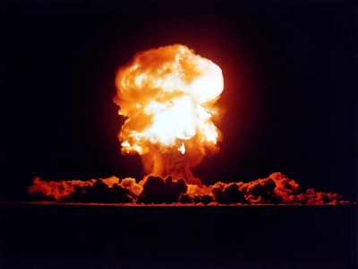
The Atomic Bomb Ends WWII

Slide 13
Why?
US wanted unconditional surrender of Japan
US did not want to invade Japan because Japan would put up a tough fight
Truman says ending the war quickly will ultimately save lives.

Slide 14
A Last Chance for Japan!
July 1945-The Potsdam Ultimatum asked Japan to surrender (They don’t!)

Slide 15
Manhattan Project
Manhattan Project: Code name for The research and building of the atomic bomb.
Famous Scientist: J. Robert Oppenheimer
Only a select few Americans knew about the bomb.
President Truman found out about it when he became president
Originally, the atomic bombs were supposed to be used on Germany

Slide 16
We have discovered the most terrible bomb in the history of the world. It may be the fire destruction prophesied in the Euphrates Valley Era, after Noah and his fabulous Ark.
This weapon is to be used against Japan between now and August 10th. I have told the Sec. of War, Mr. Stimson, to use it so that military objectives and soldiers and sailors are the target and not women and children. Even if the Japs are savages, ruthless, merciless and fanatic, we as the leader of the world for the common welfare cannot drop that terrible bomb on the old capital or the new.
He and I are in accord. The target will be a purely military one and we will issue a warning statement asking the Japs to surrender and save lives. I'm sure they will not do that, but we will have given them the chance. It is certainly a good thing for the world that Hitler's crowd or Stalin's did not discover this atomic bomb. It seems to be the most terrible thing ever discovered, but it can be made the most useful.
President Truman’s Diary July 25, 1945

Slide 17
"We knew the world would not be the same. A few people laughed, a few people cried. Most people were silent. I remembered the line from the Hindu scripture, the Bhagavad-Gita. Vishnu is trying to persuade the Prince that he should do his duty, and, to impress him, takes on his multi-armed form and says, 'Now I am become Death, the destroyer of worlds.' I suppose we all thought that, one way or another.“
~ Lead atomic bomb scientist J. Robert Oppenheimer after having seen the atomic bomb tested for the first time.

Slide 18
Testing of Bomb
Tested in remote desert in New Mexico
Light from explosion seen 180 miles away
(Charlotte NC to Athens Georgia)

Slide 19
1st Place: Hiroshima
Where?
Important Japanese military center
Population at time of attack: 255,000
(approximately 55,000 people live in Concord NC- 709,000 live in Charlotte)

Slide 20
2nd Place: Nagasaki
Large sea port in Japan
Population at time of attack: 240,000

Slide 21
How ?
Two B-29 bombers dropped the bombs over the cities.
Enola Gay
Bockscar

Slide 22
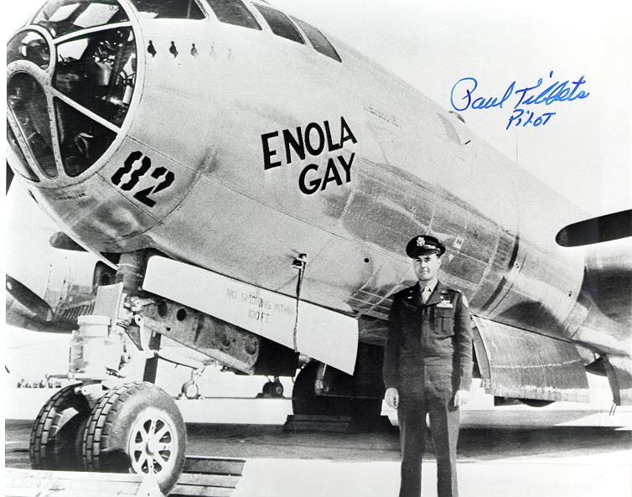
Enola Gay
Carried
Little Boy

Slide 23
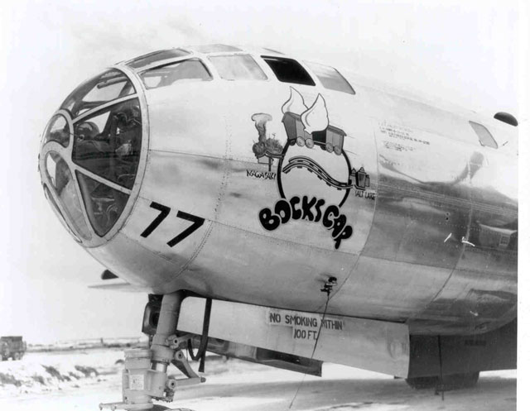
Bockscar
Carried
Fat Man

Slide 24
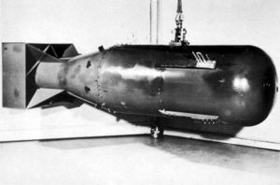
Little Boy 8,900 lbs
Dropped August 6, 1945
at 8:15am
Target: Hiroshima

Slide 25
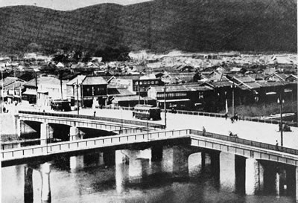
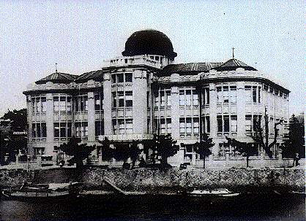
Hiroshima, Japan … BEFORE

Slide 26
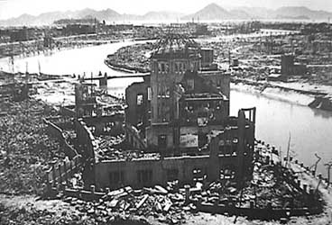
Hiroshima, Japan … AFTER
Blast was equal to 13,000 tons of TNT
Killed 70,000-80,000 people
Destroyed 90% of city

Slide 27
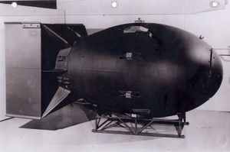
Fat Man 10,200 lbs
Dropped August 9, 1945 at 11:02am [3 days later]
Japan’s leaders hesitated to surrender after Little
Boy dropped…
So the US dropped Fat Boy on Nagasaki, Japan

Slide 28
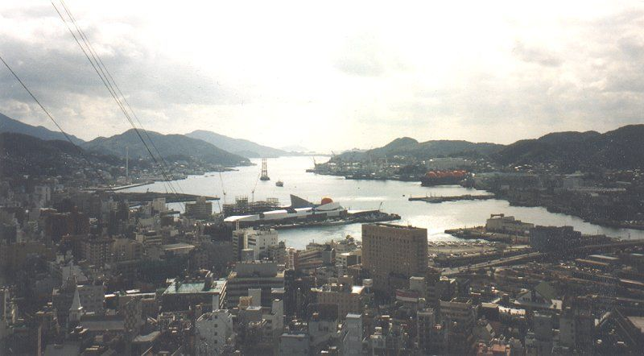
Nagasaki, Japan … BEFORE

Slide 29
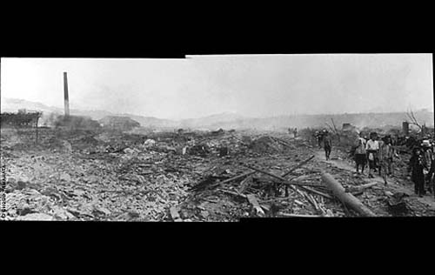
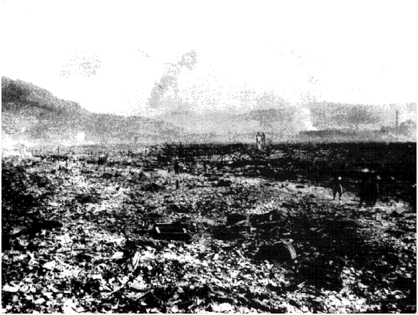
Nagasaki, Japan … AFTER
Instantly Killed
Approx. 40,000
Blast equal to
21,000 tons of
TNT

Slide 30
Video Clips: The Atomic Bomb
US Prepares to Drop Atomic Bomb on Hiroshima
Dropping the Bomb

Slide 31
Results
EVERYONE was horrified by the destruction
Japan surrendered on September 2, 1945 (VJ- Victory in Japan DAY)
Estimated 200,000 people died as a result of injuries and radiation poisoning from the atomic bombs

Slide 32
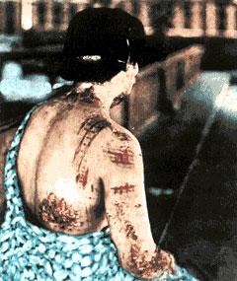
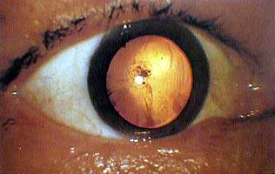
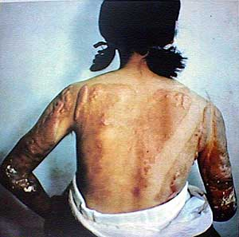
Common Injuries
Cornea after explosion
Radiation
burns

Slide 33
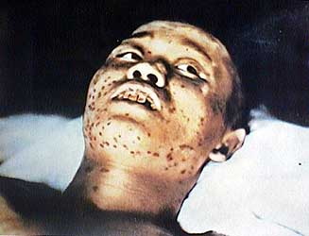
Effects of Radiation
Inside wooden house
at time of explosion
Appeared fine at first
Admitted to hospital few weeks later for bleeding gums and marks on face
Becomes delirious at time of death
Dies one month after bomb dropped
18 year old soldier

Slide 34
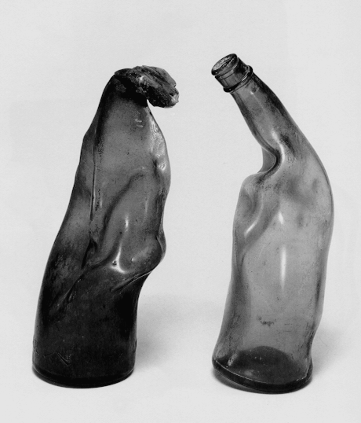
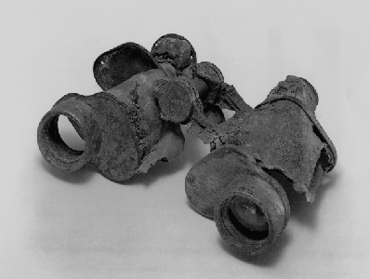
Force of Explosion
Binoculars
Glass bottles

Slide 35
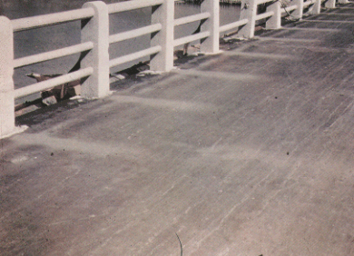
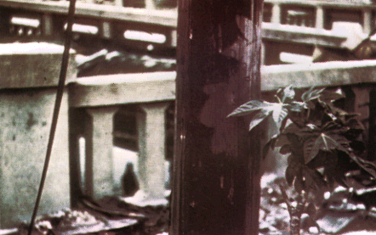
Force of Blast
Imprint of shadows

Slide 36
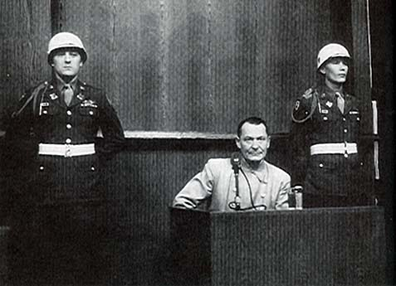
Nuremberg Trials
When Allies discovered death camps, they
put Nazi leaders on trial for crimes against humanity/peace
Established the idea that individuals are responsible for their own actions

Slide 37
Effects of World War II
Europe and Japan Ruined
European Colonies Gain Independence
America is out of the Great Depression
African Americans gain momentum to pursue civil rights.
2 World Powers Emerge: Soviet Union and the United States

Slide 38
To Drop the Bomb or not?
Read the series of primary source quotes and excerpts related to the atomic bomb. Answer the questions at the bottom of the primary source You may write on the paper. Don’t forget to put your name at the top!

Slide 39
“ I realize the tragic significance of the atomic bomb. Its production and its use were not lightly undertaken… But we knew that our enemies were on the search for it. We know now how close they were to finding it. And we know the disaster which would come tot his nation.. To all civilizations, if they had found it first.”~ Truman

Slide 40
“Having found the bomb we have used it. We have used it against those who attacked us without warning at Pearl Harbor, against those who have starved and beaten and executed American prisoners of war, against those who have abandoned the pretense of obeying international laws of warfare. We have used it in order to shorten the agony of war, in order to save the lives of thousands of young Americans” ~Truman
What factors led President Truman to drop the atomic bomb?
What alternative were available to him?

Slide 41
Do Now: Did Truman make the right decision?
Read the excerpt from Truman’s defends his decision and the scientist’s petition and answer the questions on your own n notebook paper.

Slide 42
R-A-F-T
Role: ?
Audience: President Truman
Format: Letter
Topic: Was Harry Truman right to drop the bombs on Hiroshima and Nagasaki? Did he have any other choice? Include at least 3 details to support your point of view.
Use what you know about history to decide how your character might have felt about the atomic bomb. The more passionate & creative, the better!

Slide 43
Did President Truman make the right decision to use the atomic bomb on Japan?
Yes, absolutely
No, definitely not!

Slide 44
Test Review
Study Guide Questions?

Slide 45
World War II Match
Match the appropriate description with the key term, person or event.

Slide 46
Honors Test
35 MC (2 pts each)
3 IDs (out of 5 – 5 pts each)
2 constructed response (5 pts each)

Slide 47
3rd period test
20-30 Multiple Choice/Matching
4 constructed response (out of 6 choices)

