Slide 1
Wednesday November 5th
Turn in your Holocaust DBQ
Then, for today’s bellringer- # your paper 1-10. You don’t need to leave much room!

Slide 2
Who is Responsible??? If you were a judge, how would you assess the responsibility of these people for what happened during the holocaust.
Not responsible
Minimally responsible
Responsible
Very responsible

Slide 3
#1 A doctor who participated in sterilization of Jews

Slide 4
#2The Pope, who made no public statement against Nazi Policy

Slide 5
#3 An American industrialist who helped arm Hitler in the 1930s

Slide 6
#4 A person who voluntarily joined the Nazis in the 1930s

Slide 7
#5 A manufacturer who used concentration camp inmates as slave labor in his plants

Slide 8
#6 A person who complied with the law excluding Jews from economic and social life

Slide 9
#7 The German couple who took up residence in a home abandoned by Jews

Slide 10
#8 a teacher who taught Nazi propaganda

Slide 11
#9 Parents who sent or allowed their children to attend Hitler Youth meetings

Slide 12
#10 A person who turned the lever to allow gas into the chambers

Slide 13
DBQ Wrap Up
Based on what you explored in your Holocaust DBQ, what were some examples of ways Jewish people had their rights violated during the Holocaust?

Slide 14
Honors American History II Wednesday November 5th 2014
Essential Questions: How did the U.S. prepare for war without officially entering it? Why does the U.S. eventually enter WWII?
Objectives:
Describe FDR’s foreign policy in the mid-1930s and the great debate between interventionists and isolationists.
Analyze/Interpret a primary source document (FDR’s Day that will live in Infamy Speech)
Explain how and why the U.S. eventually became involved in WWII by creating an illustrated timeline
Agenda
-Bellringer: Recap Questions
-PP Notes: America Becomes Involved in WWII
-Video Clip: Pearl Harbor (Compare 9/11 and Pearl Harbor)
-Pairs: Primary Source Analysis ~Day that will live in infamy speech
-Indv: Road to War Illustrated Timeline
-Wrap Up: Charades Activity
Reminders: -Work on your Study Guide & Extra Credit
-Holocaust DBQ was due today!

Slide 15
American History II Wednesday November 5th 2014
Essential Questions: How did the U.S. prepare for war without officially entering it? Why does the U.S. eventually enter WWII?
Objectives:
Describe FDR’s foreign policy in the mid-1930s and the great debate between interventionists and isolationists.
Compare/Contrast Pearl Harbor with September 11th
Explain how and why the U.S. eventually became involved in WWII by creating an illustrated timeline
Agenda
-Bellringer: Recap Questions
-PP Notes: America Becomes Involved in WWII
-Video Clip: Pearl Harbor (Compare 9/11 and Pearl Harbor)
-Indv: Road to War Illustrated Timeline
-Wrap Up: Charades Activity
Reminders: -Work on your Study Guide & Extra Credit
-Holocaust DBQ was due today!

Slide 16
Bell ringer Part I Tuesday 11/14 *Turn in WWII Map HW if you did not yesterday*
1. What were the long term causes of World War II? *Hint: there are 4
2. Why was the British strategy of appeasement not working?
3. Which event led France and Great Britain to declare war on Germany?
4. What was America’s position at the start of WWII?

Slide 17
Bellringer Part II
Get a good job
Read whatever book you are interested in
Date or get married
Attend your church
Attend school
Feel safe and protected
Come and go from your home as you please.
Use the telephone
Hang out with your friends
Purchase safe/fresh food
Number your paper 1-10 and add each of the following items. Then, out beside the activity on a scale of 1-5 (with 1 being not at all important/something you don’t care about being able to do and 5 being VERY important/something you love doing or care very much about)

Slide 18
Roaming DBQ
Outside there are 10 documents pertaining to the Holocaust. Pictures, maps and quotes are all included.
You will be given 5 post-it notes to start. Please write your name (very small) on all 5. Be sure to visit ALL 10 documents but you only need to comment on 5 of them.
Comments can be questions or thoughts.
For now, try to ignore the comments and questions or other students to think of your own unique thought.

Slide 19
Roaming DBQ
Now you will be given 5 more post-it notes. Write your name on all (very small). This time you will need to comment on OTHER student’s comments. If they posed a question you can answer it, or you can add an additional thought, etc.

Slide 20
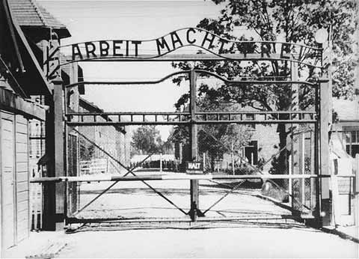
The Holocaust
Focus Question: Why did the Holocaust Occur?
Notes:
This PowerPoint presentation was designed for use with my Year 11 students studying GCSE history. They were writing an essay on: What was meant by the term ‘Final Solution’ and how was it organised?

Slide 21
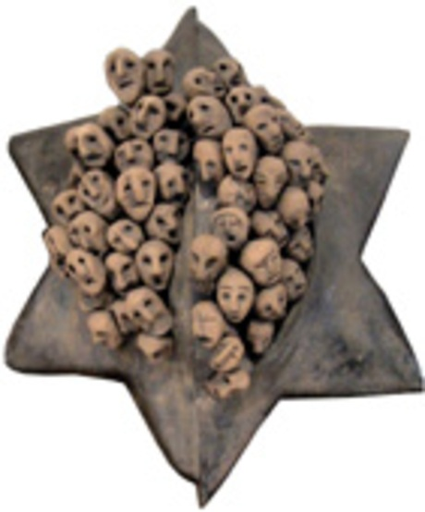
A. HOLOCAUST
1. The systematic
murder of 11 million people across Europe – half of whom were Jews.
2. Why the Jews?
a. Hitler blames
them for the
loss of WW I
&
economic
problems that
followed

Slide 22
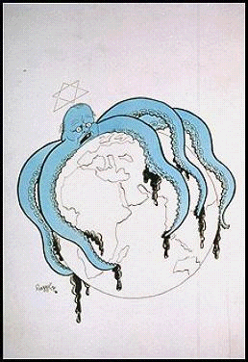
B. Anti-Semitism
This is the term given to political, social and economic agitation against Jews.
a. In simple terms it means ‘Hatred of Jews’.
C. Aryan Race
This was the name of what Hitler believed was the perfect race.
a. These were people with full German blood, blonde hair and blue eyes.

Slide 23
Pre-War
Approximately 11 million Jews in Europe
Poland and the Soviet Union had the largest Jewish populations
Jews very assimilated: farmers, factory workers, business people, doctors, teachers, and craftsmen
Jewish community of Sighet, Romania in front of a wooden synagogue.

Slide 24
Germany blames Jews for Post WW1 problems
Post WWI Blues
Many Germans upset over the loss (Hurt Pride)
Upset about Reparations
German Army is limited in size
Germany falls to extreme depression.
Extremists blamed Jews for Germany’s defeat in WWI
Blamed the German Foreign Minister (a Jew) for his role in reaching a settlement with the Allies.

Slide 25
The Holocaust
The Beginning Stages

Slide 26
Persecution
April 1933
eliminated from civil service
social security eliminated
quotas in schools
September 15, 1935 - Nazis passed Nuremberg Laws:
Stripped Jews of their German citizenship.
Prohibited from marrying or having sexual relations with persons of “German or related blood.”
were required to carry ID cards

Slide 27
Persecution
The “Jewish Question” evolved in three steps:
1. Expulsion: Get them out of Europe
2. Containment: Confine in one place — Ghettos
3. “Final Solution”: annihilation
Other Groups Targeted:
Gypsies (Sinti and Roma)
Homosexuals
Jehovah’s Witness
Handicapped Germans
Poles
Political Dissidents
Helene Gotthold, a Jehovah's Witness, was beheaded for her religious beliefs on December 8, 1944, in Berlin. She is pictured with her children in 1936.

Slide 28
Kristallnacht
“Night of the Broken Glass” November 9-10,1938
Anti-Jewish rampage in Germany: Burnings, arrests and beatings
Nazis attacked synagogues, homes and businesses

Slide 30
Anti-Semitism Propaganda
Nazi teachers began to apply the “principles” of racial science by measuring skull size and nose length and recording students’ eye color and hair to determine whether students belonged to the “Aryan race.”
The Nazis used propaganda to promote their anti-Semitic ideas.
One such book was the children’s book, The Poisonous Mushroom.

Slide 32
The Holocaust: The Final Solution
Nazis would attempt to exterminate the entire Jewish population of Europe, an estimated 11 million persons.

Slide 33
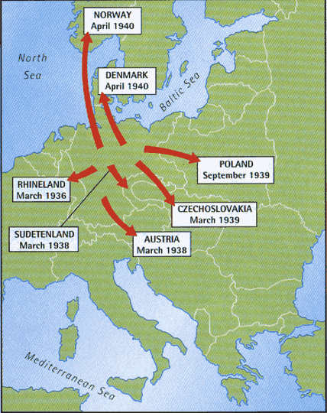
Prelude to the Final Solution
In 1939, Germany invaded Poland which had a much larger population of 3 million Jews.
In 1941, Germany invaded Russia which had a population of 5 million Jews.

Slide 34
Final Solution
Jews to be rounded up, go through process of selection
Healthy Jews → Labor camps
Death through over work and starvation
Too Young, Too Old, Mothers of young, or unhealthy → Death Camps

Slide 35
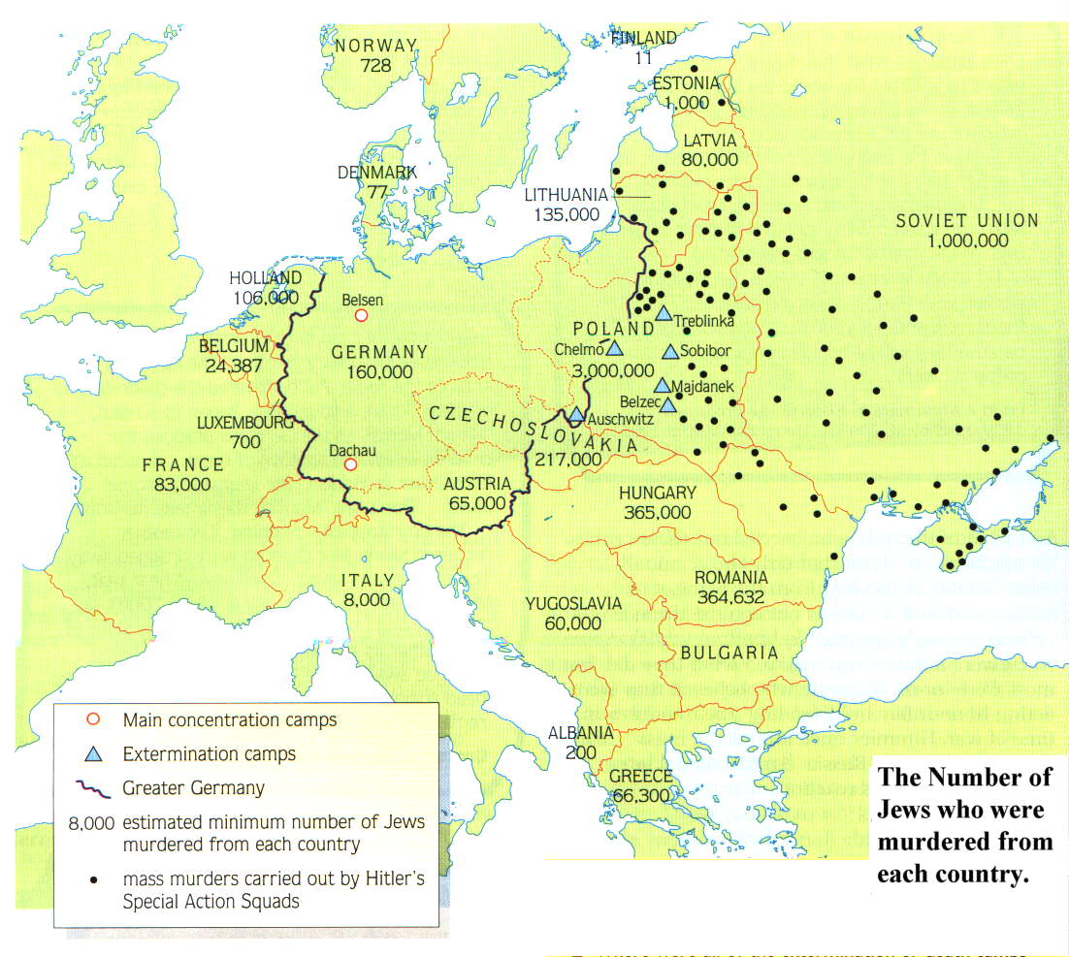
Where were the Death Camps built?
The work of the Einsatzgruppen
Why do you think that they located them here?
Notes:
Remember that the black dots represent the work of the Einsatzgruppen

Slide 36
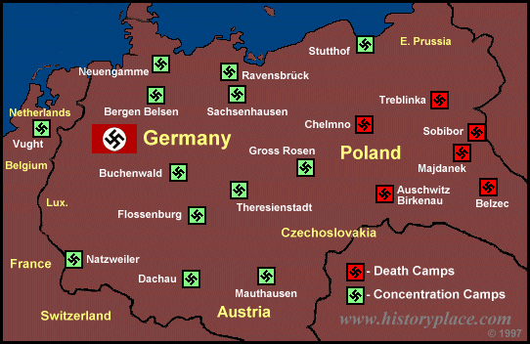
A MAP OF THE CONCENTRATION CAMPS AND DEATH CAMPS USED BY THE NAZIS.
Notes:
There were concentration camps and death camps. If you went to a death camp the chances of coming out alive were virtually nil.
Even at concentration camps though you were likely to die from the appalling conditions.
Or, if you were very young, old, or incapable of hard labour, it was likely you would be transferred to a death camp too.
Anne Frank died at Belsen from Typhoid.
Leonard Leher's mother and sisters were sent to Sobibor.
YOU MAY ASK "WHO WERE THESE PEOPLE WHO WERE SENT TO PLACES LIKE THIS?"
THEY WERE CHILDREN JUST LIKE YOU. THE ONLY DIFFERENCE WAS THEIR RACE AND THE RELIGION THEY FOLLOWED.

Slide 37
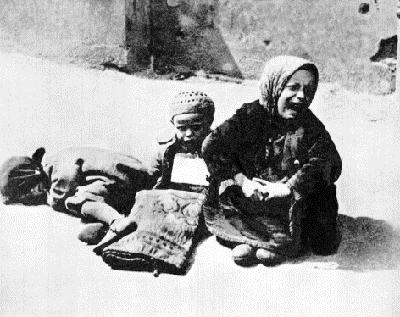
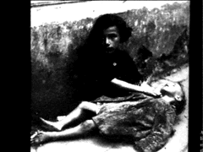
Children Dying of Starvation in the Warsaw Ghetto
Notes:
Evil is when a few good men decide to do nothing.

Slide 38
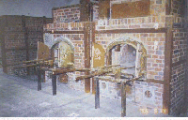
The Ovens at Dachau

Slide 39
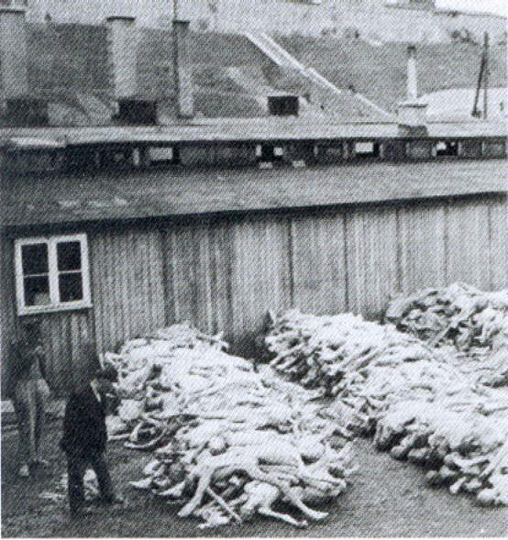
Dead bodies waiting to be processed

Slide 40
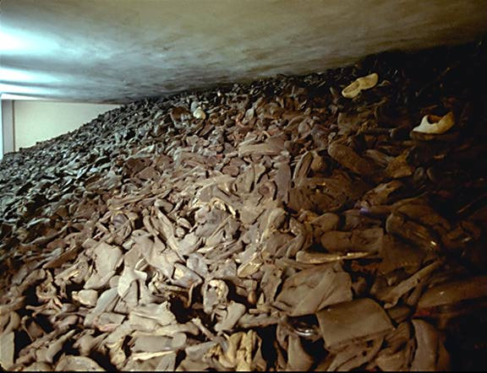
Shoes waiting to be processed
Taken inside a huge glass case in the Auschwitz Museum. This represents one day's collection at the peak of the gassings, about twenty five thousand pairs.

Slide 41
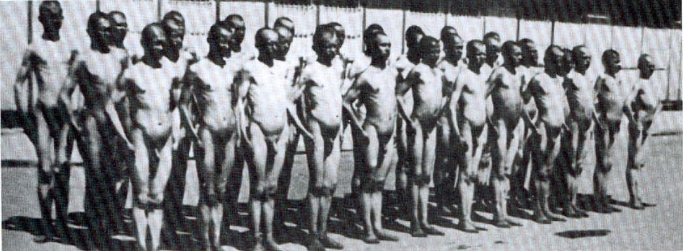
Destruction Through Work
This photo was taken by the Nazis to show just how you could quite literally work the fat of the Jews by feeding them 200 calories a day

Slide 42
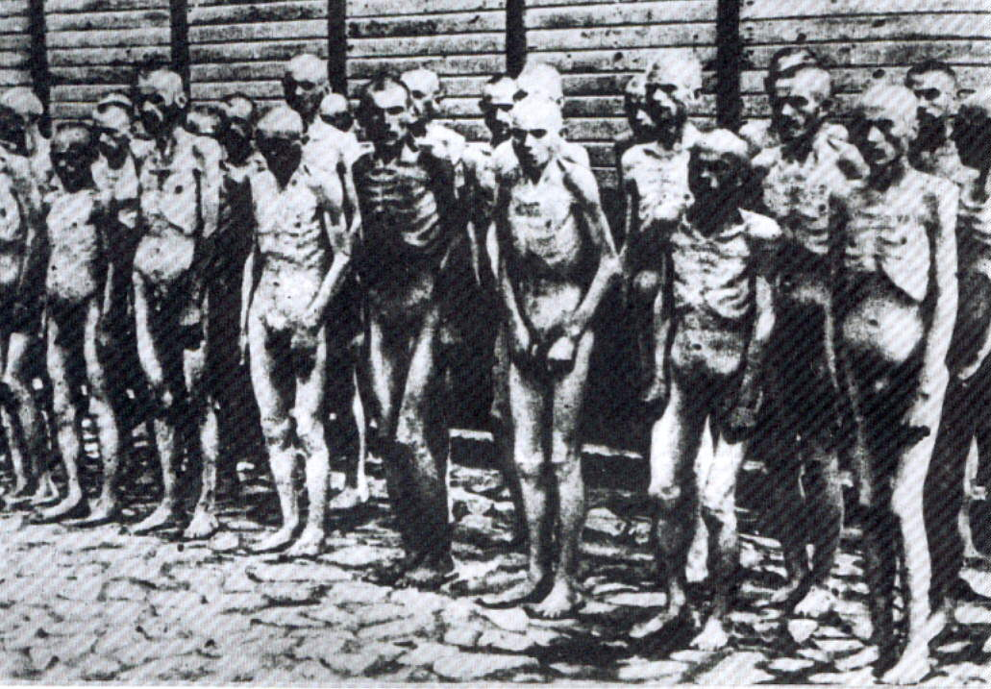
Destruction Through Work
Same group of Jews 6 weeks later

Slide 43
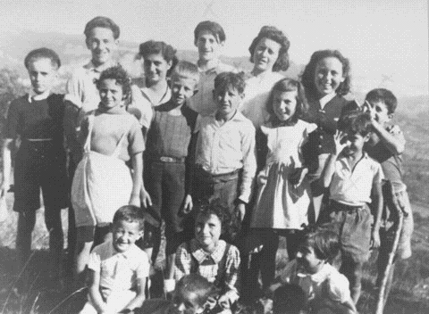
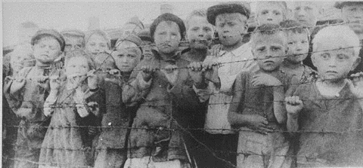
16 of the 44 children taken from a French children’s home.
They were sent to a concentration camp and later to Auschwitz.
ONLY 1 SURVIVED
A group of children at a concentration camp in Poland.
Notes:
HOW DID THEY KILL THESE INNOCENT CHILDREN, ALONG WITH THEIR PARENTS, GRANDPARENTS, FRIENDS ETC..
YOU WILL ALL HAVE PROBABLY HEARD OF THE WAY NAZiS GASSED THE JEWS.

Slide 44
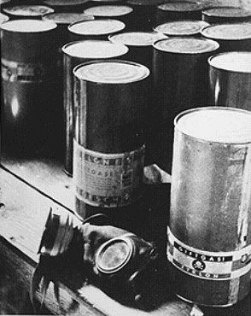
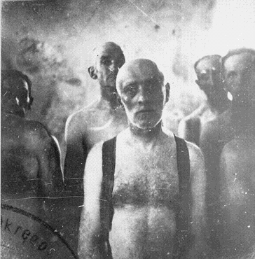
Part of a stockpile of Zyklon-B poison gas pellets found at Majdanek death camp.
Before poison gas was used , Jews were gassed in mobile gas vans. Carbon monoxide gas from the engine’s exhaust was fed into the sealed rear compartment. Victims were dead by the time they reached the burial site.
Notes:
THIS IS THE GAS THAT WAS INTRODUCED IN 1942.
JEWS WERE SENT INTO SEALED SHOWER UNITS ON THE PRETENCE THAT THEY WERE GOING TO BE SHOWERED. PELLETS WERE THEN PLACED INTO THE SHOWER HEADS AND GAS CAME FROM THE SHOWERS INSTEAD OF WATER.
15 MINUTES LATER THE SHOWER ROOM WOULD BE EMPTIED, BODIES WERE ALWAYS IN A PYRAMID SHAPE, PEOPLE TRIED TO CLIMB ON TOP OF ONE ANOTHER TO ESCAPE THE GAS.
BEFORE THIS TYPE OF KILLING METHOD WAS INTRODUCED THOUGH A MORE PRIMITIVE GASSING METHOD WAS USED....
I DON'T KNOW HOW, OR EVEN WHY THIS PHOTO WAS TAKEN, BUT IT SHOWS SOME MEN AWAITING DEATH ON THEIR WAY TO THEIR BURIAL PLACE.
DID THEY ALWAYS BURY THE DEAD?

Slide 45
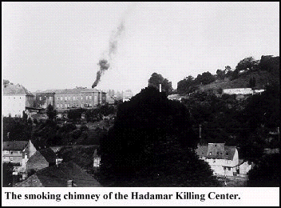
Smoke rises as the bodies are burnt.
Notes:
NO.
MORE OFTEN THAN NOT, ESPECIALLY WHEN THE NUMBER OF PEOPLE MURDERED GREW ESPECIALLY HIGH, NAZIS BURNED THE BODIES.
SO WHAT OTHER METHODS WERE USED TO SYSTEMATICALLY MURDER THESE PEOPLE?

Slide 46
Jewish women, some holding infants, are forced to wait in a line before their execution by Germans and Ukrainian collaborators.
Notes:
MASS EXECUTION USING A FIRING SQUAD WAS COMMON.
THESE WOMEN HAVE BEEN ORDERED TO REMOVE EVERYTHING, CLOTHES, JEWELLERY, EVEN WEDDING RINGS AND ARE BEING FORCED TO LINE UP AND WAIT FOR THEIR TURN TO BE KILLED.
SOME TIME LATER...

Slide 47
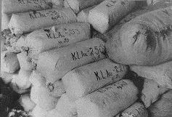
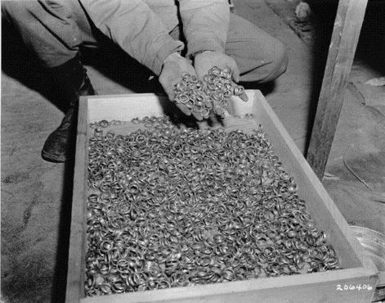
Bales of hair shaven from women at Auschwitz, used to make felt-yarn.
After liberation, an Allied soldier displays a stash of gold wedding rings taken from victims at Buchenwald.
Notes:
THESE PICTURES SHOW WHAT THEY WANTED.
WERE THE NAZI'S NOT WORRIED ABOUT THE CONSEQUENCES OF THEIR ACTIONS?
DID THEY NOT THINK ABOUT WHAT MIGHT HAPPEN IF ALLIED COUNTRIES DISCOVERED WHAT WAS HAPPENING?

Slide 48
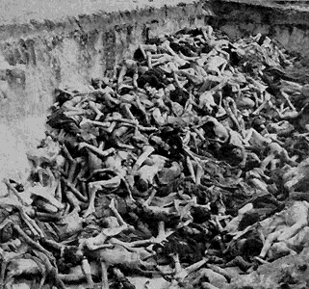
D. Between 1939 &1945 1. six million Jews were murdered, along with hundreds of thousands of others
a. Gypsies, Jehovah’s Witnesses, disabled and the mentally ill.

Slide 49
U.S. and World Response
Evian Conference - summer of 1938 in Evian, France.
32 countries met to discuss what to do about the Jewish refugees who were trying to leave Germany and Austria.
Despite voicing feelings of sympathy, most countries made excuses for not accepting more refugees.
Anti-Semitic attitudes played a role in the failure to help refugees.

Slide 50
2. Percentage of Jews killed in each country
POLAND 91%
AUSTRIA 35%
USSR 36%
BELGIUM 45%
NORWAY 45%
LUXEMBOURG 55%
ROMANIA 84%
ESTONIA 44%
HUNGARY 74%
BOHEMIA 60%
YUGOSLAVIA 81%
LATVIA 84%
NETHERLANDS 71%
LITHUANIA 85%
GERMANY 36%
GREECE 87%
FRANCE 22%
Notes:
How did they manage to get together all these Jews to kills them?
How did they kill them when they had them?
To begin with there were concentration camps.

Slide 51
Who is to blame for the Holocaust?
Complete the back side of your notes handout “Who is to blame?” Don’t forget to write a sentence explaining your decision in addition to just writing the letter. Full instructions are on the top of the handout ☺

Slide 52
Come to a consensus
Compare your answers for 1-10 with your elbow partner.
For any rankings that you and your partner disagree on- come to a CONSENSUS (unanimous agreement)– talk and discuss to reach this
Then: Create a pie chart in the space provided with each of the 10 groups being given a “slice” of the blame

Slide 53
Poll Everywhere
Text HEATHERWILSO021 to 37607 to join the poll
(That’s WILSO as in my last name and then the number zero).
Question: Who is the blame for Holocaust?

Slide 54
How were the rights of Jewish people violated during the Holocaust? Think of 3 categories of violations and then give at least 2 specific examples per category.
Category 1
Category 2
Category 3

Slide 55
Holocaust DBQ
Go to my website, AHII > Unit 6 to find the Documents and Questions. Answers should be written on notebook paper. You do not have to rewrite the question. When you finish the documents, answer the final thought question in essay form (one strong page- with a clear thesis). Essay prompt is on my website as well: Cite the document after you use an example from it. Ex: (Document C).
*Due tomorrow at the start of class

Slide 56
Holocaust DBQ
Analyze the documents and answer all questions. Answers should be in complete sentences and should be written on notebook paper. Do not write on the DBQ handout!
When you finish the documents, answer the final thought question in one strong paragraph: How were human rights violated during the Holocaust? Include at least three varied, specific examples from the documents. Cite the document after you use an example from it. Ex: (Document C). **Please also include which document (or image) stands out the most to you and why.

Slide 57
Holocaust Survivors Video
Answer the Discussion Questions as you watch!

