Slide 1
2nd block 11/1
Because of the assembly today:
Your 20s quiz will be tomorrow- STUDY!
You have Homework tonight– it is on my website. Download notes handout “Life during the Depression”. Read PPT “Life during Depression” and take notes. These are YOUR notes on this material.
Complete the Photo Story Assignment (On my website)--- Due Thursday 11/3 for Hw grade!

Slide 2
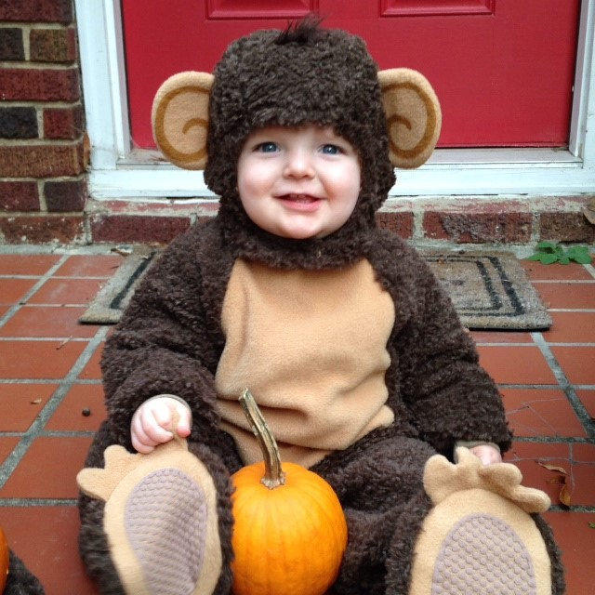

Slide 3
Wednesday 11/1: NO Bellringer today
Review your 1920s notes for today’s quiz. Quiz will be informal grade & go on 2nd quarter. It is 20 Multiple Choice Questions.

Slide 4
Wednesday 3/22: No bellringer today
Review your 1920s notes for today’s quiz. Quiz will be informal grade & go on 2nd quarter.

Slide 5
Bellringer Wednesday March 22nd
1) What was the Harlem Renaissance?
2) Give at least 2 examples of key people from the Harlem Renaissance & 2 examples of themes of the Harlem Renaissance.
3) Explain in your own words what happened during the Teapot Dome Scandal & the Scopes Trial.

Slide 6
1920s Quiz
You need a pen or pencil.
Clear everything off your desk
Touching your phone while quiz is on your desk = zero on quiz.

Slide 7
Reminders
Keep up with the Unit 5 Reading per unit 5 outline
Unit 5 Test is Thursday November 9th (Study Guide & EC Due @ start of class)

Slide 8
Honors American History II Thursday October 23rd 2014
Essential Question: How did the prosperity of the 1920s give way to the Great Depression?
Objectives:
Identify and explain the long and short term causes of the Great Depression.
Evaluate the significance and immediate effects of the Black Tuesday Stock Market Crash.
Participate in a family budget simulation to better understand what life was like during the Great Depression.
Reminders:
-1920s Quiz Today!
-Unit 5 study guide and extra credit are due Monday November 3rd
-1st quarter ends 10/27
Agenda
-Bellringer (Recap Questions)
-1920s Quiz: 20 MC Questions
-PP Notes: Causes of the Great Depression
-Video Clip: Black Tuesday
-Pairs: Begin Great Depression Family Budget Simulation

Slide 9
American History II Thursday October 23rd 2014
Essential Question: How did the prosperity of the 1920s give way to the Great Depression?
Objectives:
Identify and explain the long and short term causes of the Great Depression.
Evaluate the significance and immediate effects of the Black Tuesday Stock Market Crash.
Participate in a family budget simulation to better understand what life was like during the Great Depression.
Agenda
-Bellringer (Recap Questions)
-1920s Quiz: 10 fill in blank Qs
-PP Notes: Causes of the Great Depression
-Video Clip: Black Tuesday
-Pairs: Begin Great Depression Family Budget Simulation
Reminders:
-1920s Quiz Today!
-Facebook project was due yesterday!
-Unit 5 study guide and extra credit are due Monday November 3rd
-1st quarter ends 10/27

Slide 10
Date | Topic | Page
10/26 | 1920s Quiz | 46
10/26 | Causes of the Great Depression Notes | 47

Slide 11
Causes of the Great Depression
Focus Question: How did the prosperity of the 20s give way to the Great Depression?

Slide 12
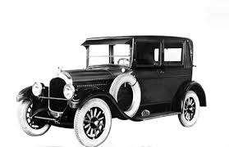
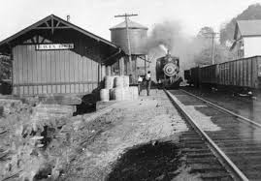
Industry
Railroad and steel industries were barely making a profit
Railroads lost business to new forms of transportation
Coal Mining hit hard due to competition by new forms of energy like fuel, oil and natural gas
# of houses being built declines

Slide 13
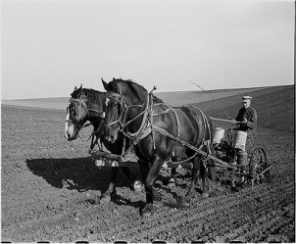

Agriculture
Demand for crops drops after WWI
Farmers go into debt- banks seize farms
McNary-Haugen bill was supposed to provide help for farmers
Coolidge vetoed it
Remember the Diet Coke example!

Slide 14
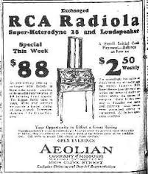
Consumer Spending
Americans were buying less by the late 1920s due to rising prices
They were overbuying on credit (installment plan)
$2,500 a year was considered the amount a family needed to live
Unequal distribution of income meant most Americans could not participate in the economic advances of the 1920s.

Slide 15
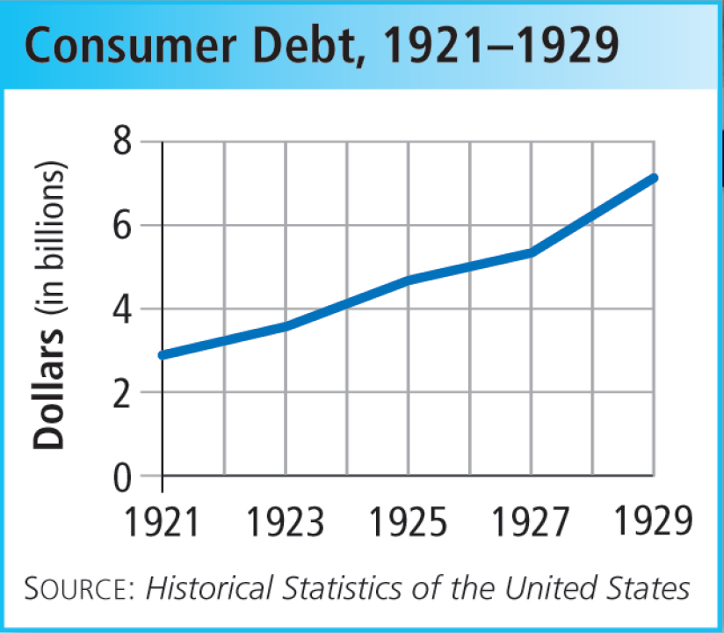
Consumer Spending
Easy Credit
Banks make loans people can’t pay back; people living beyond means – leads to rising debt
What is DEBT?
What is a CONSUMER?
What happens to Consumer Debt in the 1920s?

Slide 16
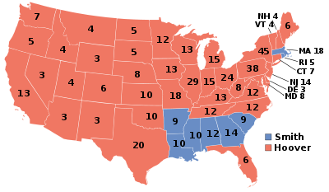
Election of Herbert Hoover
Hoover was Secretary of Commerce under Presidents Harding AND Coolidge
Ran against Alfred Smith (Democrat)
Pointed to years of prosperity under Republicans since 1920

Slide 17
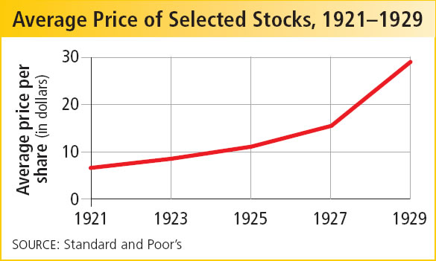
Rags and Riches: The Stock Market
The Dow Jones Industrial Average measures the health of the stock market
Dow Jones reaches all-time high of 381 points
Many people engaged in speculation (buying stocks on chance of fast profit- ignoring risks)
Buying on Margin:
Buying stocks on credit

Slide 18
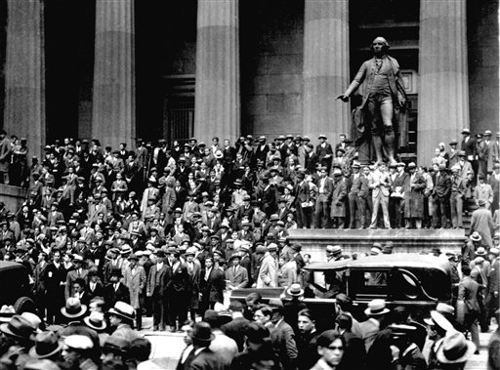
The “Spark” – The Stock Market Crashes
October 24th –Stock Market takes a plunge, many investors sell shares
“Black Tuesday” October 29, 1929: Shareholders dump over 16 million stocks & many cannot sell
Marks the beginning of the Great Depression
1929-1940
How long does the Great Depression last?

Slide 19
Video Clip: BLACK TUESDAY!!!

Slide 20
“Cycle of Disaster” – many businesses went bankrupt
Businesses cut
production
Workers suffered
from wage cuts
and lay offs.
Demand for
goods fell.
People had
little or no
money to spend.

Slide 21
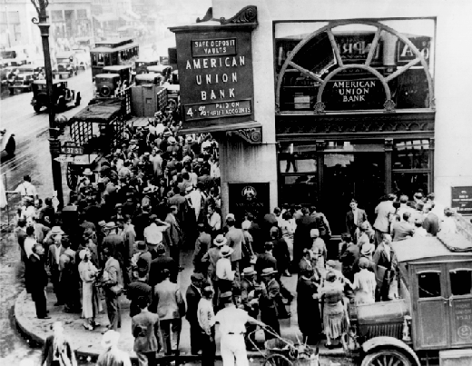
Effects of the Great Depression
Bank Failures
People rush to the banks to get their $$ but banks don’t have enough because banks also invested in the stock market

Slide 22

Effects of the Great Depression
Thousands of industries went bankrupt such as the automobile and railroads
Unemployment Rate reaches 25%
1 out of 4 (25%) out of work

Slide 23
Effects of the Great Depression
Worldwide Economic Collapse
1930: Hawley-Smoot Tariff – highest tariff in history to protect against competition.
But- it stopped other countries from earning American money to buy our goods
Congress did not understand we had become a global economy.

Slide 24
Causes
Great Depression
Effects

Slide 25
Great Depression Budget Simulation
Task: Your group has been given a profession, salary and family statistics. Assume the role of a person in that profession living in the Great Depression. Use the resources to explore your economic choices for your family.
Directions:
Part 1: Use the information packet provided to complete the following budget worksheet while. Remember, you can’t spend money you don’t have and these supplies should last you the entire month!
Part 2: Answer the “Decision Time” Questions in each section as a group. This is your chance to explain why your group decided to budget the money the way you did.

Slide 26
Rules!!
For Housing: you must include water & electric in housing costs
For Food: Adults (18+) need 30 lbs of food per month. Kids (4-17) need 10 lbs, Kids under 3 need 5 lbs. You must fill the page with variety (each line gets a different item… ie: don’t just buy potatoes for your family!!!)
Clothing: EACH person in your family needs one new outfit (top to bottom including shoes) per month. If your breadwinner is a doctor or accountant you MUST buy a suit
For Entertainment: One “fun” thing per family member for the month is required but you can go above that if you want
For Automobile: Follow instructions on your Life Card
For Miscellaneous: Must buy at least ONE household item (see Furniture & Appliances) for the month. If your life card tells you a specific one, buy that– otherwise whatever you want.

Slide 27
Reflection Questions (1 copy per pair)
1.What were some sacrifices you were forced to make as a family?
2. How would you grade your standard of living? (Excellent, Average, Poor) Why?
3. Considering your remaining money, what would be some possible obstacles your family could face over the course of the month?
4. Do you think your family would survive the Great Depression? Explain why or why not?

Slide 28
Homework!
Read CH 22 Section 2. Complete the back of today’s notes handout as you read.

Slide 29
2nd Period Groups
Evan, Farandia
Chad, Ethan
Dru, Nicole
Gabby, Felicia, Matt
Jamal, Tatianna
Valerie G., Valerie M.
Chrishera, Bryanna
Jarrett, Adam
Sam, Dennis
Keven, Alex
Christian, Vincent
Brice, David

Slide 30
In your groups
Task: Your group has been given a profession, salary and family statistics. Assume the role of a person in that profession living in the Great Depression. Use the resources to explore your economic choices for your family.
Directions:
Part 1: Use the information packet provided to complete the following budget worksheet while. Remember, you can’t spend money you don’t have and these supplies should last you the entire month!
Part 2: Answer the “Decision Time” Questions in each section as a group. This is your chance to explain why your group decided to budget the money the way you did.

Slide 31
As a group, answer in complete sentences!
1.What were some sacrifices you were forced to make as a family?
2. How would you grade your standard of living?
3. Considering your remaining money, what would be some possible obstacles your family could face over the course of the month?
4. Do you think your family would survive the Great Depression? Explain why or why not?

Slide 32
Stock Market Simulation
$10 a share
OR you can buy on margin- pay $1 now, owe $10 later
Price of your stock may go up or down depending on the market.. That is a risk you have to take!
When time is up, you will add up the money you have. You will need to pay the bank back for any stocks you bought on margin. You must pay the bank with cash.

Slide 33
Stock Market Simulation
3 different stocks for sale:
Mills Corporation (MC)- manufacturer of cereals, flour, canned goods,etc. founded 127 years ago
Private Electric (PE): brand new company, private electric manufactures radios, refrigerators and other electrical appliances.
Major Motors (MM): One of America’s leading car manufacturers, MM has been privately held for 25 years. It is now “going public” because the company wants to raise money so that it can start making airplanes.

Slide 34
1st Period Groups
Zach, Keenan
Darryl, Amanda
Weston, Mary
Tyrone, Kristen, Jake
Nikki, Curtis, DJ
Gabby, Kymtrece, Mike
Jazmine, Nick, Danny
Tiffany, Dexter
Sean, Adrianne
Kara, Drew
Tyler, Jordan, Alex
Anthony, Dexter

