Slide 1
Friday October 24th Bellringer
Create the following chart in the bellringer section of your notebook. Use your notes from yesterday to help
Causes of the Great Depression
Great Depression
(Don’t add anything here)
Immediate Effects of the Great Depression

Slide 2
Wednesday 11/2 Bellringer Part I
1) Name AND explain at least one long term cause of the Great Depression (hint: this would be something that was happening throughout the 1920s that eventually led to the Great Depression)
2) Name the *Spark* of the Great Depression and explain what happened.
3) Explain the difference between speculation & buying on margin.

Slide 3
November 2nd Bellringer Part II
Pick up a copy of the lyrics to the “Brother Can You Spare Me a Dime?” song from the front table. Answer the following questions in the bellringer section of your notebook after you read the song lyrics:
1) What do you think the author of this song is writing about?
2) What is the tone/mood of the song?
3) What had Al done for his country?

Slide 4
Depression Budget Simulation
Working with the same partner from yesterday, please finish your Great Depression Budget Simulation
Make sure to tally up the grand total of how much $$ your family spent
Don’t forget to answer all of the “Decision Time” questions in your packet.
Don’t forget to also buy any miscellaneous things mentioned in your life scenario card your group drew!

Slide 5
As a group, answer the questions below on notebook paper. Write in complete sentences! Staple answers to your packet, along with your life card. One paper per group is fine
1.What were some sacrifices you were forced to make as a family?
2. How would you grade your standard of living? (Excellent, Above Average, Average, Poor) Explain.
3. Considering your remaining money, what would be some possible obstacles your family could face over the course of the month?
4. Do you think your family would survive the Great Depression? Explain why or why not?

Slide 6
Date | Topic | Page
10/27 | Life During the Great Depression | 48

Slide 7
Hardship & Suffering During the Great Depression
Focus Question: How did the Great Depression impact people’s lives?

Slide 8
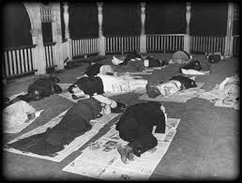
Impact in Cities
People lost jobs
Were evicted from their homes- ended up homeless
Many slept in parks or sewer pipes, wrapping themselves in newspapers (Hoover Blankets) to keep warm.

Slide 9
Key Terms for Depression Life
Shantytowns: little towns consisting of shacks made out of scrap materials where homeless people gathered during the great depression. Also known as Hoovervilles
Soup Kitchens: offered free or low-cost food
Breadlines: lines of people waiting to receive bread provided by charitable organizations.

Slide 10
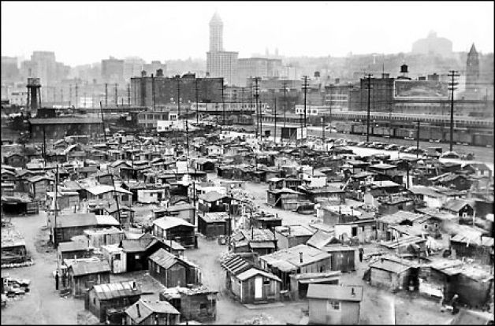

Slide 11
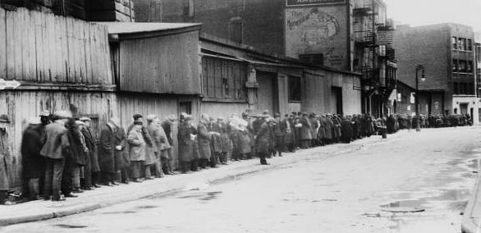
“Two or three blocks along Times Square, you’d see these men- silent, shuffling along in a line. Getting this handout of coffee and doughnuts, dealt out from great trucks… I’d see that flat, opaque, expressionless look which spelled for me, human disaster. Men…who had responsible positions. Who had lost their jobs, lost their homes, lost their families… They were destroyed men.”

Slide 12
Impact on Minorities
Conditions for African Americans and Latinos were especially difficult.
Their unemployment rates were higher and they were the lowest paid.
Also dealt with increasing racial violence from unemployed whites competing for the same jobs.
Many whites began to demand Latinos be deported.

Slide 13
Impact on Rural Areas
One advantage of depression living in a rural area- you could grow your own food.
However, many farmers lost land through foreclosures. Had to become tenant farmers and barely scraped out a living.

Slide 14
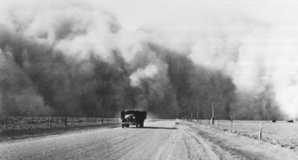
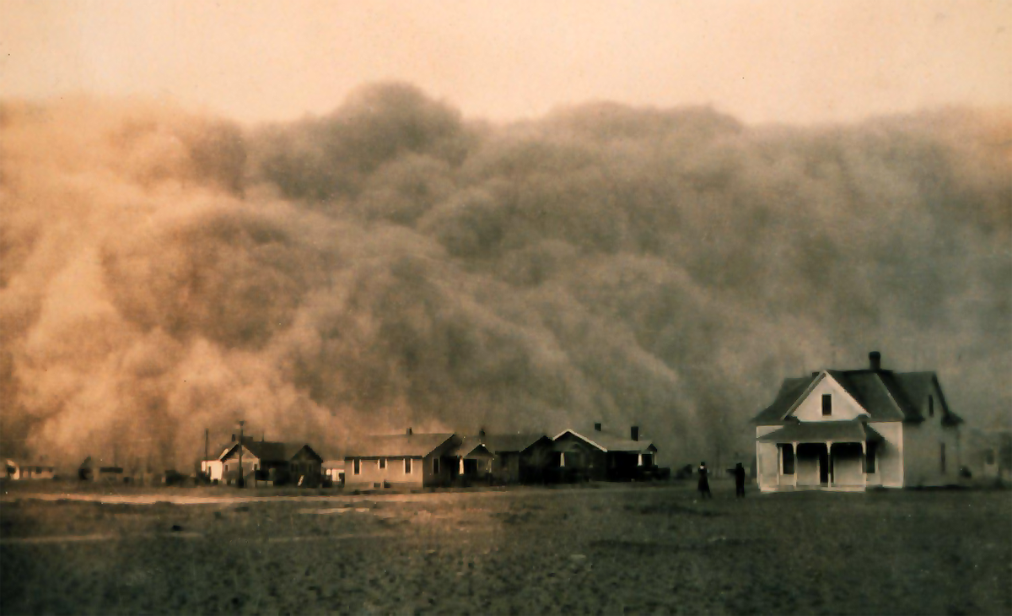
The Dust Bowl
Drought that began in the early 1930s and impacted the entire Great Plains.
Caused by drought, overproduction + winds. Little grass and few trees held the soil down and dust traveled hundreds of miles.
Approximate number of miles impacted: 150,000 square miles.

Slide 15
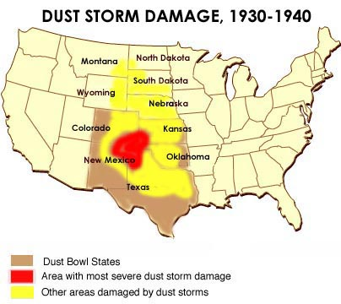
Dust Bowl Video Clip

Slide 16
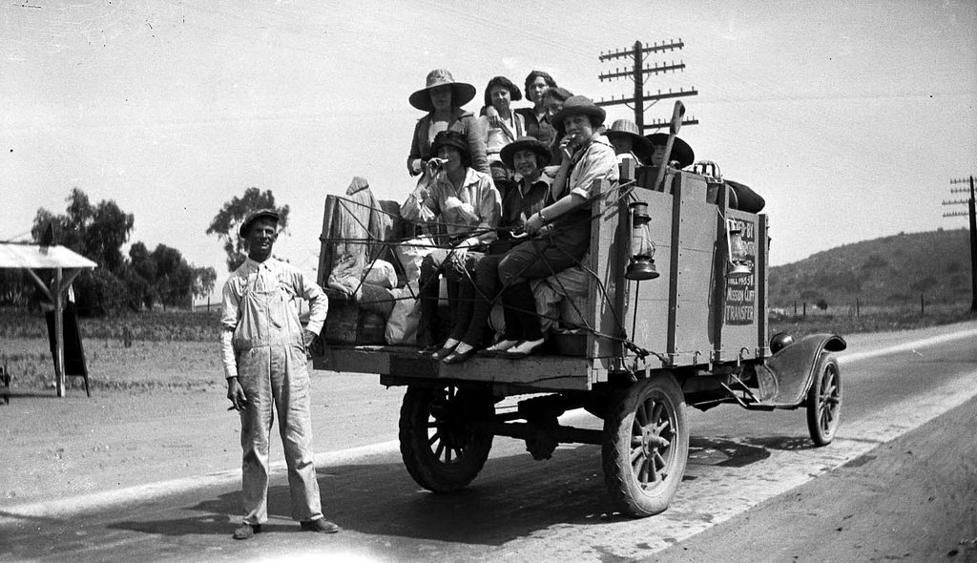
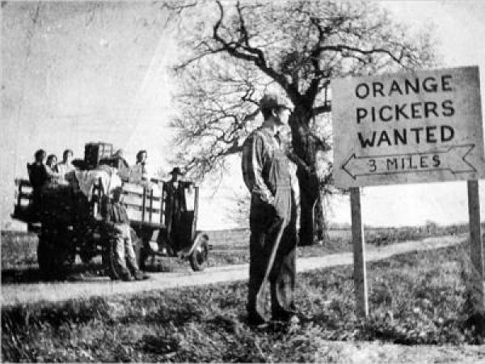
Okies
People who migrated to the west to California during the dustbowl.

Slide 17
Impact of Depression
Homelessness was a bigger problem
Increased crime
More reliance on charity (soup kitchens & breadlines)
People could still grow own crops
Many people lost the land they owned
Dust Bowl
Cities
Rural Areas

Slide 18
So did these people get any help?
No federal system of direct relief (cash payments or food provided by the government to the poor).
Some cities and charity services did offer relief to those who needed it but benefits were meager (ex: NYC weekly payment was $2.39 per family per week).

Slide 19
Impact on Men
Many men had hard time adjusting because they were used to supporting their families
Walked the streets in search of jobs
Many left their families- became hoboes- hitching rides on trains.

Slide 20
Impact on Women
Carefully managed household budgets- tried to save $$
Worked outside the home when possible
Difficult for them to get a job (especially if married)

Slide 21
Impact on Children
Poor diets & lack of money for health care led to serious health problems for children.
School boards had to shorten school year and close schools- many kids went to work instead.
Many teenagers ran away from home
Little $$ for fun- had to have community-wide birthdays for example.
“If I leave my mother, it will mean one less mouth to feed.” ~ Eugene Williams Age 13

Slide 22
Social & Psychological Effects
Some people so demoralized they lost their will to survive. Suicide rate between 1928 and 1932 rose more than 30%.
3 times as many people were admitted to mental hospitals.

Slide 23
After you finish today’s notes- Great Depression Photo Story
Choices of photos are on my website. Instructions for the activity are on the back of today’s notes. Story goes on NB paper for a classwork grade. Make it creative and detailed ☺ The idea is to show your knowledge of today’s reading & notes in your story.
Due at the end of class!
If you finish early, you may turn in your photo story and work on your Facebook Project or your Unit 5 Study Guide and/or Unit 5 Extra Credit.

Slide 24
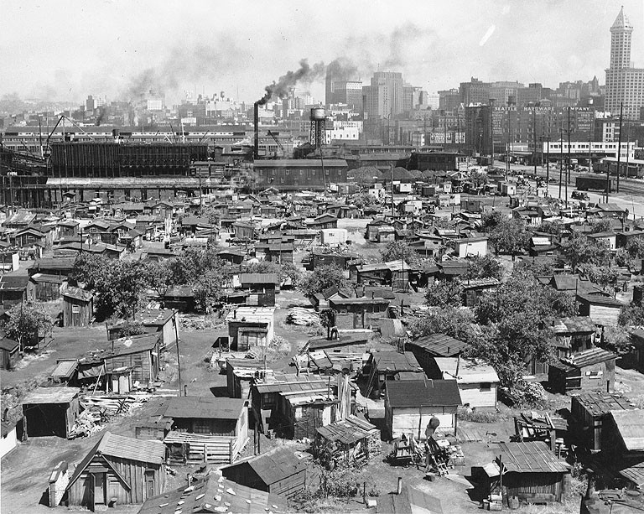

Slide 25
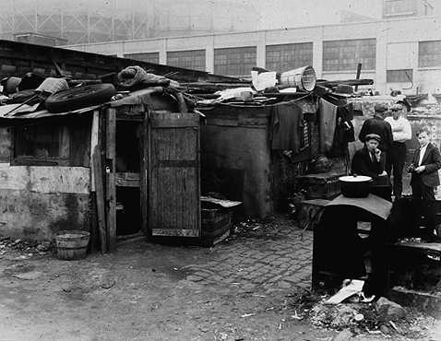

Slide 26
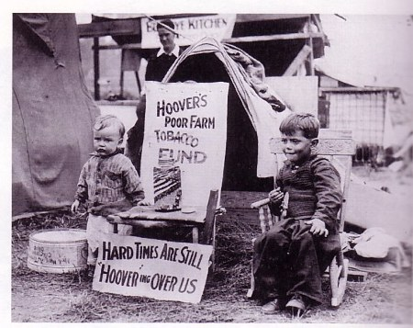

Slide 27
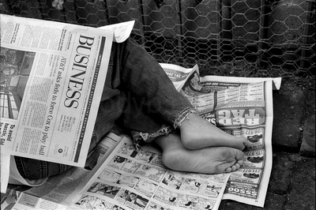

Slide 28
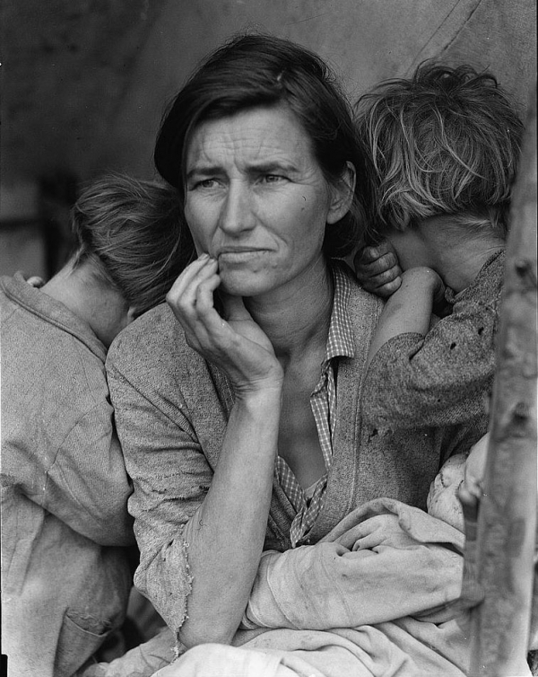

Slide 29
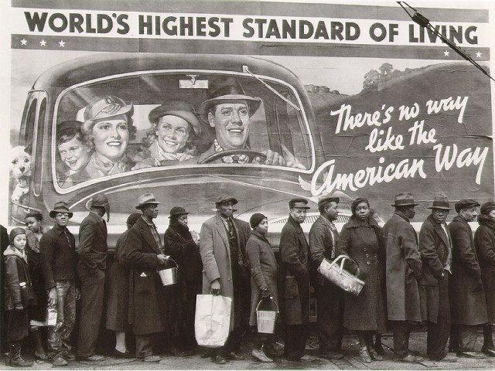

Slide 30
Bellringer Wednesday April 1st
Come pick up a copy of the “Dust Bowl” reading from the front table. Do not write on the handout!
Instead, write the answers to the questions in the bellringer section of your notebook!

Slide 31
Reminders/Announcements
Facebook project due tomorrow (4/2) at the start of class in hard copy form.
Unit 5 Study Guide & Extra Credit due 4/15

Slide 32
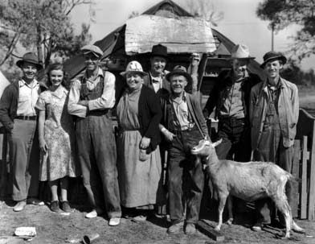

Slide 33
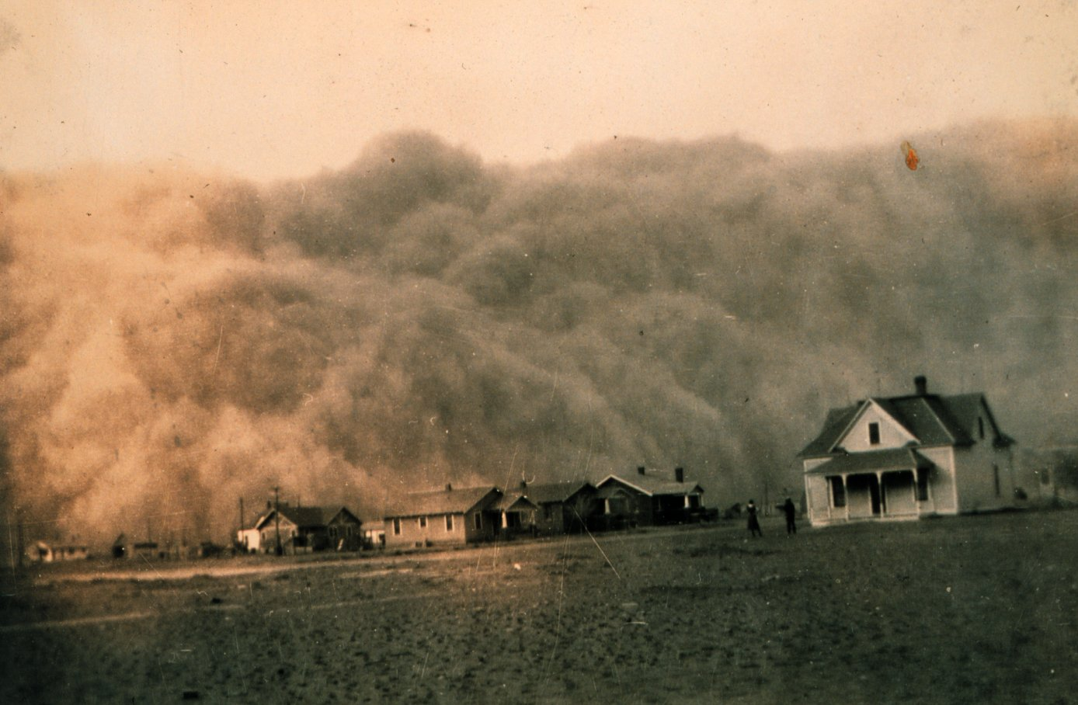

Slide 35
Life During the Great Depression
Welcome to Hooverville Video clip

Slide 36
Date | Topic | Page
10/24 | Life During the Depression Notes | 61

Slide 37
Do Now
Working with the same partner from yesterday, please finish your Great Depression Budget Simulation
Make sure to tally up the grand total of how much $$ your family spent
Don’t forget to answer all of the “Decision Time” questions in your packet.
Rules Reminder: 1 pound of food per person per day & 1 clothing outfit per family member for the month. Don’t forget to also buy any miscellaneous things mentioned in your life scenario card your group drew!

Slide 38
As a group, answer the questions below on notebook paper. Write in complete sentences! Staple answers to your packet.
1.What were some sacrifices you were forced to make as a family?
2. How would you grade your standard of living? (Excellent, Above Average, Average, Poor)
3. Considering your remaining money, what would be some possible obstacles your family could face over the course of the month?
4. Do you think your family would survive the Great Depression? Explain why or why not?

Slide 39
Great Depression Photo Story
Visit my website- AHII Unit 5 to look at the different options for your photo story.
Select one photo that you would like to use.
Follow the instructions on the back of today’s notes handout to create your photo story.
Story may be typed or handwritten- 1 page!
Due @ the beginning of class on Tuesday 10/28. Make these detailed and creative!

Slide 40
Bellringer Wednesday 4/1
Pick up a copy of the “Letter from a dust bowl survivor” from the front table.
Answer the discussion questions in the bellringer section of your notebook.
Do NOT write on the handout!

Slide 44
Reminders/Announcements
Facebook project due tomorrow (4/2) at the start of class in hard copy form.
Unit 5 Study Guide & Extra Credit due 4/15

Slide 45
Bell ringer Friday November 3rd **Turn in Photo Story HW**
1) What is a Shantytown?
2) How did the Great Depression impact cities and rural areas differently?
3) Explain what happened in the Dust Bowl.
4) Choose one of the following groups and give one example of how the Depression impacted them: Men, Women, Children

Slide 46
Hoover And the Depression
Focus Question: Why do many Americans blame Herbert Hoover for the Great Depression? Is this fair?

Slide 47
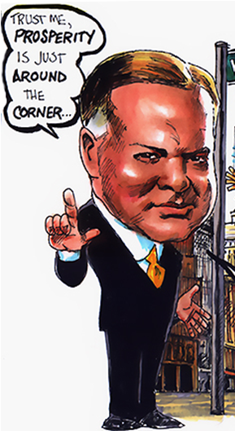
Hoover’s Reassurance
“Any lack of confidence in the economic future… is foolish” -Herbert Hoover 1929’
Believed that Americans should carry on as usual.
Rapid growth and slumps just a part of American economic trend

Slide 48
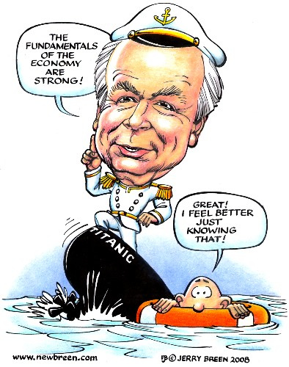

Slide 49
Hoover's Philosophy
Hoover was a Humanitarian (person who promotes human welfare)
Believed that Americans should have savings protected, steady job, insurance, etc.
However, believed this was not governments job.
Rugged Individualism- people should succeed through their own efforts.
Felt that handouts would weaken “moral fiber”

Slide 50
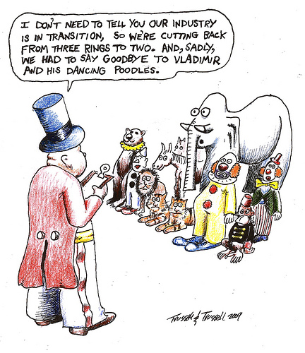
Hoover’s Actions
Asks employers not to cut wages or lay off workers.
Asked labor leaders not to demand higher wages or go on strike.
Great idea but no way to enforce it.

Slide 51
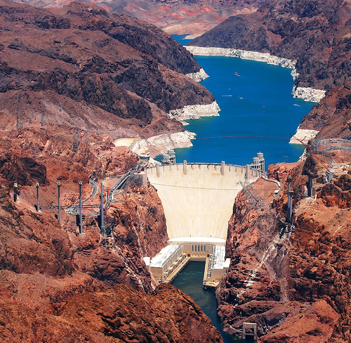
Boulder Dam- example of a government works project
-Dam in the Black Canyon of the Colorado River (between Arizona & Nevada)
-Constructed between 1931 and 1936
-Dam’s generators provide power for several western states.
-The Dam created over 3,000 jobs (although temporary)

Slide 52
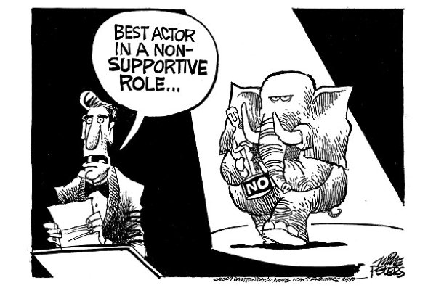
Despite Criticism, Hoover struggles to maintain his principles.
Angry Americans blame him for Depression

Slide 53
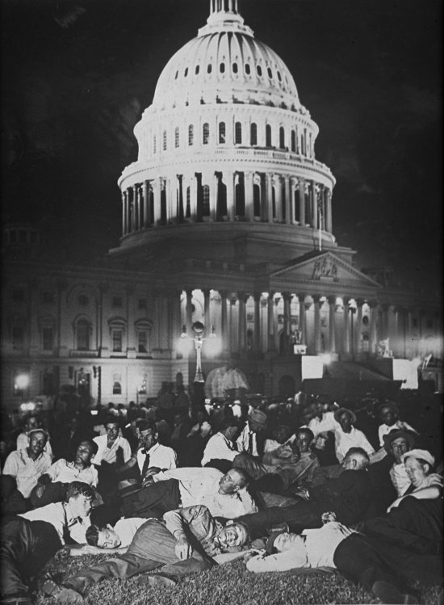
Bonus Army
In 1932 10,000-20,000 WWI veterans march on Washington D.C.
Demanded that a bonus promised for 1945 be paid immediately
Hoover said no but acknowledged their right to assemble peacefully

Slide 54
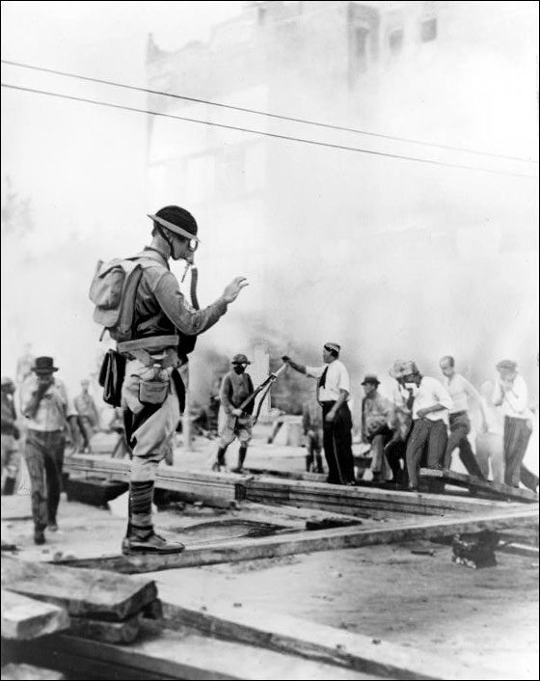
Bonus Army Cont.
The proposal went to the Senate who voted it down.
Hoover asks army to leave
Most did but 2000 refuse
Hoover calls on a group of 1000 soldiers to remove the veterans
Led by Douglas Macarthur and Dwight D. Eisenhower
Soldiers eventually used tear gas and torched building to get people to leave

Slide 55
Welcome to Hooverville Video

Slide 56
Go sit with your Birthday Partner– we will be with them the rest of class so you can bring your stuff ☺ ☺ ☺

Slide 57
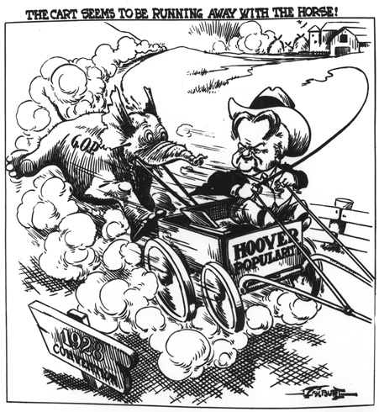
A

Slide 58
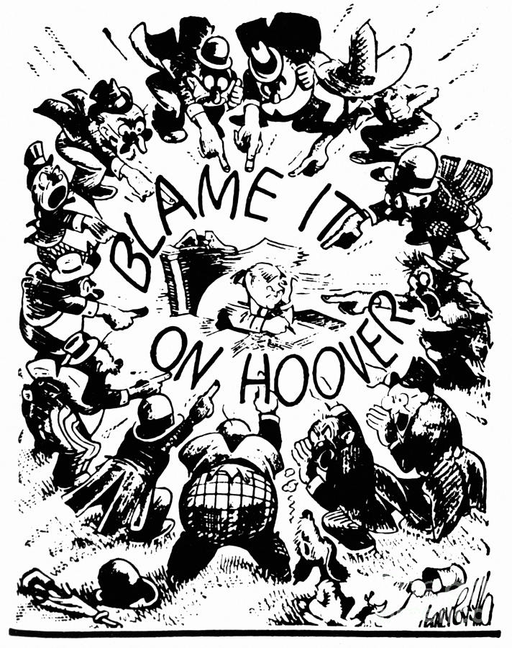
B

Slide 59
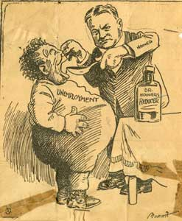
C

Slide 60
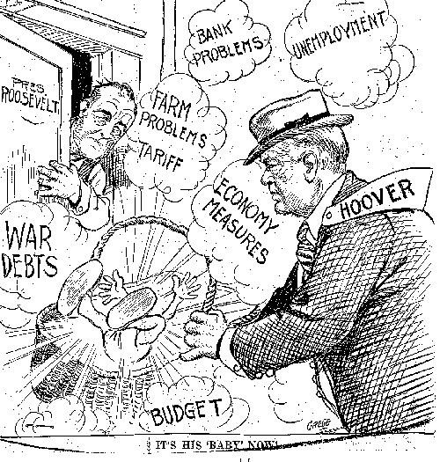
D

Slide 61
On notebook paper, with your partner:
Write a 1 paragraph response supporting the point of view you were assigned:
Hoover IS to blame for the depression or Hoover is NOT to blame for the depression.
Include details to support your point and remember even if you don’t actually agree with the point you were assigned- make it convincing!

Slide 62
Is it fair to blame Herbert Hoover for the depression? Read the article you were given and add details to the side you were assigned. Details should come from the article but you can think of additional reasons as well. *Need 5 total
YES
NO

Slide 63
Final Thought Question– EACH person needs to write their own. Now this is just YOUR actual opinion
How would you describe the public’s perception of Herbert Hoover by 1932? Is this fair? Who else might be to blame for the Great Depression? Should Hoover go down as one of the worst Presidents ever?

Slide 64
Traveling Think/Pair/Share
Find three different people to share your opinion with. Have them initial your paper after you share your opinion.

Slide 65
What do you think?
“I do not believe that the power and duty of the federal government ought to be extended to the relief of individuals suffering… The lesson should be constantly enforced that though the people support the government, the government should not support the people.” ~ Herbert Hoover

Slide 66
With your Partner:
Create a political cartoon that corresponds with the point of view you were assigned--- either:
Hoover IS to blame for the depression or Hoover is NOT to blame for the depression.
Don’t forget a title!

Slide 67
So, is it fair to blame Hoover?
YES!!!!
NO!!!!

Slide 68
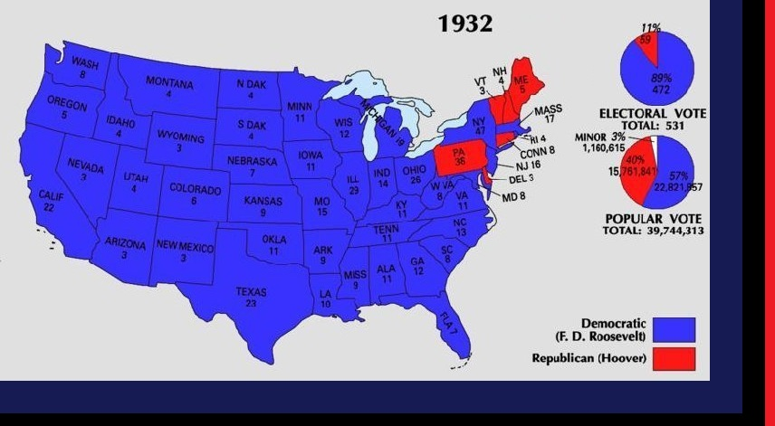

Slide 69
Primary Source Time!
Read the primary source titled “Attack on the Bonus Army” and answer the four discussion questions on the back of today’s notes.
Don’t forget to also answer the final thought question!
One copy per pair is fine.

Slide 70
Do Now
Use this time to work on one of the following items:
Unit 5 Study Guide
OR
Unit 5 Extra Credit
OR
Photo Story if you did not complete this

Slide 71
1st period: Do Now
Look back to yesterday’s notes (Life During the Depression). On the back side of the notes you will see instructions for how to write your Photo Story.
To get pictures- can go to my website and look under AHII, unit 5 OR you can look at the paper copies up front.
Story Due @ End of Class
If you finish early: Turn in your story and you may use this time to work on your facebook project that is due tomorrow OR your Unit 5 Vocabulary.

Slide 72
Do Now
On the back of your notes, please complete the History Frame Graphic organizer by adding in details from today.
Then, once you have your detail boxes complete- answer the final thought question at the bottom of your paper.

Slide 73
Do Now
You may use this time to work on:
Your Great Depression Photo Story (due at the start of class tomorrow)- directions are on the back of Friday’s notes handout. Photos to choose from are on my website (AH II Unit 5) or I have paper copies of the photos as well. Remember- you need to tell me which picture you chose, which person you are, what you titled it and include SIX vocab words (from sheet)
OR if you have finished your photo story, you may work on your Unit 5 Study Guide or Unit 5 Extra Credit

