Slide 1
E/I Monday October 1st
Sit anywhere for now (don’t get too comfy, you will be likely moving shortly)
Update your Table of Contents!

Slide 2
E/I Monday October 1st
Purple Group (10/10 on CFA #1)
Teal Group (9/10 on CFA #1 or lower)
Move to the Purple Group Station and begin working on the assignment there.
Look at the questions you missed on CFA #1. If you only missed 1 question- you will go to that station. If you missed more than one question you can select the area you feel you need the most work on and go to that station.
Complete the assignment at your station

Slide 3
Bellringer 8/28
In the bellringer section of your notebook, please write down any three things that come to mind when you think of Native Americans!
*Turn in your postcard from the west if you didn’t turn it in yesterday to the front table (make sure name is on it).
**If you have your signed syllabus today, turn that in too!

Slide 4
Bell Ringer Wednesday August 30th
Answer the following questions using yesterday’s notes:
1) What was the Homestead Act?
2) Name one PULL FACTOR that might attract someone to the west.
3) Name one GROUP of people who went west.
4) Name one detail about LIFE out west.

Slide 5
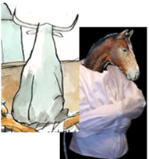
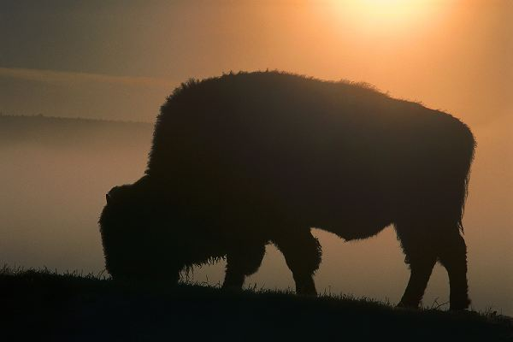
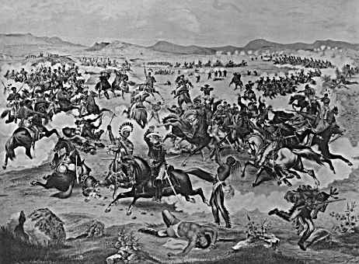
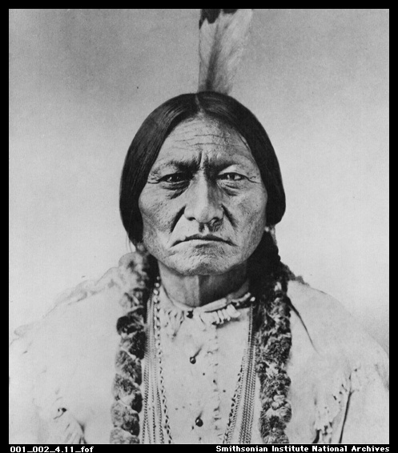
Native American Conflict Part I Focus Question: How did the pressures of westward expansion impact Native Americans?

Slide 6
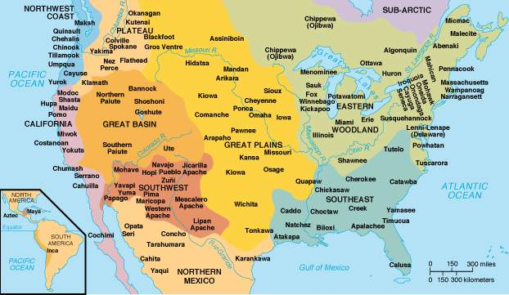
Native American tribes prior to 1492

Slide 7
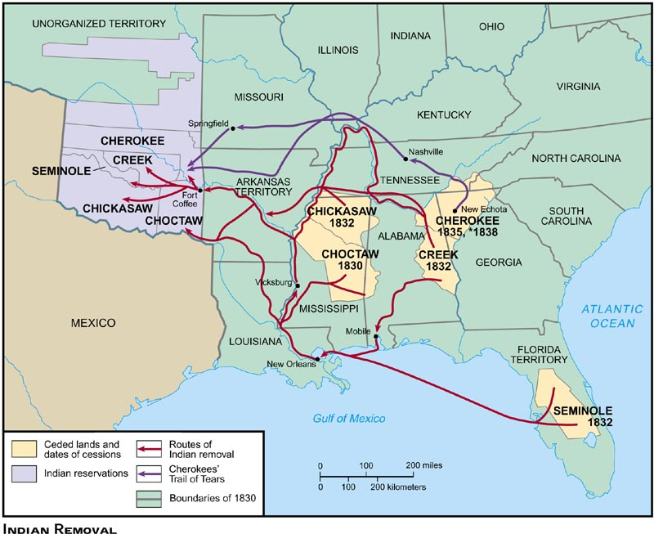
Native American Tribes Trail of Tears

Slide 8
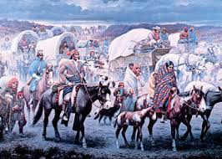

Slide 9
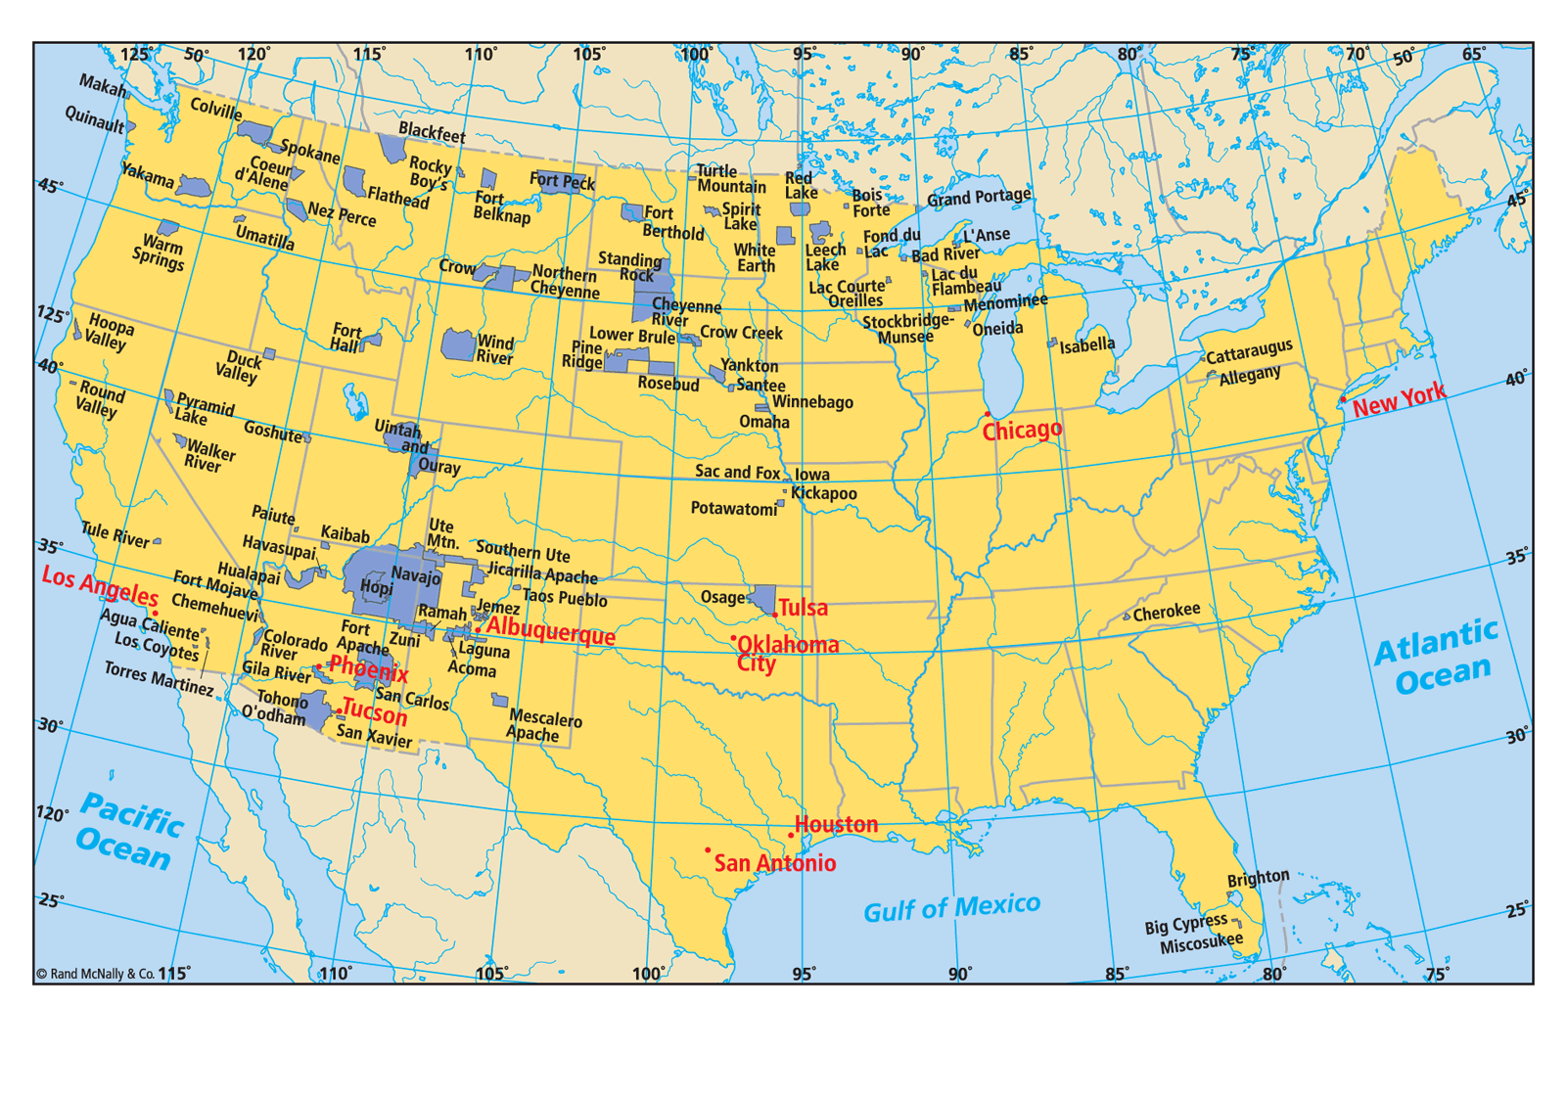
Native American Lands By 1900

Slide 10
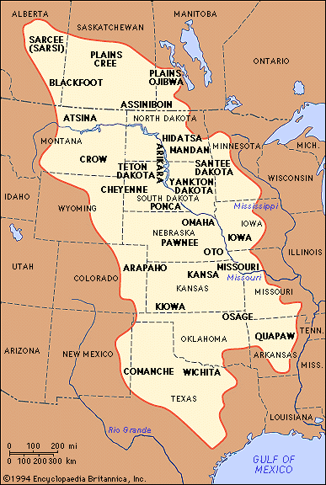
Native Americans
Plains Indians
Had Nomadic Lifestyle: moved often
Depended on Horse and Buffalo
Lived with extended families
Men-hunters/warriors
Women- cooked and prepared hides

Slide 11
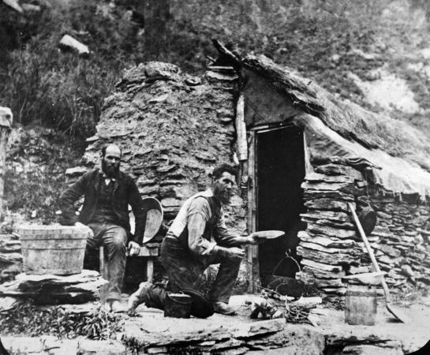
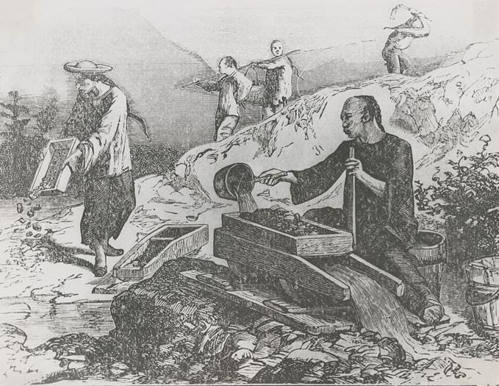
Settlers Push Westward
Reasons settlers moved west:
Cheap Land!
Railroad made it easier to get there

Slide 12
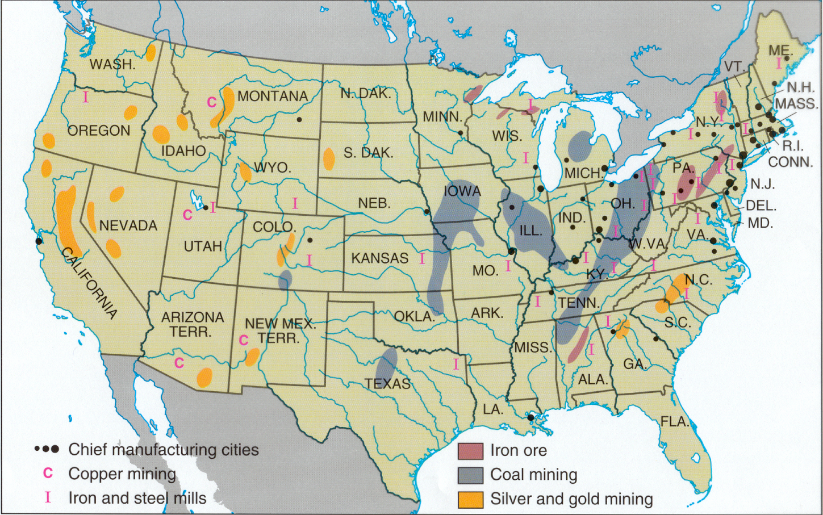

Slide 13
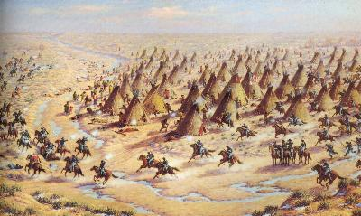
Dispersal of Native American’s
Government ignores promise to leave plains as Indian territory
Government forces treaties which push natives into reservations
Reservation: an area of land set aside where Native Americans are forced to live

Slide 14
Dispersal of Native Americans
Some Native Americans ignore treaties and continue to use land
Leads to additional violence between Indians and the U.S. Military
Why would Native Americans not like reservations? Why would the U.S. government put them there?

Slide 15
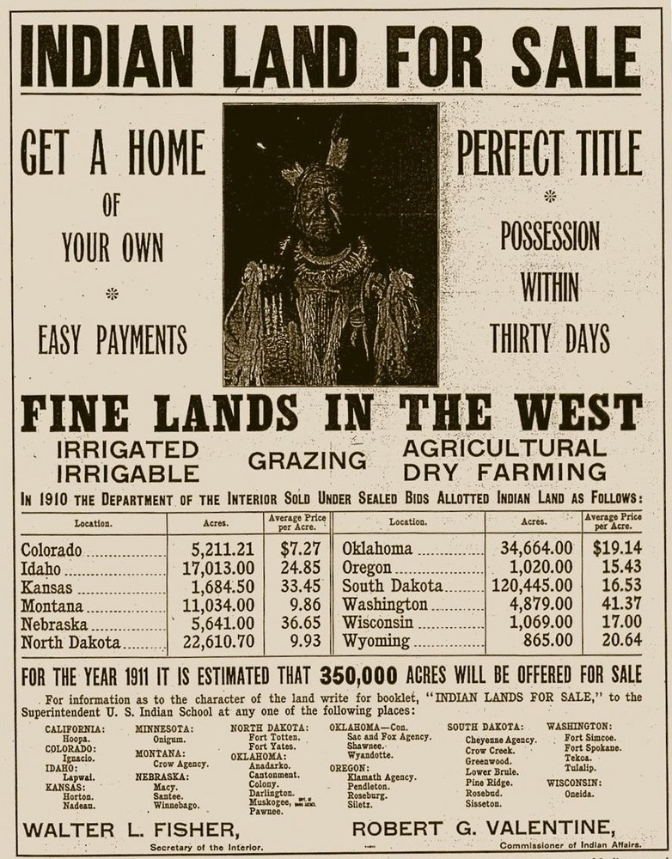
Based on the advertisement, what did the American government do with Indian land after forcing Indians to reservations?

Slide 16
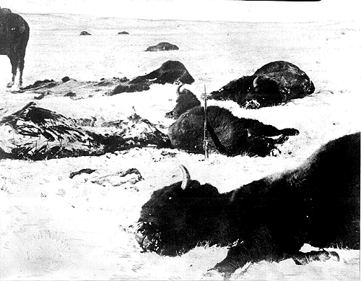
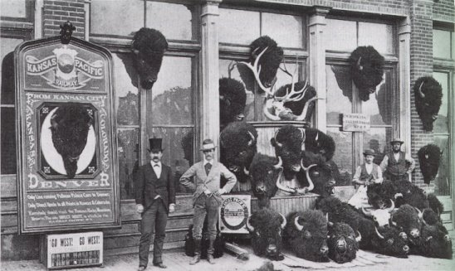
Destruction of the Buffalo: Video
Settlers hunted for sport, buffalo was very important to Native American culture (food, housing, clothing)
1800-65,000,000
1890-1,000
1900- one herd

Slide 17
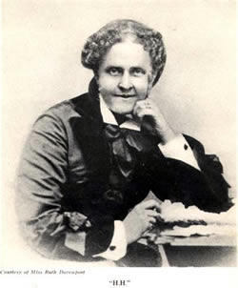
A Century Of Dishonor
Book Written by Helen Hunt Jackson
About: Describes broken promises and assaults on Native Americans
Important: drew attention to the fact that Native Americans have been mistreated by U.S. government for 100 years!

Slide 18
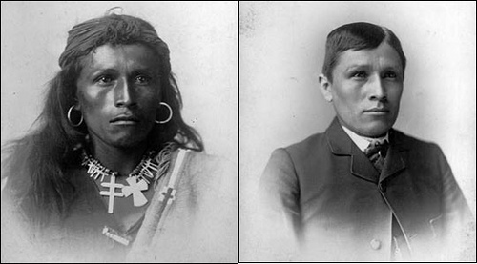
Assimilation
Assimilation
Abandoning your culture to be like the mainstream culture
Modern day examples of assimilation?

Slide 19
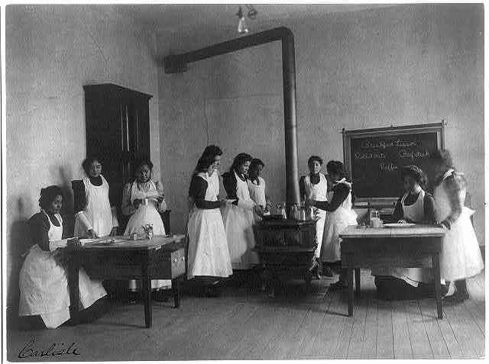
Examples of Assimilation:
-Boarding Schools
-New “American” names
-New hairstyles
-New Dress
-Christianity

Slide 20
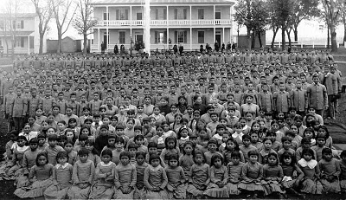
The Carlisle School

Slide 21
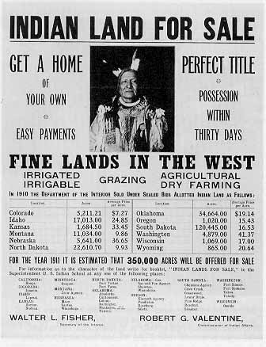
Dawes Act
Dawes Act aka Dawes Severalty Act (1887)
Attempt to “Americanize” Native Americans
Broke up Reservations
Gave land to individuals (80 acres) or families (160 acres)
Government would pay for farming equipment
Natives never see a dime

Slide 22
Native Americans
Prior to European arrival?
10,000,000
By 1890?
25,000

Slide 23
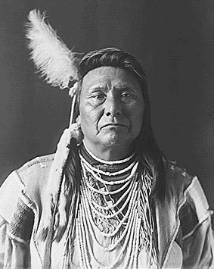
Do Now: Independently
Studying a Native American Leader: Chief Joseph
Read the Chief Joseph primary source & answer the questions on a separate sheet of paper.
*Please write in complete sentences
You must finish for HW if not finished in class today. An electronic version of the reading is on my website (AHII, Unit 1) if you need to access it again.

Slide 24
What would you have done if you were Chief Joseph?
Surrender
Keep Fighting
Any modern day comparisons?

Slide 25
On Your Poster:
NAME of your battle
When it happened?
Where?
Any key people involved?
1-2 details about your battle (can be bullet point)
Outcome (who won/why is it important?)
A picture

Slide 26
Do Now: Researching the Indian Wars
Use a red Americans textbook (pgs. 408-414) to find the details on your Indian Wars Chart.

Slide 27
Do Now
WHAT IS A PRIMARY SOURCE? SECONDARY SOURCE?
Section B #6 should read “How would you describe Chief Joseph’s personality?”
Studying a Native American Leader: Chief Joseph
Read Biography & Answer Questions
Then, read primary source quote on your paper and answer questions.
All answers should be in complete sentences on a sheet of notebook paper!

Slide 28
Native Americans Today: The Redskins Controversy
Present Day Controversy with the Washington Redskins
Reflection- Please write your response on a sheet of notebook paper. You will be turning it in, so make sure it doesn’t have anything else on it and make sure to write your name.
Is the Washington Redskins nickname racist?
Should the team change its name? Why or why not?

Slide 29
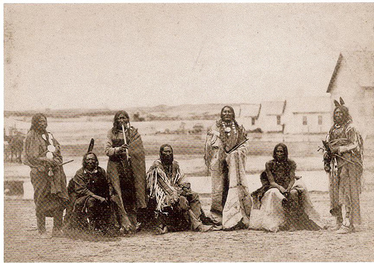
Native American Conflict
Sand Creek Massacre-1864
Cheyenne return to Sand Creek Reservation to prepare for winter
Massacred by militia
150 natives killed

Slide 30
Native American Conflict
1876-Custer’s Last Stand/
Battle of Little Big Horn
Sitting Bull and Crazy Horse
lead attack on Custer’s
regiment.
Kills Custer and all of his
soldiers in one hour

Slide 31
Native American Conflict
Death of Sitting Bull- 1890
25,000 Sioux hold a “Ghost Dance”
American Military Freaks out and call for the arrest of Sitting Bull
Sitting Bulls bodyguard (Catch-the-Bear) shoots one of the men.
In retaliation, the men shoot and kill Sitting Bull

Slide 32
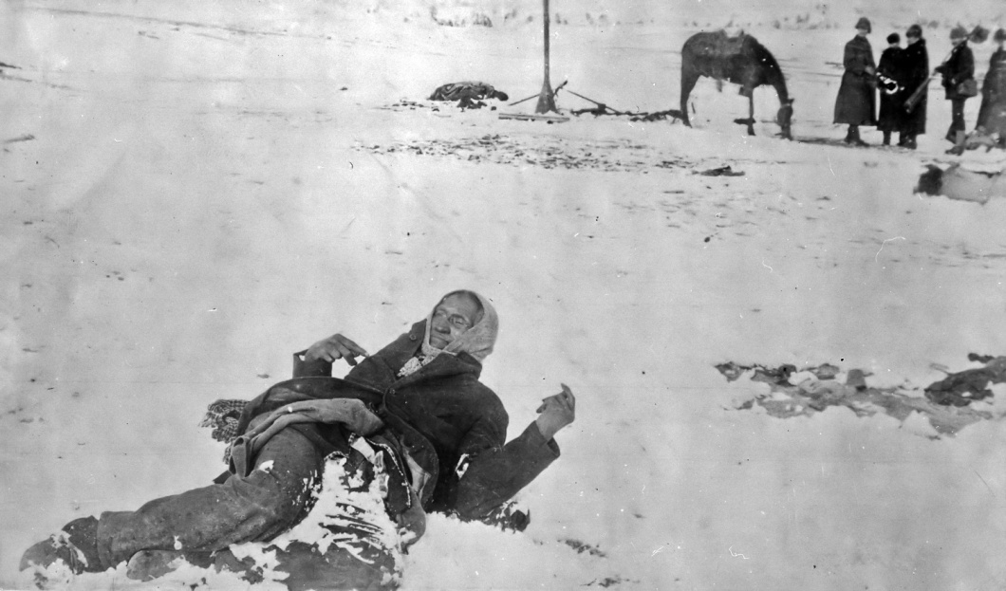
Native American Conflict Video Clip
Wounded Knee-1890
Sioux move after Sitting Bull dies
In 1890, the Seventh Cavalry (Custer’s old regiment) is sent in to transport starving and freezing Natives to a Reserve
Someone fires a shot causing the soldiers to open fire
300 mostly unarmed natives die
This marks the end of the Indian Wars
http://www.history.com/shows/america-the-story-of-us/videos/andrew-carnegie#the-last-of-the-sioux

Slide 33
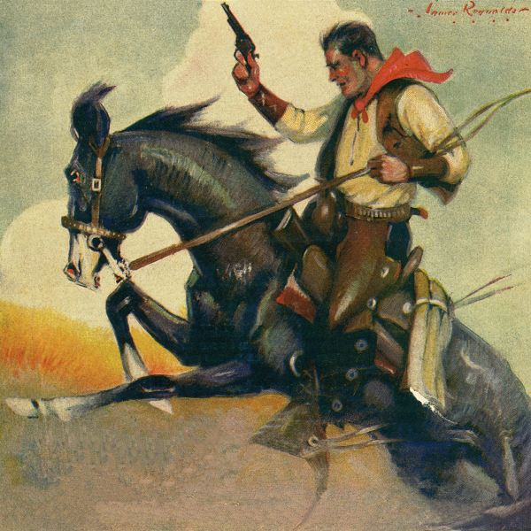
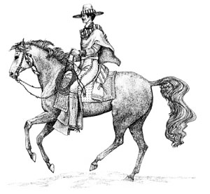
Cowboys
Buffalo = Cattle
Settlers learn to round up, brand, rope herds from Spanish wranglers in Mexico
Adopt clothing, food and vocabulary
Spurs, stirrups, Chaps, Jerky
Mustang, Bronco, Corral, Rodeo
25% African American
15% Mexican
Herded cattle to railroads and shipped around the country
Led to growing demand for beef
Open Ranging

Slide 34
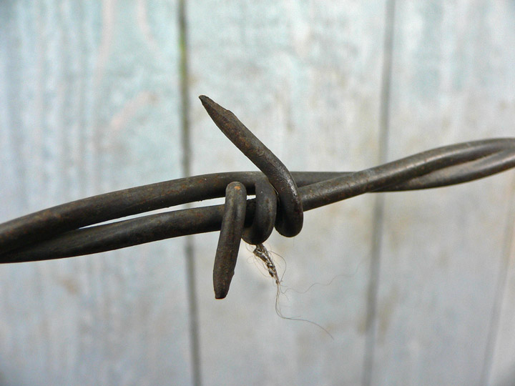
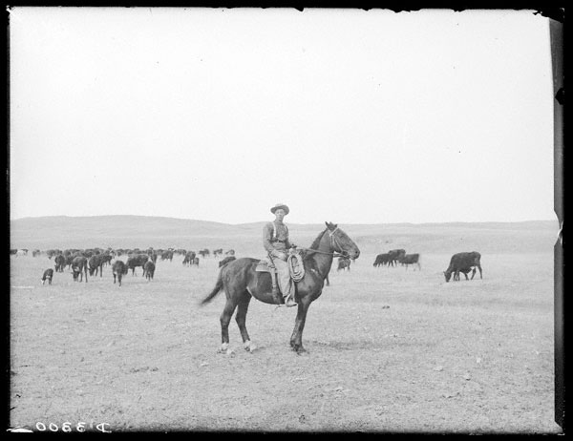
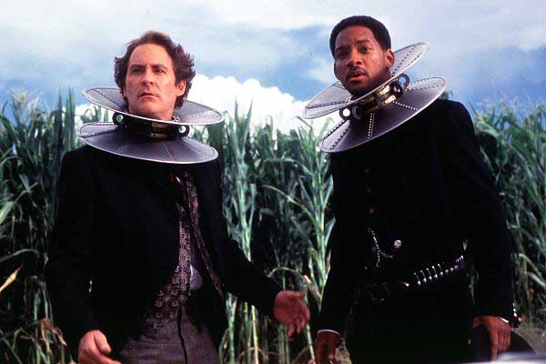
End of Open Range
Over Grazing
Bad Weather
Barbed Wire
Wild West comes to a close

Slide 35
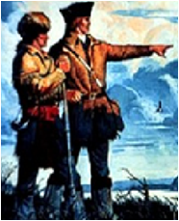
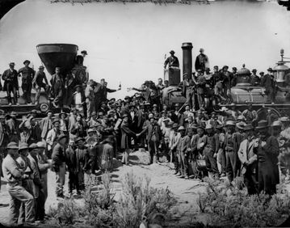
Railroads Open South
Lewis & Clark
The first Transcontinental Railroad-1869
Trip that once took 6 months now took 6 days
Jerks!
Chinese
Irish

Slide 36
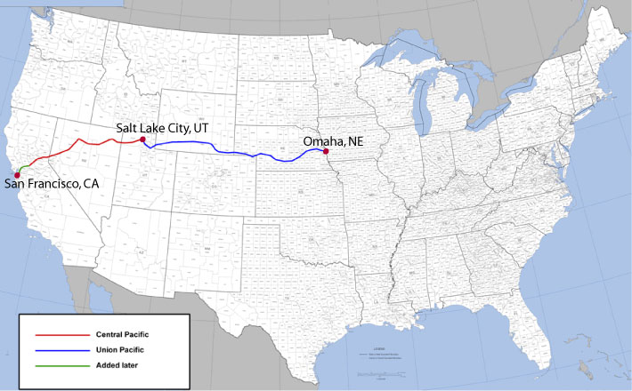
http://www.history.com/shows/america-the-story-of-us/videos/andrew-carnegie#transcontinental-railroad
1869

Slide 37
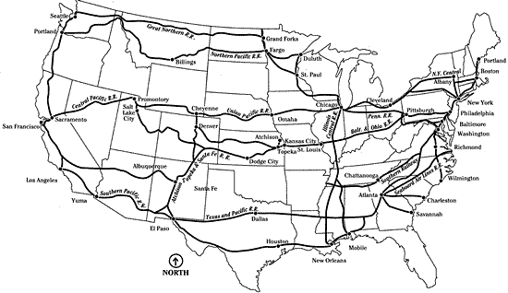
1900

Slide 38
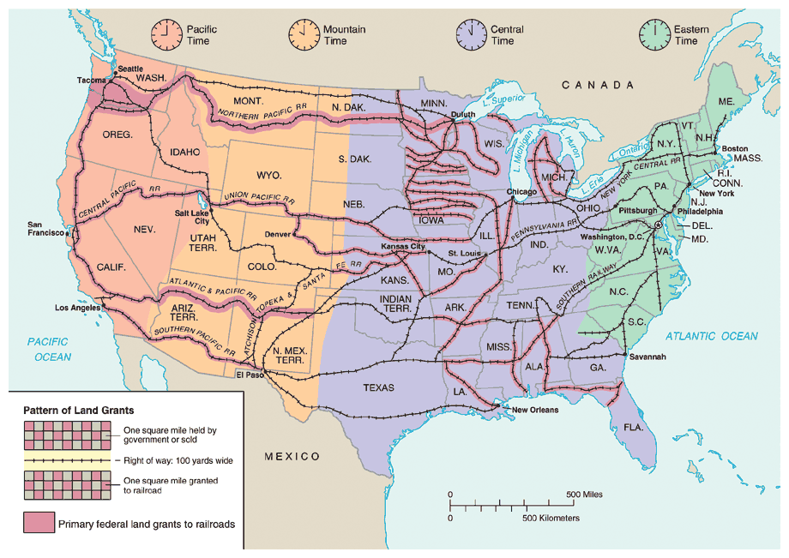

Slide 39
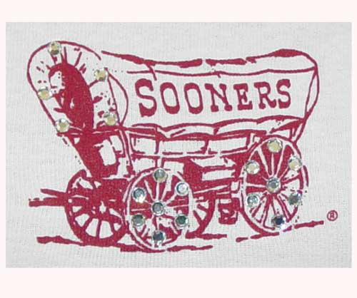
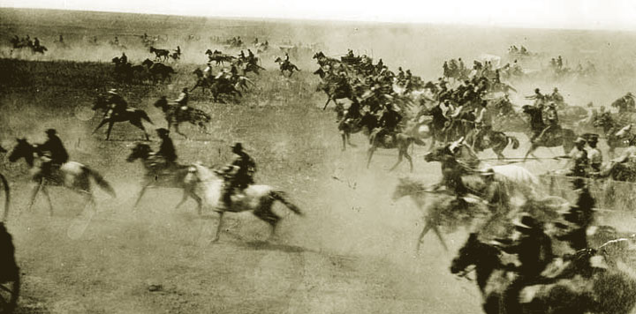
Government Supports Settlement
Homestead Act
160 free acres to any head of household
600,000 families took advantage
Several thousand were freed African Americans
Sooners
In 1889, government opens up remaining Oklahoma
2 million acres claimed in one day
Several settlers jumped the gun (Sooners)

Slide 40
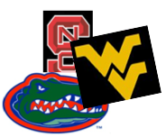
Agricultural Education
Morrill Land Grant Act
Federal Government provides funding for agricultural colleges
Attempt to encourage farming
Auburn - LSU
Arizona - Michigan State
Connecticut - Nebraska
Florida -Rutgers
Texas A&M -Tennessee
Hawaii -NC State
Purdue -NC A&T
Iowa State -Ohio State
Kansas State -Oregon State
- Clemson -West Virginia

Slide 41
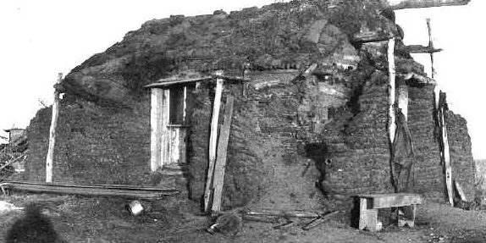
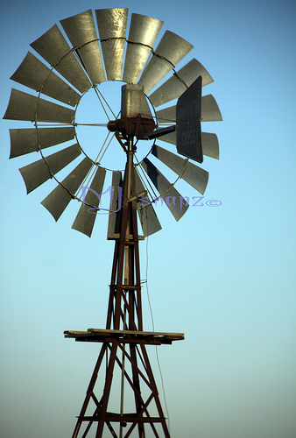
Life on the Frontier
Soddies
Due to lack of wood, houses were
built out of sod
Warm in winter, cool in summer
Women
Women forced to work beside the men in order to make ends meet
Led to women gaining political rights sooner in West
Technology
Riding Steel Plows
McCormick Reaper
Windmills- Bring up water from underground

Slide 42
With your partner:
Cowboys: Write a letter to a family member back home.
-Tell about your experiences (good/bad)
-Describe why you made the move west
-Provide FIVE specific events/vocab words which help describe your experience
-Make up a unique name for your character
Each group will be assigned the role of either a Cowboy or an Indian. With your group, construct a creative letter on construction paper
Indians: Write a letter to a U.S. Govt’ Official
-Tell about how your people are being treated
-Describe at least one of the Native American confrontations mentioned in your notes
-Provide FIVE specific events/vocab words which help describe your situation
-Make up a unique name for your character

Slide 43
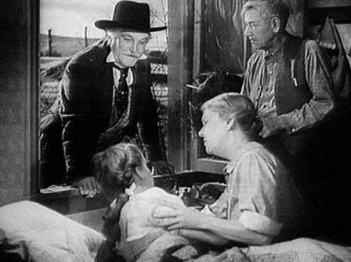
Farmers in Debt
I wonder if she’ll still be this happy when we tell her that Toto was crushed by a flying cow in the storm
Expensive Machinery and need for additional land forced farmers to take out loans
When wheat prices fell, farmers bought more land to make up for difference
Huge farms known as Bonanza Farms
Prices continue to fall
Leads to a semi-depression

