Slide 1
Bellringer August 29th
Recap Questions: Look back over your notes from the past few days to answer the following questions. You should write the question and your answer. For any that you don’t know- you should write down the question at least.
1. What did Helen Hunt Jackson advocate in her book, a Century of Dishonor? (In other words, what was her book about)?
2. What contributed to the population growth in the western part of the country?
3. How did frontier life affect attitudes about social class? Womens Rights?
4. What acts or policies were created by the US government to encourage Western Settlement?
5. Who gave the speech “I will fight no more forever”?
6. How did the invention of the steel plow, mechanical reaper and the windmill change the environment?

Slide 2
Date | Topic | Page
8/29 | Indian Wars Chart | 7

Slide 3
Indian Wars Activity: Pairs or Individual
Create an Illustrated Timeline with details about each of the four wars we studied today. Timeline should be in chronological order, should include a description of what happened, the date and a picture that helps show why that war is unique from all other wars
Then:
Write 5 Test Questions (must be either Short Answer or Multiple Choice about the Indian Wars that I could use on your Unit 1 Test)

Slide 4
American History II Friday August 29th 2014
Essential Question: Why do Native Americans and white settlers (as well as the U.S. government) clash in the late 1800s? How do these clashes end?
Objectives:
Identify key distinguishing features of four Indian Wars and explain the significance of each.
Create a song/poem or Illustrated Timeline with information on Indian Wars
Agenda
-Bellringer
-PowerPoint Notes: Indian Wars
-Video Clips: Indian Wars
-Your Choice: Song/Poem or Illustrated Timeline about Indian Wars
-Wrap Up

Slide 5
First Period Groups
Afomya, Rachel, Chris, KT
Emma B, Zoe, Amy, Addy
Mohamed, Maddison C Nick T, Julian
Esther, Gabriel, Thomas, Angel, Anna
Nicole, Sam D, Stevie, Anton
Claire, Mariya G, Catherine, Madeline
Maria H, Sara, Mary, Katie
Imani, Eloise, Emma Grace, Cole
Heather, Karsyn, Sam L, Jack

Slide 6
Bellringer Tuesday September 2nd
No bellringer today. Please get back with the group you were working with on Friday. Takeout your Indian Wars Chart. Send one person from your group up to get a textbook and the folder for whichever war your group did not finish.
Take 10 minutes to add the details for your final war to the chart!

Slide 7
Bell ringer Thursday August 31st (Turn in your HW to your period’s tray, then:
Test Question Practice! Write the letter of your answer in the bell ringer section of your notebook. You do not need to write the question
“We were like deer. They were like grizzly bears. We had a small country. Their country was larger. We were contented to let things remain as the Great Spirit Chief made them. They were not, and would change rivers and mountains if they did not suit them.” Which BEST explains Chief Joseph’s meaning?
A. The US troops had overpowered and defeated his people
B. His people would never willingly become part of the US
C. He’s asking US troops to permit the Nez Perce to emigrate to Canada
D. He was explaining the reason for his alliance with Geronimo and the Apache

Slide 8
Question 2
. The experiences of Chief Joseph and the Nez Perce illustrate how____
A. The US government allowed some Native Americans to keep their homelands
B. Christian missionaries converted Native Americans
C. Violent conflicts arose among settlers, the federal government, and the Native Americans
D. Most Native Americans moved peacefully onto reservations

Slide 9
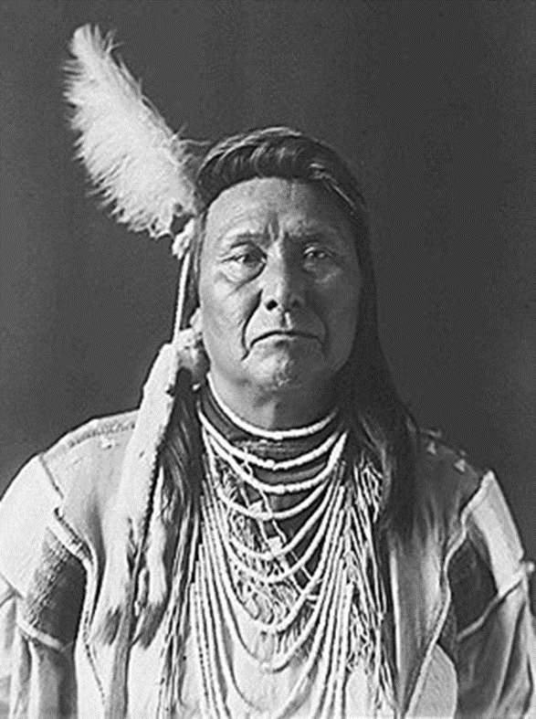
What would you have done if you were Chief Joseph?
Surrender
Keep Fighting
Any modern day comparisons?

Slide 10
Native American Conflict Part II
Focus Question: How did westward expansion impact Native Americans?

Slide 11
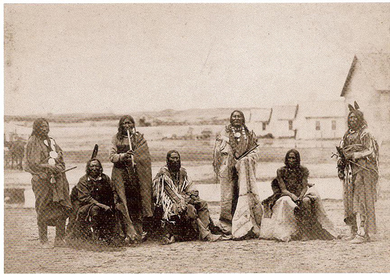
Sand Creek Massacre
1864/Colorado
Details: Cheyenne return to Sand Creek Reservation to prepare for winter.
The Natives assume they are under protection of the militia and they return to their reservation for winter
Army commander General S. Curtis sends telegram to militia that read “I want no peace until the Indians suffer more”
Massacred by U.S. militia
Outcome: 150 natives killed– mostly women and children
Significance: First of the major wars between U.S. army and Native Americans

Slide 12
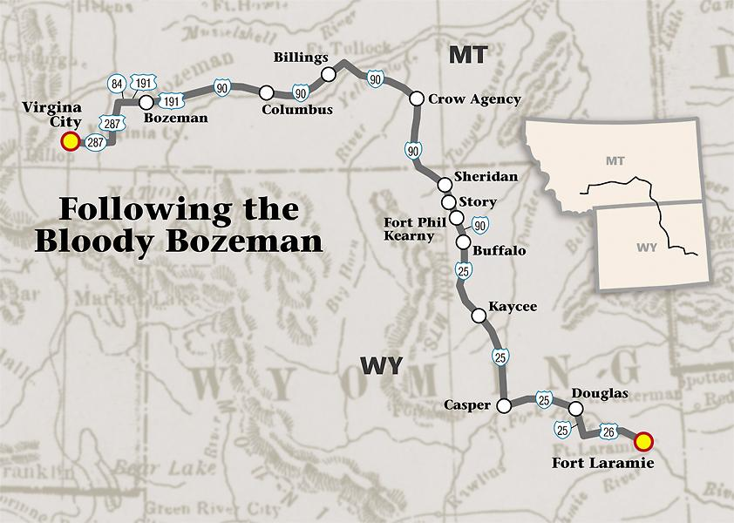
Fetterman Massacre/Treaty of Fort Laramie
1866/Wyoming
Details: Sioux chief, Red Cloud unsuccessfully appealed to the government to end white settlement on the Bozeman Trail.
Crazy Horse ambushed William J. Fetterman & his white soldiers at Lodge Trail Ridge
Treaty of Fort Laramie: Sioux agreed to live on a reservation along the Missouri river (This was forced on them, they had no choice– their leader Sitting Bull never signed it).
Outcome: Over 80 white soldiers were killed. Treaty of Fort Laramie attempted to stop the fighting, but failed--- many say Treaty of Fort Laramie tricked Native Americans.
Significance: Treaty of Fort Laramie is yet another example of the U.S. government not keeping promises

Slide 13
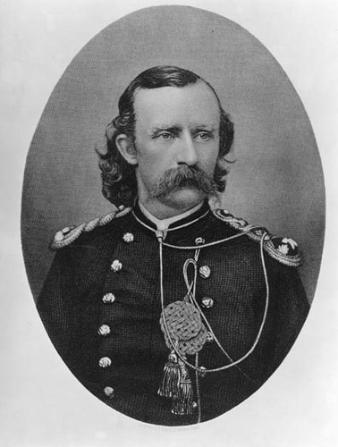
Battle of Little Big Horn
1876
Montana
Sioux and Cheyenne had a sun dance, during which Sitting Bull had a vision of soldiers and some Native Americans falling from their horses.
When Colonel Custer and his troops reached Little Bighorn River, Native Americans were ready for them.
Led by Crazy Horse and Sitting Bull- Natives outflanked and crushed Custer’s troops. Within an hour, Custer and all of the men of the seventh Calvary were dead.
Outcome: Despite early wins, by 1876, Sioux were beaten. Sitting Bull forced to surrender.
Significance: Shows that even though the Native Americans were able to defeat key military Colonel (Custer), the American army still prevailed in the end. *One of the only times the Native Americans were on “offense”

Slide 14
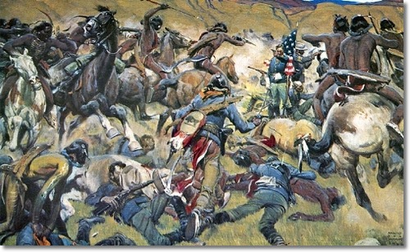
Wounded Knee Massacre
1890
South Dakota
Natives doing Ghost Dance- ritual to return Native America lands/connect with their dead– made U.S. government nervous.
U.S. 7th Calvary rounded up 350 starving and freezing Sioux and took them to a camp at Wounded Knee Creek in South Dakota.
Next day, soldiers demanded the Natives give up all of their weapons.
A shot was fired (unsure which side), and then white soldiers opened fire with a deadly cannon.
Outcome: Within minutes, Seventh Calvary killed 300 mostly unarmed Native Americans including several children. Soldiers left corpses to free in the ground.
Significance: Brought the Indian Wars to an end, this is the last of the Indian Wars.

Slide 15
Video Clips
Into the West
Crash Course: Western Expansion

Slide 16
Memorial “Quilt”
Each table is responsible for creating a memorial quilt for your assigned Indian Battle. Imagine the quilt will hang in a Native American History Museum. Each person at your table should create one “square” of the quilt. No two squares should be the same- so you must communicate with each other regarding what to draw. One square of the quilt must be devoted to a memorial poem. Each of the other squares must have an illustration AND a caption or a quote.
Quilts should showcase what makes YOUR battle unique or significant. Quilts should reflect what you learned today about your battle and should also honor those who lost their lives.

Slide 17
With your partner:
Cowboys: Write a letter to a family member back home.
-Tell about your experiences (good/bad)
-Describe why you made the move west
-Provide FIVE specific events/vocab words which help describe your experience
-Make up a unique name for your character
Each group will be assigned the role of either a Cowboy or an Indian. With your group, construct a creative letter.
Indians: Write a letter to a U.S. Govt’ Official
-Tell about how your people are being treated
-Describe at least one of the Native American confrontations mentioned in your notes
-Provide FIVE specific events/vocab words which help describe your situation
-Make up a unique name for your character

Slide 18
Sand Creek Massacre
1864/Colorado
Details: Cheyenne return to Sand Creek Reservation to prepare for winter.
The Natives assume they are under protection of the militia and they return to their reservation for winter
Army commander General S. Curtis sends telegram to militia that read “I want no peace until the Indians suffer more”
Massacred by U.S. militia
Outcome: 150 natives killed– mostly women and children
Significance: First of the major wars between U.S. army and Native Americans
Video

Slide 19
Fetterman Massacre/Treaty of Fort Laramie
1866/Wyoming
Details: Sioux chief, Red Cloud unsuccessfully appealed to the government to end white settlement on the Bozeman Trail.
Crazy Horse ambushed William J. Fetterman & his white soldiers at Lodge Trail Ridge
Treaty of Fort Laramie: Sioux agreed to live on a reservation along the Missouri river (This was forced on them, they had no choice– their leader Sitting Bull never signed it).
Outcome: Over 80 white soldiers were killed. Treaty of Fort Laramie attempted to stop the fighting, but failed--- many say Treaty of Fort Laramie tricked Native Americans.
Significance: Treaty of Fort Laramie is yet another example of the U.S. government not keeping promises

Slide 20
Battle of Little Big Horn
1876
Montana
Sioux and Cheyenne had a sun dance, during which Sitting Bull had a vision of soldiers and some Native Americans falling from their horses.
When Colonel Custer and his troops reached Little Bighorn River, Native Americans were ready for them.
Led by Crazy Horse and Sitting Bull- Natives outflanked and crushed Custer’s troops. Within an hour, Custer and all of the men of the seventh Calvary were dead.
Outcome: Despite early wins, by 1876, Sioux were beaten. Sitting Bull forced to surrender.
Significance: Shows that even though the Native Americans were able to defeat key military Colonel (Custer), the American army still prevailed in the end.

Slide 21
Wounded Knee Massacre
1890
South Dakota
Natives doing Ghost Dance- ritual to return Native America lands/connect with their dead– made U.S. government nervous.
U.S. 7th Calvary rounded up 350 starving and freezing Sioux and took them to a camp at Wounded Knee Creek in South Dakota.
Next day, soldiers demanded the Natives give up all of their weapons.
A shot was fired (unsure which side), and then white soldiers opened fire with a deadly cannon.
Outcome: Within minutes, Seventh Calvary killed 300 mostly unarmed Native Americans including several children. Soldiers left corpses to free in the ground.
Significance: Brought the Indian Wars to an end, this is the last of the Indian Wars.

Slide 22
Indian Wars Menu Activity
Detailed instructions are on the back of today’s notes
Everyone must do same “appetizer” (creating 5 test questions about Indian Wars)
Then, you have a choice for which “main course” you would like to do (Either Illustrated Timeline or Song/Poem)
Make sure you are following the directions carefully and including detail.
Take your time and make it nice!
If you finish early- work on your Unit 1 Study Guide!

