Slide 1
Native American Assimilation Photos

Slide 2
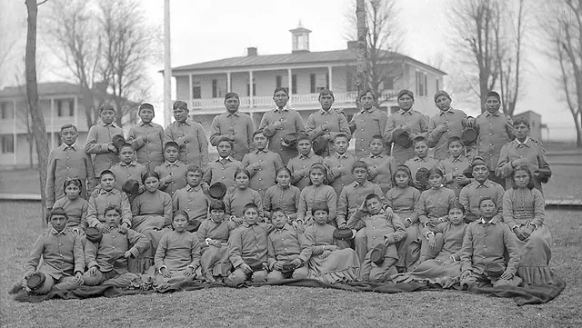
Photo Number 1

Slide 3
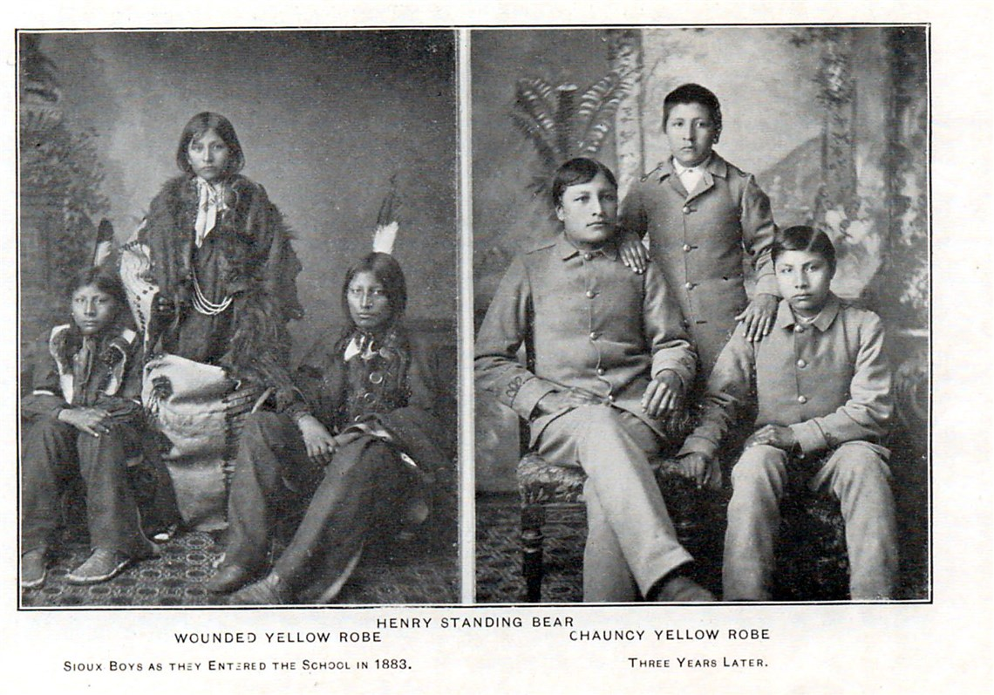
Photo Number 2

Slide 4
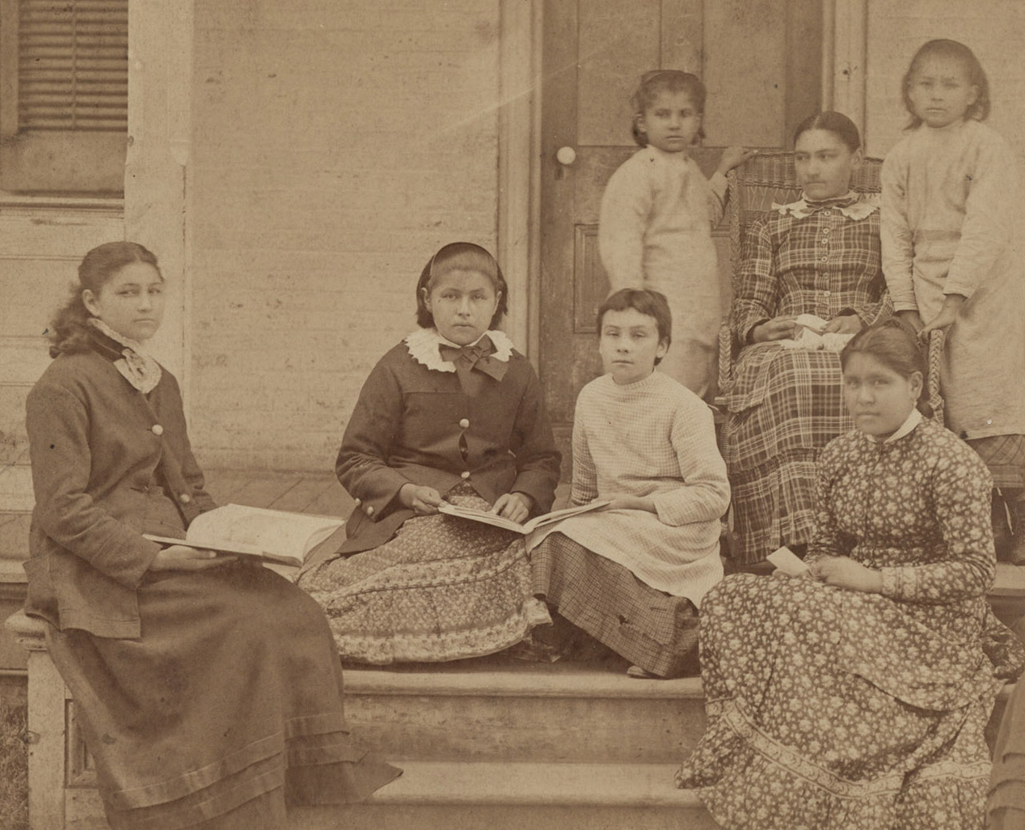
Photo Number 3

Slide 5
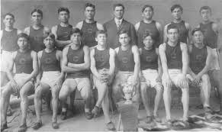
Photo Number 4

Slide 6
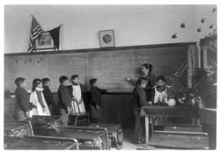
Photo Number 6

Slide 7
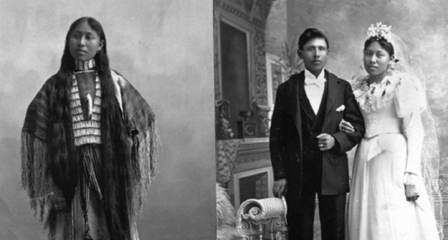
Photo Number 7

Slide 8
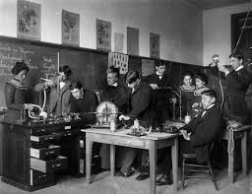
Photo Number 8

Slide 9
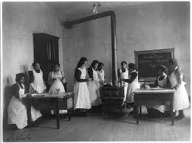
Photo Number 9

Slide 10
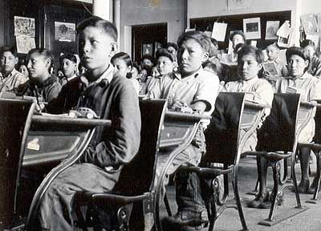
Photo Number 10

