Slide 1
Photo Story Directions
Look through the photos and select one you would like to use for your photo story. Write a first person narrative (story) based upon the photo you have selected from my this powerpoint. Each story must fill one entire page and include the criteria below:
Give a caption (title) to your picture that summarizes the overall mood or main idea of the picture. Don’t forget to label the picture with the appropriate letter (“I chose Picture C and I titled it ___”)
Select one person in your picture and write a first person story about their life up to this point and how it was changed by the depression. If your photo has more than one person in the picture, you can select any person to “tell” the story that you’d like. Remember the person you choose might change your story (ex: the person at the back of the breadline might have a different story than the person at the front of the line). Be detailed in your discussion of the challenges you have faced as a result of the depression (use answers you came up with in today’s reading section or emotions you felt while participating in our in class family budget simulation to keep your story accurate).
Include at least 6 vocabulary words (in bold) from the list below in your response.
Dust Bowl
Okies
Hoovervilles
Hoover Blankets
Direct Relief
Shantytowns
Breadlines
Soup Kitchens
Black Tuesday
Great Depression
Speculation
Overproduction
Easy Credit
Herbert Hoover
Economic Inequality
In your story, also include ways you think your life could be made easier and whose job it is to make things better. In other words, what do you think should be done to help end the Great Depression?
Final Note: Remember, this is a fictional story, so be creative and have some fun with it. However it must be detailed and include historically accurate information!
Details: Your Photo Story should be written (or typed) on a separate sheet of paper. Photo Story is due at the start of class on Friday 3/23.

Slide 2
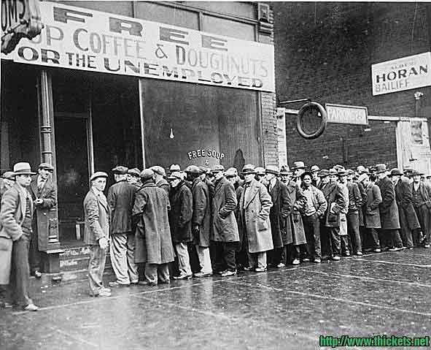
Picture A

Slide 3
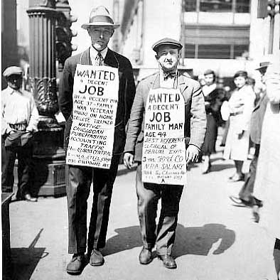
Picture B

Slide 4
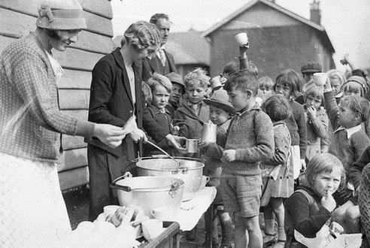
Picture C

Slide 5
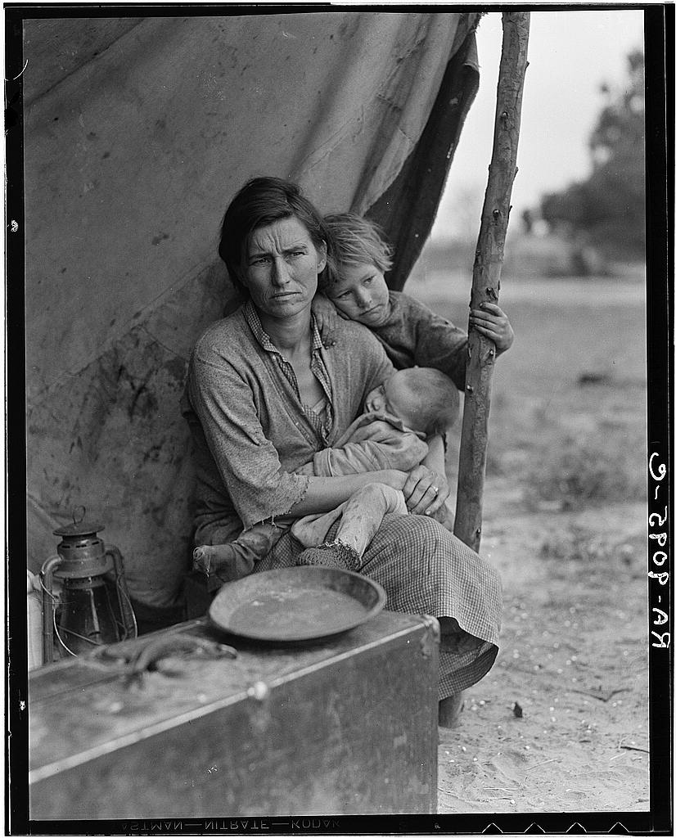
Picture D

Slide 6
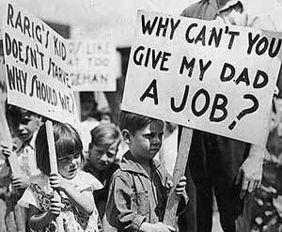
Picture E

Slide 7
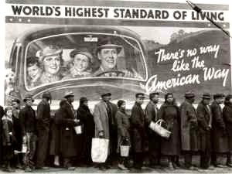
Picture F

Slide 8
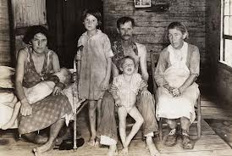
Picture G

