Slide 1
Warm-up: March 19, 2013
Directions: Please finish/start the assignment from yesterday. If you are already finished, please work quietly on your vocabulary.
Answer the following questions in complete sentences:
Write a sentence about how school protects students.
Give two examples of what might happen if school did not have an administration and rules.
Recall the Triangle Shirtwaist Factory fire. Write a paragraph about what happened, explain how the government could have prevented the fire, and list some rules that they could have put in place.

Slide 2
Monday October 14th
Sit in your test day seat (no we aren’t testing I just haven’t figured out how I want to do our next seating arrangement ☺ )
Update your Table of Contents
I know you are one row short on your TOC, just add a row to have it all fit and tomorrow I’ll get you a new TOC

Slide 3
E/I Monday October 14th
Purple Group (grade of 93 or higher on Unit 4 test)
Teal Group (Grade of 92 or lower on Unit 4 Test)
Creating and playing Taboo Game
Review: Wild West Crossword Puzzle with partner
Smartboard Match as a class

Slide 4
Bell ringer Monday Sept. 25th
***Find your new seat by looking at the seating chart on the board**
Think back to our last unit & Make a list of problems from the Gilded age.
Write as MANY problems as you can remember.

Slide 5
What do we already know….
Government
Working Conditions
Urbanization
Big Business
Social Rights

Slide 6
Reminders/Announcements
Unit 3 outline is on my website- keep up with reading!
We selected characters for our Unit 3 FORMAL project (Speed Dating) last week– please see me after class if you did not select a character. You should be working on this at home (Due 10/4)
Unit 2 Test is Thursday 9/28, study guide & EC due at the start of class in hard copy form
3rd period only: If your parents are OPTING OUT of the Bullying/Harassment lesson, I need that opt out slip by the start of class tomorrow (9/26).

Slide 7
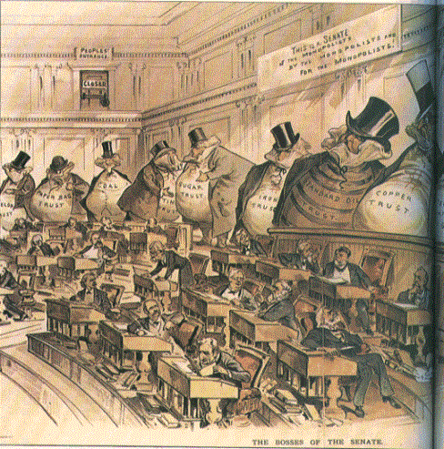
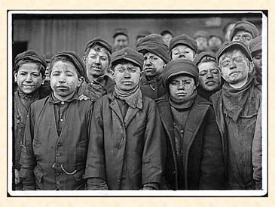
The Progressive Era
1900-1920
How did the political, economic and social conditions of the Gilded Age lead to the Progressive Era?

Slide 8
Introduction to the Progressive Era (1900-1920)
What does PROGRESS mean? Any guess what types of progress we will see in the Progressive Era?
Video Clip

Slide 9
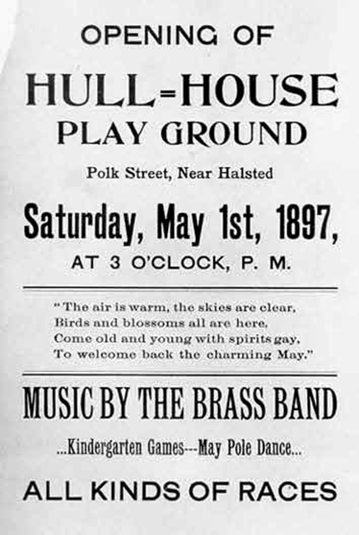
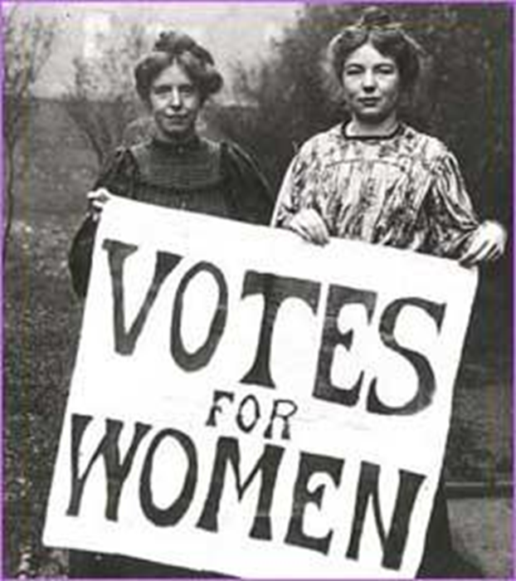
Progressivism
Aimed to return control of the government to the people, restore economic opportunities, and correct injustices in American life Goal= to fix the problems of the Gilded Age
Lasts from approximately 1900-1920 (Presidents: Teddy Roosevelt, William Howard Taft & Woodrow Wilson)

Slide 10
Goals of the Progressive Era
Protecting Social Welfare
Promoting Moral Improvement
Creating Economic Reform
Reforming Local & State Government

Slide 11
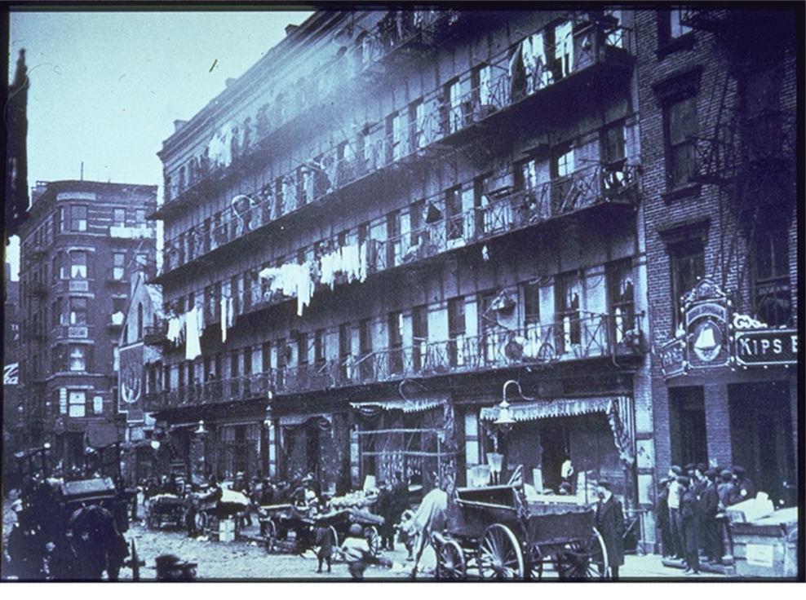
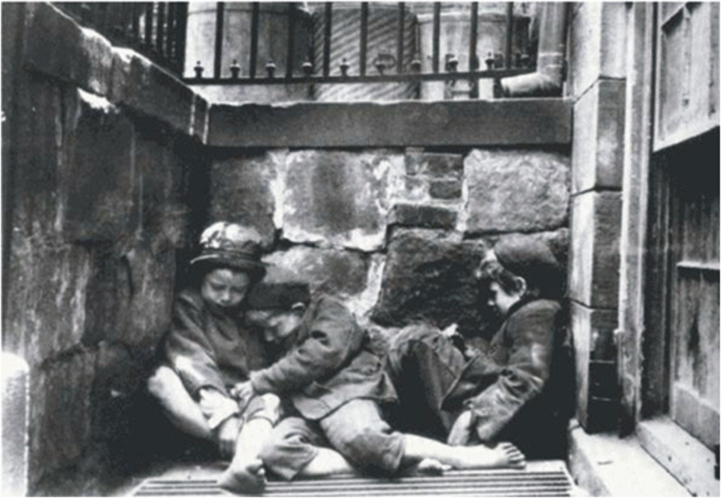
Origins of the Movement?
“Discovery” of Poverty– Jacob Riis takes photos that show how bad it really is

Slide 12
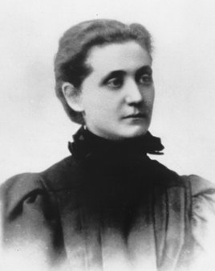
Origins of the Movement?
Jane Addams starts the Social Gospel Movement (a reform movement based on the belief that Christians have a responsibility to help improve working conditions and alleviate poverty)

Slide 13
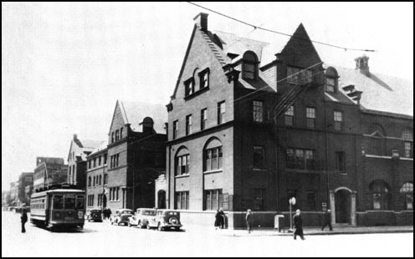
Origins of the Movement?
Settlement Houses created to help immigrants and poor people in cities
Community Center providing assistance to residents-particularly immigrants- in a slum neighborhood
Hull House in Chicago is a famous example
BY 1910, there are around 400 settlement houses in various cities
Video

Slide 14
Protecting Social Welfare
Attempt to soften harsh conditions of Industrialism
Returning Power to the People

Slide 15
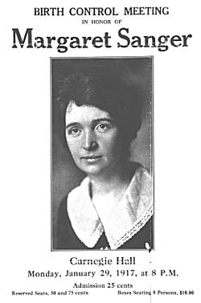
Social Reform: Key People
Florence Kelly: fought for better working conditions for children and women
YMCA & Salvation Army created
Established soup kitchens & recreational facilities
Margaret Sanger: fought for women to have access to birth control for family planning

Slide 16
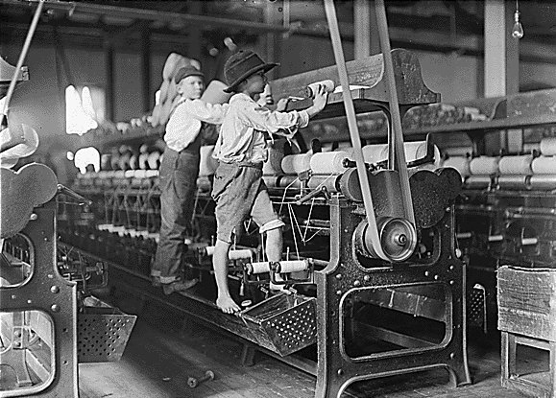
Protecting Social Welfare: Reforms
Keating-Owen Act
1916 ban goods produced by child labor
Muller v. Oregon
limited women to a 10 hour workday

Slide 17
Promoting Moral Improvement
Good Morals =
Good Life
Returning Power to the People

Slide 18
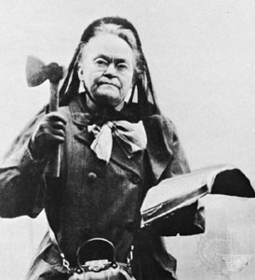
Moral Reform: Key People
Women’s Christian Temperance Union
- largest women’s group is U.S. history
- 245,00 members by 1911
Founded by Frances Willard

Slide 19
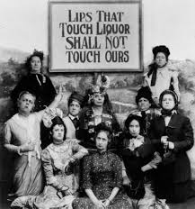

Slide 20
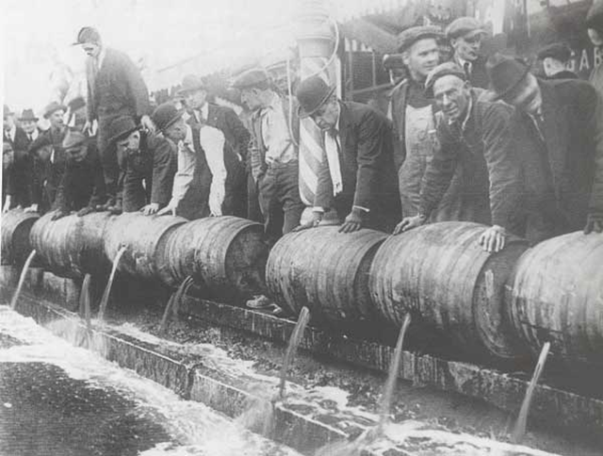
Promoting morals: reforms
18th Amendment: prohibits the sale, manufacture and consumption of alcohol
Anti-Saloon League: felt alcohol was undermining American morals and ruining families. Fought to close saloons (bars)

Slide 21
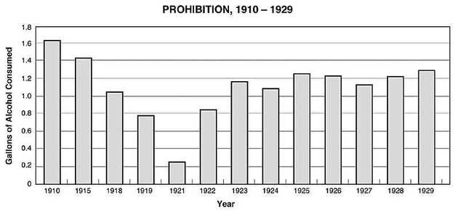

Slide 22
Creating Economic Reform
Separating Business and Politics
Narrowing Gap Between Upper and Lower Class
Returning Power to the People

Slide 23
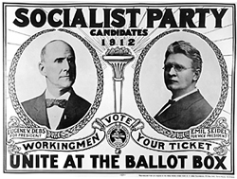
Economic Reform: Key People
Eugene Debs- founded the Socialist Party
Believed that the means of production should be owned or regulated by the community as a whole.
“Share the wealth”

Slide 24
Economic Reforms
Clayton Anti Trust Act: Strengthened the Sherman Anti-Trust Act, Made it more difficult to have a monopoly
Federal Trade Commission: Government begins to monitor business practices such as false advertising
Increased Regulation of business
Increased Protections for Workers
How is this different from the Gilded Age?

Slide 25
Reforming Local Government
Giving Power Back to the People
Holding Officials Accountable
Returning Power to the People

Slide 26
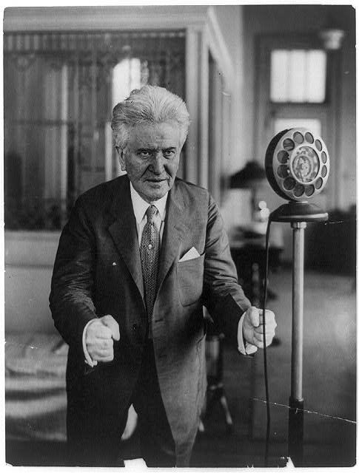
Political Reform: Key People
Wisconsin Gov. Robert M. La Follette
Fighting Bob”
3 term governor
Goal: drive corporations out of politics
Main target: railroads

Slide 27
Political Reforms
What do all three of these reforms have in common?
Initiative
a ballot bill by the people instead of lawmakers
Referendum
a vote on the initiative
Recall
public officials face another election before the end of their term

Slide 28
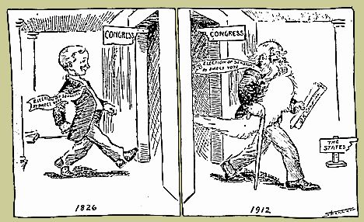
17th Amendment
- 1913
- Direct Election of Senators
Cities begin to hire city managers to take power away from corrupt mayors
Returning Power to the People

Slide 29
Answer the final thought Question on the bottom of today’s notes
Out of the four areas of reform, which do YOU think was most important/pressing in the Progressive Era? (Political, Moral, Social or Economic) Why?

Slide 30
Where would you put your $$??
Complete the “hook” exercise with your elbow partner. Only one of you needs to write.
Be ready to explain your justification to the class!

Slide 31
Where would you put your $$?
Read the document you have been assigned (A,B,C or D).
The first time, just read it silently without annotating.
The second time, read it again and annotate– key points, paraphrase, etc. and answer the questions on your handout!

Slide 32
Where would you put your $$
Get together with everyone who read your same document (A’s together, B’s Together,etc)
As a group- First, check answers to the questions on your handout. Then, decide why YOUR area of concern is the most important of the progressive era. Why should someone give a million dollars to your cause over the other causes? Make this argument persuasive and draw from the documents. Be sure each person in the group can articulate this argument.

Slide 33
Where would you put your $$?
Now we will form groups of 4 with 1 person representing each “area” or document.
Take turns sharing a brief summary of your document.
Next take turns sharing your argument– why is your topic the most important.
As a group you must come to a unanimous consensus– which of the four topics is most important and why does it get the money?

Slide 34
So where would we put our $1 million?

Slide 35
Progressive Era Collage Time!
Your Task: Create a collage using pictures (and words) to represent the four goals of the progressive Era- 1) Moral Reform 2) Social Reform 3) Economic Reform and 4) Government Reform. Your pictures may come from a magazine or they may be hand-drawn. Must include label for four areas of reform and at least 4 pictures for each area. Pictures shouldn’t be too similar and must relate specifically to topics in today’s notes. Don’t forget a creative title! The idea is that a person walking by should be able to glance at your collage and get an idea of the types of reform Progressives wanted. **You may also do an electronic version– see your assignment handout for specifics on this.
Warning: Don’t rush on this! Due Tuesday 2/21 at the start of class Tip: Use your notes from today to get ideas for goals of the Progressive Era that might inspire pictures!

Slide 36
Collage groups & your assigned part S= Social, E = Economic, M= Moral, P= Political
Killian (S), Velaria (E), Colby (M), Spencer (P)
Cameron (S), Matthew (E), Ursula (M), Shaccori (P)
Kiim (S), Yesult (E), Alan (M), Ayila (P)
Michelle (S), Elsa (E), Charlie (M), Lucy (P)
Sarah (S), Nathan (E), Nikole (M), Jackson (P)
Lily (S), Marco (E), Jadon (M), Grace (P)
Izzy (S), Michael (E), Jose (M), Caitlin (P)

Slide 38
Don’t forget Progressive Collage due Tuesday @ start of class Progress Reports
Get them signed by a parent or guardian and return them by the end of the week!
Missing Homework or Classwork? You may still turn it in for a grade of 50% up until 2 weeks before the end of the quarter.
Fail the Unit 1 Test? Remember you have until TOMORROW to complete the optional assignment to raise your grade to a 70.
Think something’s wrong? Write me a note with your name and the issue and I will look in to it.
Want a higher grade? Tutoring on Tuesdays, Extra Credit, Use the outline to keep up with assignments!

Slide 39
PSA Project
Goals for today:
Begin researching your topic. Remember to stick within the years of 1890-1920. Your book (Chapters 16 and 17) is a good place to start in addition to researching online
Start designing your storyboard. This should show at least six frames (Scenes) for your movie. This needs to be reviewed by me before you can check out a flip camera.
Lastly- start brainstorming HOW your PSA will look- how are you going to convince people to support your movement.

Slide 40
Have by Wednesday

Slide 41
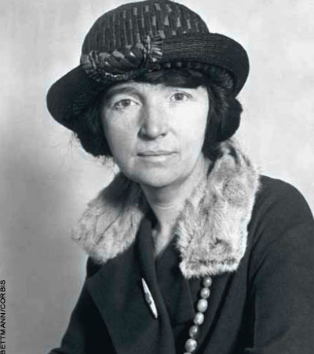
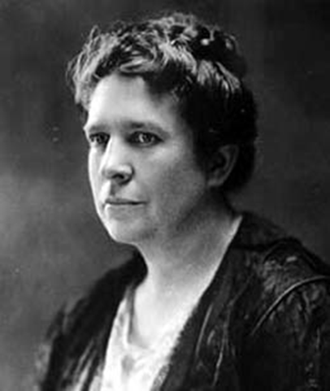
PROGRESSIVE WOMEN’S RIGHTS
Margaret Sanger – led the movement to provide birth control to prevent unwanted pregnancies among poor women
Margaret Sanger
Florence Kelley – fought against child labor
Florence Kelley

Slide 42
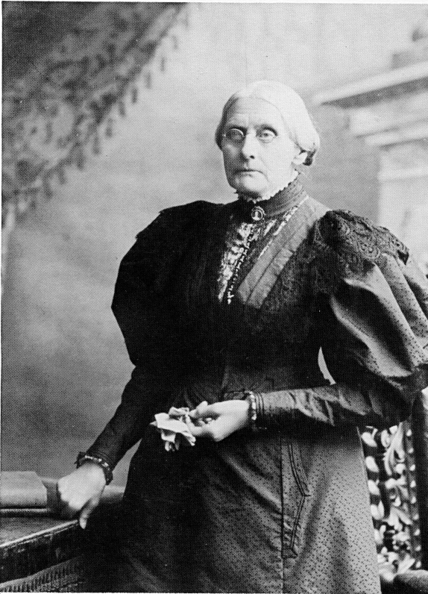
Women Lead Reform
Women’s Colleges open giving more opportunities
NACW was established to morally educate the colored race
Susan B. Anthony led suffrage movement
NAWSA est. in 1890
National American Women Suffrage Association

Slide 43
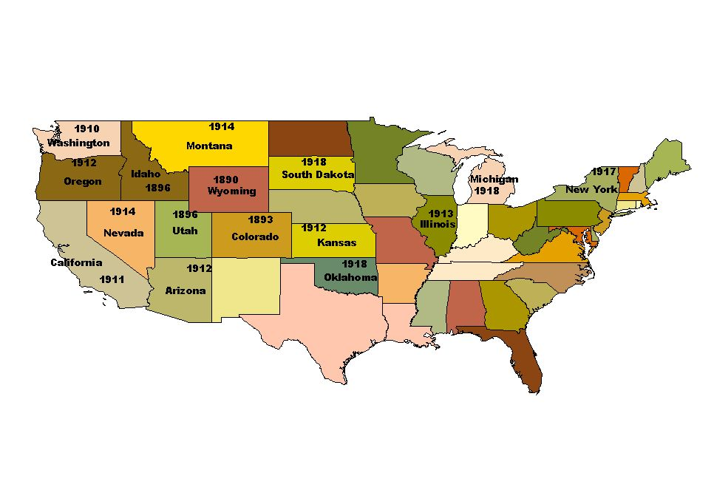
STATES THAT GAVE WOMEN THE SUFFRAGE BEFORE THE 19TH AMENDMENT

Slide 44
Progressive Movement: PSA
honors
Make Your Own Public Service Announcement
Unit 5 Project
Description: Post-Reconstruction society was plagued with corruption, economic depression, and rapid urbanization. As a result, a major movement within the US took hold. The Progressive Movement began in 1890 and ended in 1914 when the US shifts its attention to Europe. During this time, reform movements reach every sector of American society.
Your job: You need to convince Americans to support your movement! To do this, you and your group will create a Public Service Announcement on a specific movement that occurred during this era.
What is a PSA? A public service announcement is a non-commercial advertisement shown on the TV or radio for the public interest. They raise awareness about social, political, or economic issues.
Requirements:
-Research your movement! Information will be graded on accuracy
-Typed, complete, and detailed script for your PSA.
-Create a story board with captions telling me about what the action/dialogue is in each frame.
-Tape you service announcement.
Graded on: Performance Quality (5), Script (5), Creativity (5), Accurate Info (5), Group Effort (5), Storyboard (5)
Total: ____________/30 points

Slide 45
Tuesday February 21st
You have exactly FIVE minutes to get back with your group from Friday and finish up your Progressive Era collage.

Slide 46
Bellringer Tuesday 9/26
Goals of Progressivism
Goal:
Goal:
Goal:
Goal:
Examples:
Examples:
Examples:
Examples:
Create the graphic organizer on the right in the bell ringer section of your notebook. Add details from your notes yesterday.

Slide 47
Who Participated in the Movement?
Middle class citizens
Professionals
Reformers
Women
Press
Religious Groups
Robert La Follette & Teddy Roosevelt
Socialists
Expansion in public education:
86% of children in schools by 1920

Slide 48
Date | Topic | Page
9/18 | Muckraker Chart | 20

Slide 49
Muckrakers
Focus Question: How did Muckraking journalists influence the progressive era?

Slide 50
Muckrakers
Journalists and other writers who reveal (show) the need for reform.
Their investigative reports uncover the problems and make people want to reform them
A Muckrake is something used to clean manure out of animal’s stables

Slide 51
Muckraker Jigsaw
With your group, examine the primary source excerpts, political cartoons and pictures in each folder.
Each person in the group should add details to your muckraker chart as you work.
For specific area of concern- what does the muckraker target or try to raise awareness about?
For specific tactics used- are they a writer? Photographer? And add the names of any specific publications.

Slide 52
Who said it? Game
Raise your hand when your group knows which muckraker likely said the quote!

Slide 53
Who said it?
The homes of the Hebrew quarter are its workshops also…. Every member of the family, from the youngest to the oldest, bears a hand, shut in the qualmy rooms, where meals are cooked and clothing washed and dried besides, the livelong day. It is not unusual to find a dozen persons—men, women, and children—at work in a single small room

Slide 54
Who said it?
We are responsible, not our leaders, since we follow them. We let them divert our loyalty from the United States to some “party”; we let them boss the party and turn our municipal (cities) democracies into autocracies and our republican nation into a plutocracy

Slide 55
Who said it?
When Mr. Rockefeller began to gather the oil markets into his hands he had a task whose field was literally the world, for already, in 1871, the year before he first appeared as an important factor in the oil trade, refined oil was going into every civilized country in the globe

Slide 56
Who said it?
It is the easiest way to get along in the South (and those portions in the North where lynchings take place) to ignore the question all together, our American Christians are too busy saving the souls of white Christians from burning hell-fire to save the lives of black ones from present burning in fired kindled by white Christians.

Slide 57
Who said it?
There was meat that was taken out of pickle and would often be found sour, and they would rub it up with soda to take away the smell, and sell it to be eaten on free-lunch counters; also of all the miracles of chemistry which they performed, giving to any sort of meat, fresh or salted, whole or chopped, any color and any flavor and any odor they chose.

Slide 58
Who said it?

Slide 59
Video Clip
The Jungle

Slide 60
Do Now:
Use this time to work on your Unit 3 Progressive Era Speed Dating Project OR your Unit 2 Study Guide OR your unit 2 extra credit. We all have SOMETHING to be working on!!
Reminders:
-Muckraker Quiz tomorrow (Wed 9/27)
-Unit 2 Test Thursday 9/28 with study guide & EC due at the start of class
-Progressive Speed Dating Project due 10/4

Slide 61
Progressive Era Public Service Announcement Skit
Skit Must Include:
A description of the PROBLEM. Hint: Think back to the Gilded Age and highlight the worst aspects of your topic. To gain public sympathy, you need to make it seem really awful.
Don’t say the name of your muckraker!
Be sure one of you plays the muckraker.

Slide 62
Monday 9/26
Turn in your Progressive Era Collage
Then, study your notes for our quiz today. We will do a bellringer in just a minute!

Slide 63
Wednesday February 22nd

Slide 64
Bellringer Wednesday February 22nd (Match the description with the appropriate muckraker)
Description
Muckraker
1. Wrote Corruption and Reform in St. Louis
2. Wrote the Jungle about unsafe meat.
3. Took pictures of “How the other half lives”
4. Wrote Southern Horrors of Lynching
5. Wrote the History of Standard Oil
6. Drew pictures exposing Tammany Hall and other political machines.
A) Jacob Riis
B) Upton Sinclair
C) Ida B. Wells
D) Lincoln Steffens
E) Thomas Nast
F) Ida Tarbell

Slide 65
Mandela Assignment (Complete ONE with your elbow partner) on the paper I have given you.
Rank each of the six muckrakers we studied on Friday. You are ranking them in order of: Who was the most impactful/important? Put the one you determine as most important in the center of the circles and work your way out (#6 would be in the outermost circle).
In addition to the name of the muckraker, you also need to draw a symbol representing the area that particular muckraker was concerned with.
Lastly, you need a 1 sentence explanation of why you ranked that muckraker where you did.

Slide 66
Who am I? Review for Quiz

Slide 67
Unit 3 Quiz
Write your name on your paper. You MAY write on the quiz.
Phones off and away the entire time our class is quizzing!
Put up a “fort” of info from another class (or a book)
You will want a sheet of notebook paper for the Extra Credit opportunity

Slide 68
Quiz Extra Credit (Complete on notebook paper and staple to your quiz. Up to 5 possible EC points)
Imagine your great-grandmother left you $2 million during the Progressive Era. The deal was this: You would get to keep $1 million for yourself IF you donated the other $1 million to charity. Great-grandma wants you to donate ALL the money to ONE specific area of concern from the Progressive Era.
On your paper: Which area of concern would you donate to and explain why you selected this area--- why is it more important than all the others? What SOLUTIONS do you propose could be done with your $1million? (Example area of concern: Unsafe Working Conditions)

Slide 69
Progressive Era Speed Dating
Rubric and detail on my website (AHII Unit 3)– be sure to look at this!
Select historical figures
Example Projects from last year
Due @ beginning of class on Thursday 3/2
Project is FORMAL grade
2 pages handwritten autobiography/notes (First person, present tense!)
10 business cards
6 open-ended questions for your “dates”
Performance grade for how well you “act” in character.
Extra Credit if you dress the part!

Slide 70
Progressive Era Bracketology
Your task: Compare various progressive era reforms and decide which was more important/impactful/significant.
Evaluate each of the four matchups, moving the winner on and put the loser in the loser’s bracket.
Explain in at least 1 sentence how/why you decided the way you did.
When you are finished you will have one “winner” (the most important Progressive Reform) and

Slide 71
Reminders/Announcements
Announcing our new Mr./Ms. AHII
Unit 2 Test Makeups tomorrow after school. Tuesday 9/27= last day to make up this test!
Unit 3 Quiz today (Informal)
Progressive Era Collage was due today (INFORMAL)
Unit 3 Project assigned today (FORMAL)

Slide 72
Quick Review: Who am I?

Slide 73
Date | Topic | Page
9/21 | Unit 3 Quiz | 21
9/21 | Unit 3 Speed Dating Project | 22

Slide 74
Video Clip
The Jungle

Slide 75
1st period pairs
Eryn/Angel
Rocio/Lindsey
Angel/Kahlil
Ebony/Cherish
Satyam/Colby
Ron’Drekius/Aaliyah
Raja/Darnell
Hajia/Juan
Sha-Asia/Amindulah
Bar/Sernariann
Taquesha/Jordan
Teonnia/Tillie
Tamia/Cameron

Slide 76
Creating a book cover for a muckraker
At your table, each person should create a book cover for a DIFFERENT muckraker. This also has to be different from the muckraker you created a skit for. It doesn’t matter who does which person, as long as no two people at the table do the same!
Book cover should include:
Actual name of the publication (if there is one)
At least one great image that gives a good idea of what the book was about.
Do NOT put the author’s name on the bookcover.

Slide 77
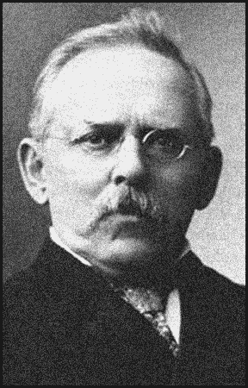
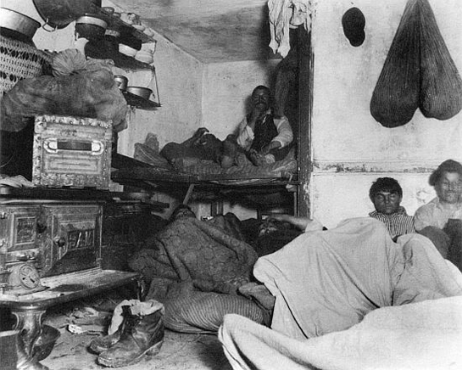
Jacob Riis: Poor Living Conditions in Cities
Jacob Riis – How The Other Half Lives (Book of photographs depicted slum life in cities)
Jacob Riis

Slide 78
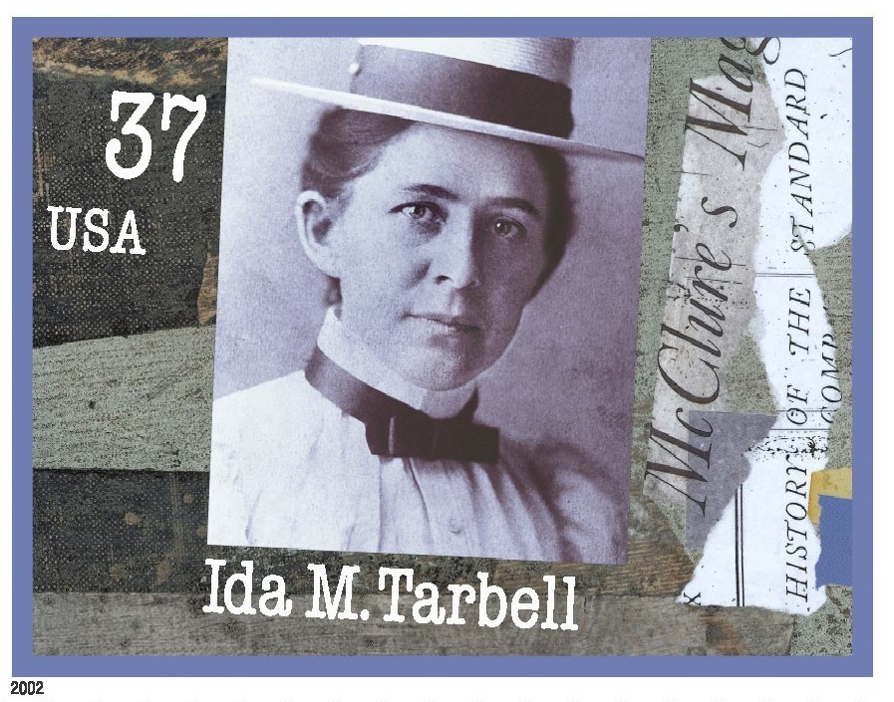
IDA TARBELL: Big Business– specifically John Rockefeller
Miss Tarbell, in her book, revealed after years of diligent research the illegal means used by John D. Rockefeller to monopolize the early oil industry.

Slide 79
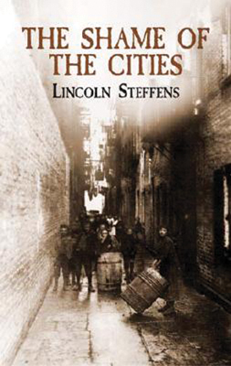
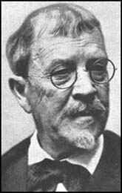
Lincoln Steffens: Corruption in city governments & poor living conditions
Lincoln Steffens – The Shame of the Cities

Slide 80
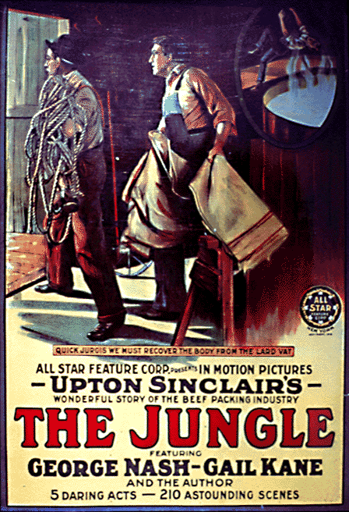
UPTON SINCLAIR: Unclean factory conditions
HIS BOOK, THE JUNGLE DESCRIBED THE FILTHY CONDITIONS IN THE MEAT PACKING INDUSTRY AND LED TO THE PASSAGE OF THE FEDERAL MEAT INSPECTION ACT OF 1906
MOVIE MADE FROM THE BOOK IN THE EARLY 1900’S

Slide 81
EXCERPT FROM THE JUNGLE
“…old sausage that had been rejected, and that was moldy and white – it would be dosed with borax and glycerin, and dumped into the hoppers, and made over again for home consumption. There would be meat that had tumbled out on the floor, in the dirt and sawdust, where the workers had tramped and spit uncounted billions of consumption germs. There would be meat stored in great piles in rooms; and the water from leaky roofs would drip over it, and thousands of rats would race about on it. It was too dark in these storage places to see well, but a man could run his hand over these piles of meat and sweep off handfuls of the dried dung of rats. These rats were nuisances, and the packers would put poisoned bread out for them; they would die, and then rats, bread, and meat would go into the hoppers together… the meat would be shoveled into carts, and the man who did the shoveling would not trouble to lift out a rat even when he saw one – there were things that went into the sausage in comparison with which a poisoned rat was a tidbit.”

Slide 82
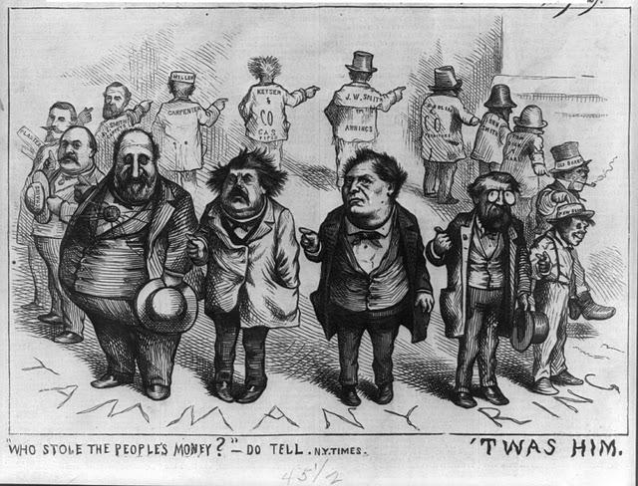
Thomas Nast: Political Corruption- specifically Tammany Hall/Boss Tweed
Political Cartoons

Slide 83
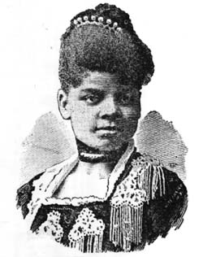
Ida B. Wells: Lynching & Mistreatment of African Americans
Books: “A Red Record” and “Southern Horrors: Lynch Law in all its phases”

Slide 84
Do Now
Read the primary source document excerpts “Examples of Muckrakers” and answer the questions on the back of today’s notes!
If you finish early, you can work on your Unit 3 Study Guide!

Slide 85
Muckrakers: Ida B. Wells
Not all nor nearly all of the murders done by white men, during the past thirty years in the South, have come to light, but the statistics as gathered and preserved by white men, and which have not been questioned, show that during these years more than ten thousand Negroes have been killed in cold blood, without the formality of judicial trial and legal execution. And yet, as evidence of the absolute impunity with which the white man dares to kill a Negro, the same record shows that during all these years, and for all these murders only three white men have been tried, convicted, and executed. As no white man has been lynched for the murder of colored people, these three executions are the only instances of the death penalty being visited upon white men for murdering Negroes.

Slide 86
Notebook Check 9/24
1) What was the bellringer on Friday 9/20? *write out entire bellringer for this one*
2) What was the bellringer on Friday 9/17? *you can write questions or your answers*
3) Look at your unit 1 study guide. What was question #2? Just write the question!
4) Look at your notes on Gilded Age Politics– what was the Pendleton Civil Service Act?

Slide 87
Do Now
Either with an elbow partner or by yourself, read the excerpts from the PRIMARY SOURCE documents.
Answer the questions on the back of your chart.
If you finish early, you may work on your Unit 3 Study Guide or Extra Credit

Slide 88
Public Service Announcement Brochure
Brochure Must Include:
A description of the PROBLEM. Hint: Think back to the Gilded Age and highlight the worst aspects of your topic. To gain public sympathy, you need to make it seem really awful.
“Name Drop” Any key people involved in your movement (ex: This movement is endorsed by Nobel Prize winner, Jane Addams herself! Be sure to include any muckrakers associated with the issue)
Suggest a REFORM/SOLUTION. How could your problem be fixed? What do you need the public to do? Hint: To gain public support, you need to be energetic and convincing. (ex: “Only YOU can help prevent forest fires!)
A picture on the cover with a slogan

Slide 89
Please create the Tree Map below. Look back over yesterday & today’s notes to add details
Progressivism:
Goals
Origins
Muckrakers
“Membership”
Protecting Social Welfare
Promoting Moral Improvement
Creating Economic Reform
Reforming Local Government

Slide 90
Please create the Tree Map below.
Progressivism:
Goals
Origins
Muckrakers
“Membership”
Protecting Social Welfare
Promoting Moral Improvement
Creating Economic Reform
Reforming Local Government

Slide 91
Who Participated in the Movement?
Middle class citizens
Professionals
Reformers
Women
Press
Religious Groups
Robert La Follette & Teddy Roosevelt
Socialists
Expansion in public education:
86% of children in schools by 1920

Slide 92
PSA Project
Goals for today:
Begin researching your topic. Remember to stick within the years of 1890-1920. Your book (Chapters 16 and 17) is a good place to start in addition to researching online
Storyboard Due by the end of class! This should show at least six frames (Scenes) for your movie. This needs to be reviewed by me before you can check out a flip camera. **Each group will have a quick meeting with me to explain their story board**
Lastly- start brainstorming HOW your PSA will look- how are you going to convince people to support your movement.

Slide 93
Bellringer Wed. October 16th
Answer these Recap Questions in the BR section of your notebook:
1) Why did the Progressive Era Start? What were the goals of the movement?
2) Why were Muckrakers important in the progressive era?
3) List the purpose of the 16th, 17th and 18th amendments
4) Match the Progressive Era person with the appropriate area:
Jane Addams
Upton Sinclair
Thomas Nast
Lincoln Steffens
Jacob Riis
Ida Tarbell
A) Food Safety
B) Anti-Big Business
C) Pictures of Poverty
D) Cartoons with political corruption
E) Settlement Houses
F) Corruption & Bad sanitation in cities

Slide 94
PSA Project
Goals for Today:
Get storyboard approved if you haven’t yet
Begin filming! Remember to be quiet in the halls! Make sure you are back by 2:10 to turn in your camera.
Reminders:
Storyboard & Script due 10/24 with VIDEO
Evidence of RESEARCH– beyond just what’s in the textbook or class notes is needed! Make sure you aren’t having too much fun with this that you forget to add facts!

Slide 96
Progressive Movement: PSA
regular
Make Your Own Public Service Announcement
Unit 5 Project
Description: Post-Reconstruction society was plagued with corruption, economic depression, and rapid urbanization. As a result, a major movement within the US took hold. The Progressive Movement began in 1890 and ended in 1914 when the US shifts its attention to Europe. During this time, reform movements reach every sector of American society.
Your job: You need to convince Americans to support your movement! To do this, you and your group will create a Public Service Announcement on a specific movement that occurred during this era.
What is a PSA? A public service announcement is a non-commercial advertisement shown on the TV or radio for the public interest. They raise awareness about social, political, or economic issues.
Requirements:
-Research your movement! Information will be graded on accuracy
-Create a story board with captions telling me about what the action/dialogue is in each frame.
-Tape you service announcement.
Graded on: Performance Quality (5), Creativity (5), Accurate Info (5), Group Effort (5), Storyboard (5)
Total: ____________/25 points

Slide 97
Movements to look at:
Women’s suffrage
Early Niagara Movement
Voting Reforms
Child Labor
Building Codes
Labor Movement
Conservation
Food & Consumer Laws
Tariffs
Anti-Trust Laws

