Slide 1
The Wild West 1850-1890
Essential Questions: Why did many Americans move west in the mid to late 1800s? How did the settlement of the Western frontier shape American culture?

Slide 2
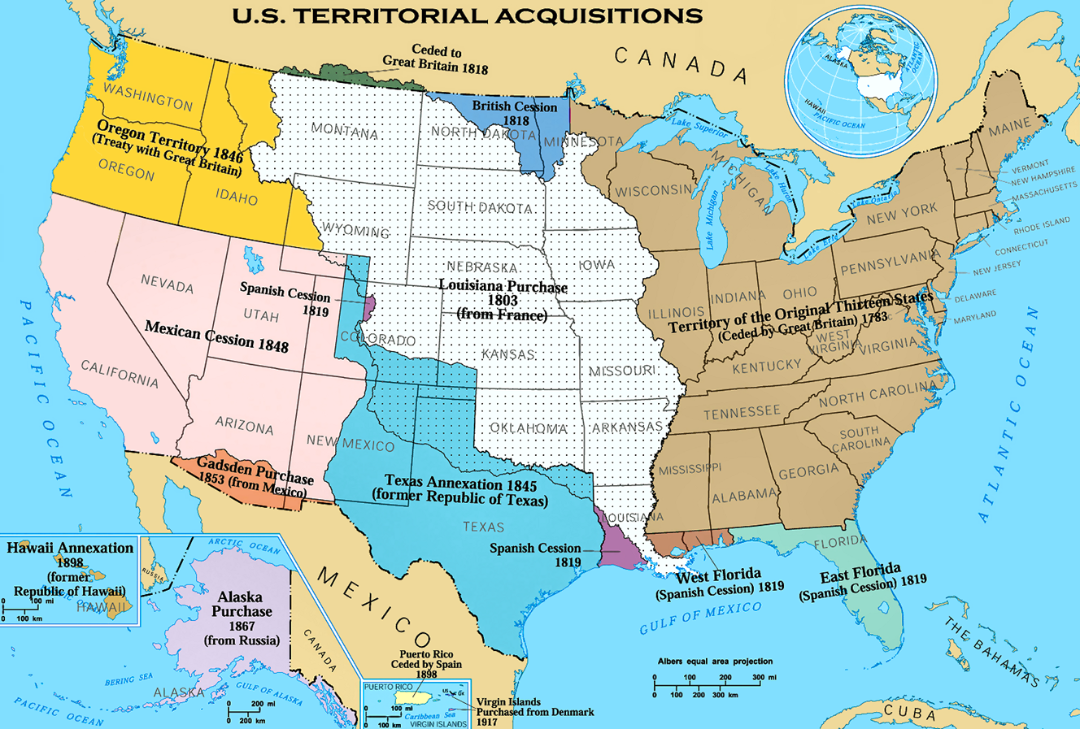

Slide 3
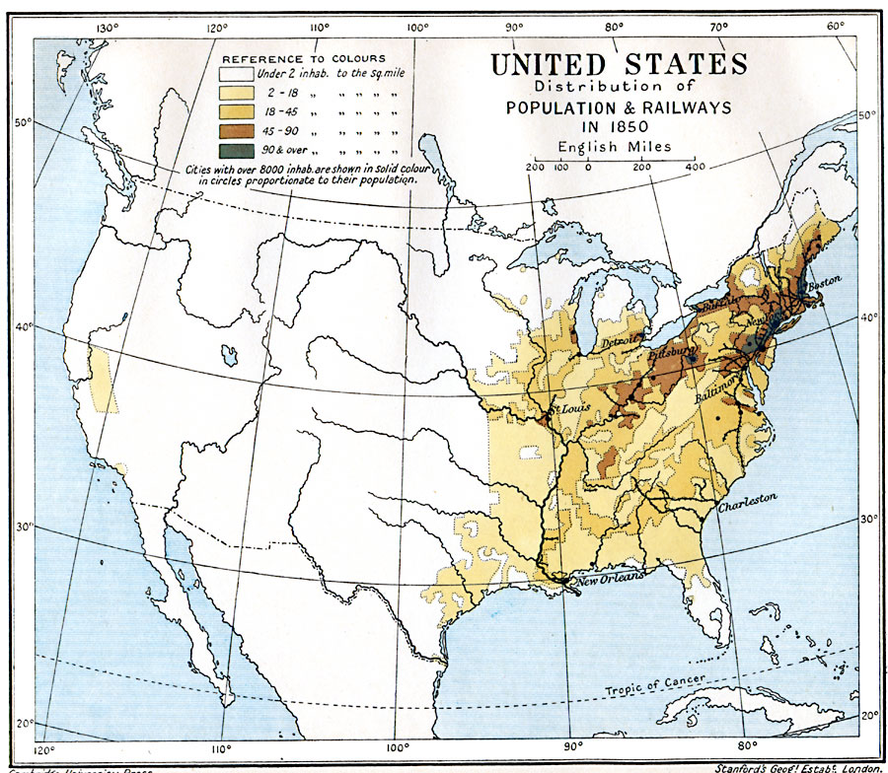

Slide 4
Push – Pull Factors
People decide to migrate because of push factors and pull factors.
A push factor induces people to move out of their present location
A pull factor induces people to move into a new location.
Both push and pull factors typically play a role in human migration.

Slide 5
Push Factors to the West
Overcrowding (you need a new place to live)
Need for jobs (displaced workers)
Ethnic/Religious repression

Slide 6
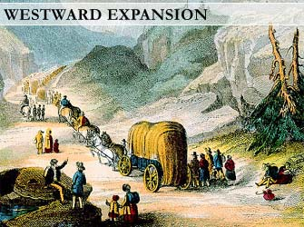
Pull Factors to the West
Land (cheap and plentiful)
Riches (gold, silver, later oil)
Freedom of religion/beliefs
Family connections

Slide 7
the
Transcontinental Railroad

Slide 8
What is the government’s motive?
10 square miles on either side of each track
they laid to the west in a checkerboard
pattern. Railroad links east and west.
United States land grants issued to railroads

Slide 9
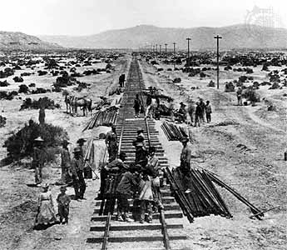
The Central Pacific Railroad
Began in California
Workers were hard to find
All wanted to work in the gold mines
Wanted to build quickly so they could earn more money
Chinese Immigrants worked for the Central Pacific
They blasted through the Sierra Nevada Mountains

Slide 10
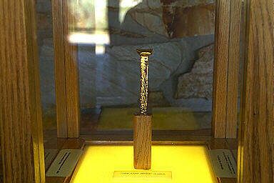
Meeting at Promontory Point
Completed in 1869
Seven years earlier than expected
Met at Promontory Point, Utah
May 10, 1869
Chinese Workers carried in one rail
Irish carried in the other
It was a huge celebration

Slide 11
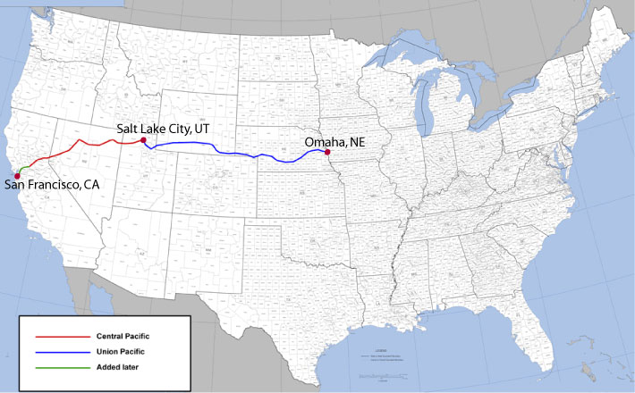
1869
http://www.history.com/shows/america-the-story-of-us/videos/andrew-carnegie#transcontinental-railroad

Slide 12
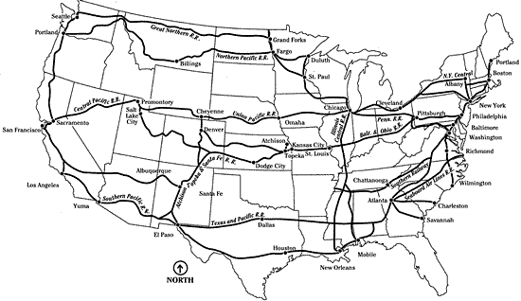
1900

Slide 13
The
MINERS
Those who go west looking for gold and silver

Slide 14
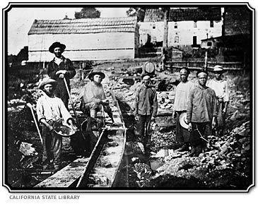
Prospecting

Slide 15
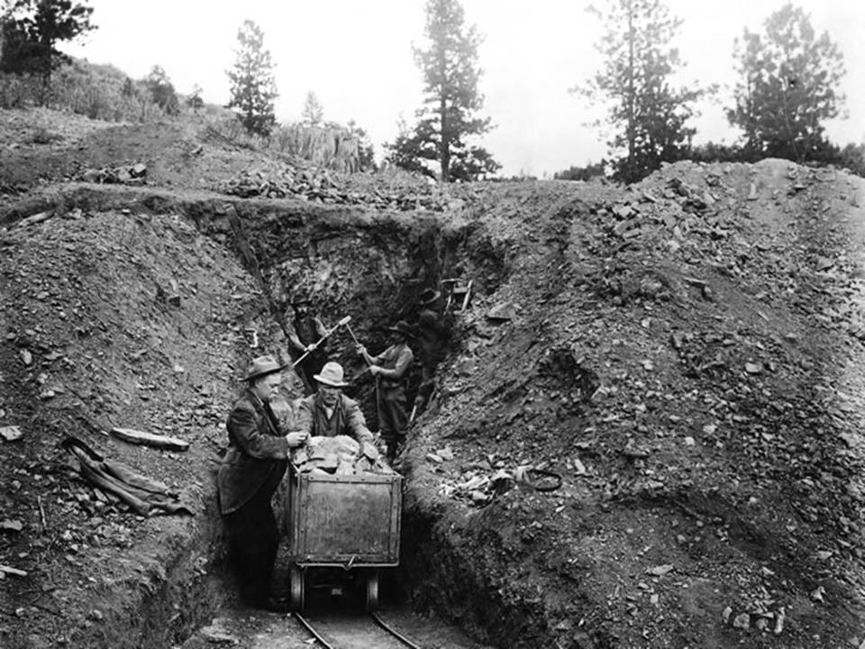

Slide 16
the
cowboys

Slide 17
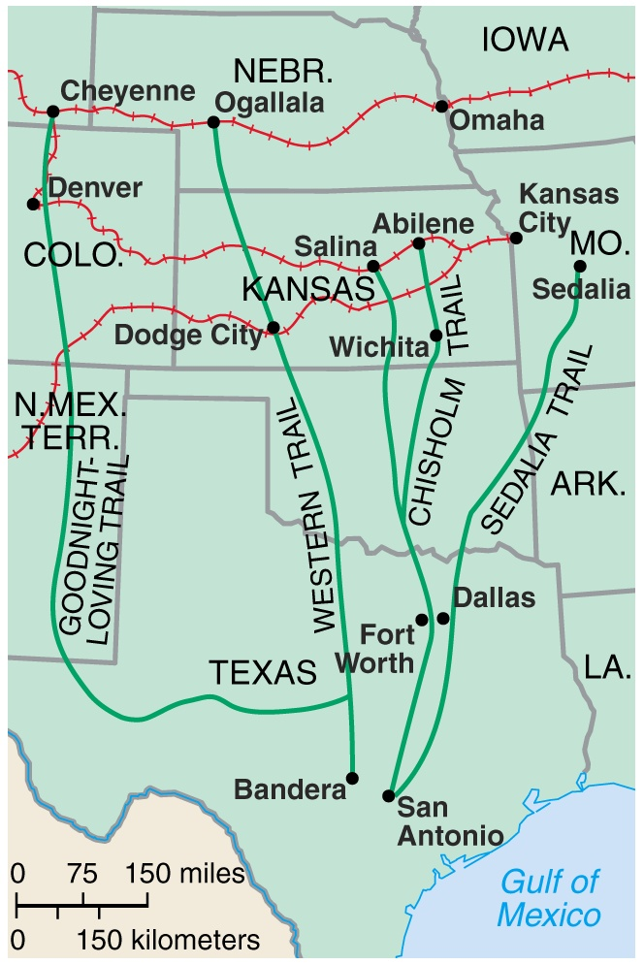
Long Drives to Railheads
Cattle shipped to slaughter houses on the Railroads (later we get refrigerated railroad cars)
Rise of the beef and meatpacking industry.
Development of the “Cowboy Culture”
Cattle Trails

Slide 18
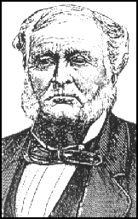
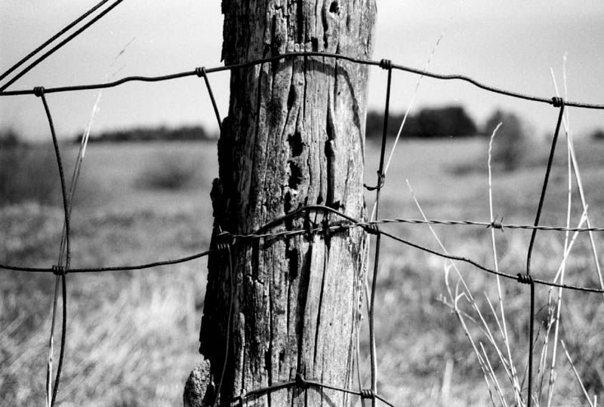
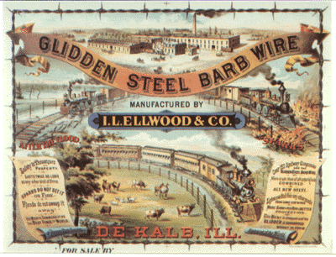
Barbed Wire- allows farmers to contain their herds.
Leads to the end of the Open Range System and the Fence Cutting Wars
Joseph Glidden

Slide 19
Minority
groups
in the West

Slide 20
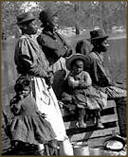
Exodusters: African American Homesteaders (People who moved west to escape discrimination)

Slide 21
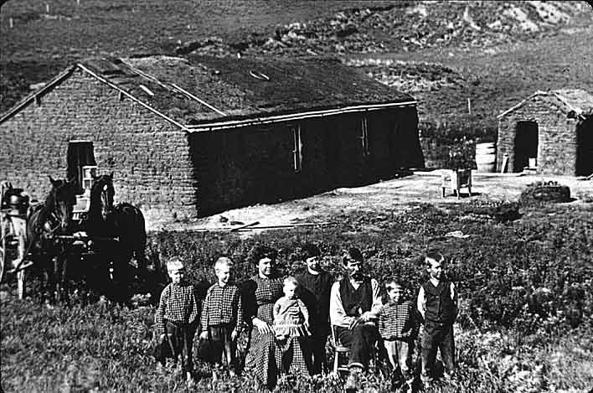
HOMESTEAD ACT
Homestead Act was a law developed in 1862 by Congress to promote settlement of the Great Plains. (Definition)
For approximately $10, settlers could have 160 acres of western land, if they met certain criteria:

Slide 22
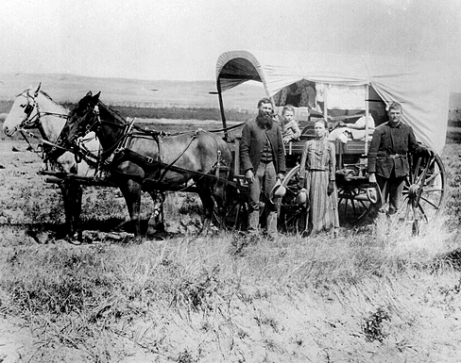
American citizens who were 21 years or older, or the head of a household
Built a home on their lot, and lived in it at least 6 mos. of the year
Farmed the land for 5 years or more
What is the government’s motive?

Slide 23
Agricultural Education
Morrill Land Grant Act
Federal Government provides funding for agricultural colleges
Attempt to encourage farming
Auburn - LSU
Arizona - Michigan State
Connecticut - Nebraska
Florida -Rutgers
Texas A&M -Tennessee
Hawaii -NC State
Purdue -NC A&T
Iowa State -Ohio State
Kansas State -Oregon State
- Clemson -West Virginia

Slide 24
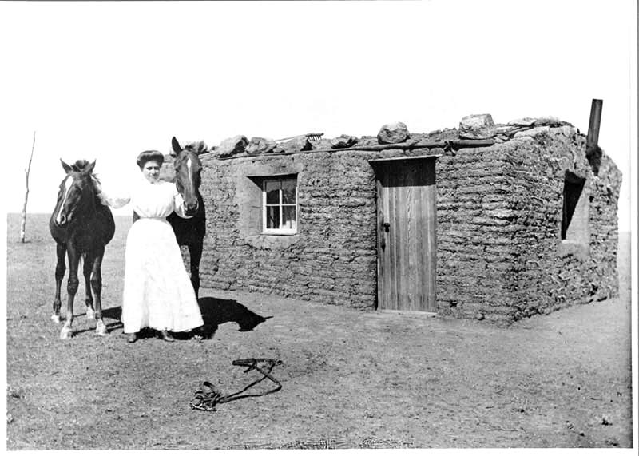
A Pioneer’s Sod House, SD
Soddy: house made out of grass/sod and dirt.

Slide 25
LIFE ON THE GREAT PLAINS
Settlers adapted to the difficult lifestyle of living on the Great Plains.
Newer advancements in agricultural technology helped settle the Plains.
More Gender Equality out west (Women treated more as equals)

Slide 26
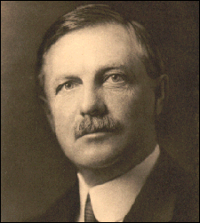
TURNER THESIS
With Indians on the reservation by 1890, the United States Census Bureau announced the official end of the frontier.
The population in the West had become dense, and the days of free western land had come to an end.
In 1893, historian Frederick Jackson Turner claimed that 300 years of the frontier had played a key role in forming the American character.
Frontier was a safety valve to let off pressure.
The Turner Thesis, stated that frontier life created Americans who were socially mobile, ready for adventure, bent on individual self-improvement, committed to democracy and able to withstand difficult times to accomplish the American Dream…
Frederick Jackson Turner

